Slide 1


Project ADAM: Advocacy Module for Residents
Module created thanks to Maria Fareri Children’s Hospital at Westchester Medical Center and Boston Children’s Health Physicians. Content thanks to Dr. Alexis Mandon (Pediatric Resident Class of 2023), Dr. Christa Miliaresis, Pediatric Cardiologist, and Dr. Amy Brown, Pediatric Pulmonologist.

Slide 2
Goals and Objectives
By the end of this online module, a resident should be able to:
Know the overall causes of sudden cardiac death at a physician level. Define Sudden Cardiac Arrest and describe its features in children/adolescents in a way that would be understandable to a lay person (such as a teacher, parent) and allow them to recognize that it is happening in order to respond appropriately.
Explain and emphasize the importance of CPR and an AED being used immediately after a collapse, as it is vital to perform in the first 3 minutes to be effective and decrease the likelihood of sudden cardiac death.
Know and outline the statistics of sudden cardiac arrest as a way of emphasizing the gravity of SCA and the importance of immediate and effective CPR being performed in schools, as this is vital in the cardiac chain of survival.
After completing this online module, you will take a quiz that requires passing. You will also have an opportunity to go in-person to a school through Project ADAM to help them become Heart Safe, or stay up-to-date on their Heart Safe certification with CPR/AED training and Emergency Response Plans.

Slide 3
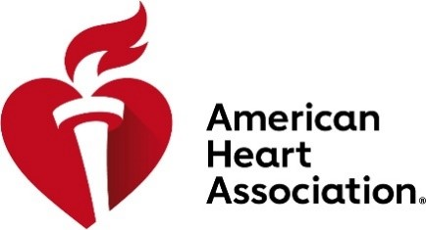

What is Project ADAM?
Click the Link Below to learn about the tragic true story behind the inspiration for Project ADAM
https://www.youtube.com/watch?v=piGikBsag_8

Slide 4

Project ADAM
Founded in 1999, Project ADAM (Automated Defibrillators in Adam’s Memory) was created in the memory of Adam Lemel, a young athlete from Wisconsin, who died suddenly while playing basketball. An AED was not available.
34 affiliates in 27 states reaching schools across the country.
Project ADAM is responsible for more than 150 lives saved!
Maria Fareri Children’s Hospital is the New York affiliate for schools and communities in Westchester County wishing to participate in Project ADAM and gain the Heart Safe Designation.
Now, it is up to pediatric resident physicians to help be part of saving lives from sudden cardiac arrest in schools and to keep our children safe!

Slide 5
Sudden Cardiac Death
Nontraumatic in origin and due to specific cardiac causes
Sudden Cardiac Death (SCD)
Incidence ranges from 0.8-6.2 per 100,000 per year in children and adolescents
In adults, incidence is 1 per 1,000
Approximately 65% of sudden deaths are a result of heart-related problems in patients with either normal or congenitally (corrected, palliated, or unoperated) abnormal hearts.
Competitive high school sports (basketball, football) are high-risk environmental factors.
Common identifiable causes of death in competitive athletes include:
Hypertrophic Cardiomyopathy (HCM) with or without obstruction of left ventricular outflow (8%)
Cardiomyopathies not otherwise specified (8%)
Anomalous Coronary artery (11%)
Myocarditis (9%)
Idiopathic Left ventricular hypertrophy/possible cardiomyopathy (8%)
Coronary artery disease (9%)
However, up to 25% of sudden cardiac deaths in young adolescent athletes are due to sudden unexplained death.

Slide 6
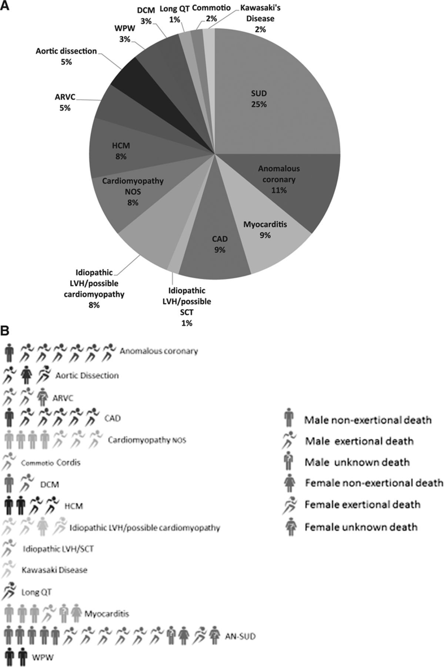
Sudden Cardiac Death Continued
Symptoms before a sudden cardiac death may be absent, but if present, they include:
Syncope, Chest Pain, Dyspnea, and Palpitations.
Patients may have a family history of heart disease (dilated or hypertrophic cardiomyopathy, long QT, arrhythmogenic right ventricular dysplasia, Brugada or Marfan syndromes) or sudden unexplained death that often follows exertion or exercise.
3 recognized Mechanisms of sudden death:
Arrhythmic
V. fib final cause in 10-20% of children
More often, bradycardia leads to V. Fib or asystole
Non-arrhythmic cardiac (circulatory and vascular causes)
Noncardiac
Notes:
Causes of sudden cardiac death in athletes. B, Cause and activity at time of death. One person figure equals 1 death; female figures follow male figures, unless no male deaths were present. AN-SUD indicates autopsy-negative sudden unexplained death; ARVC, arrhythmogenic right ventricular cardiomyopathy; CAD, coronary artery disease; DCM, dilated cardiomyopathy; HCM, hypertrophic cardiomyopathy; LVH, left ventricular hypertrophy; NOS, not otherwise specified; SCT, sickle cell trait; SUD, sudden unexplained death; and WPW, Wolff-Parkinson-White.
Resource:
Harmon, KG, Asif, I, Maleszewski, JJ et al: Incidence, cause, and comparative frequency of sudden cardiac death in national collegiate athletic association athletes, Circulation 132: 10-19, 2015, Fig 2, p 16

Slide 7
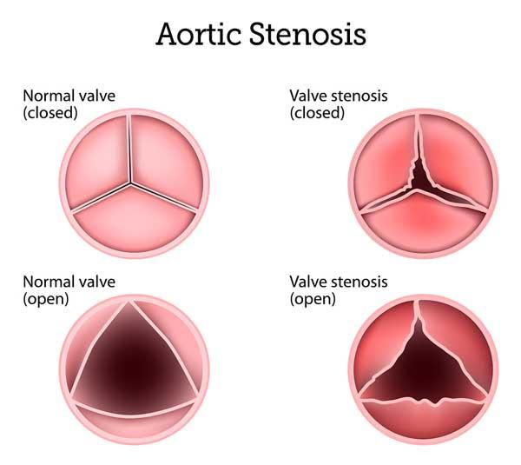
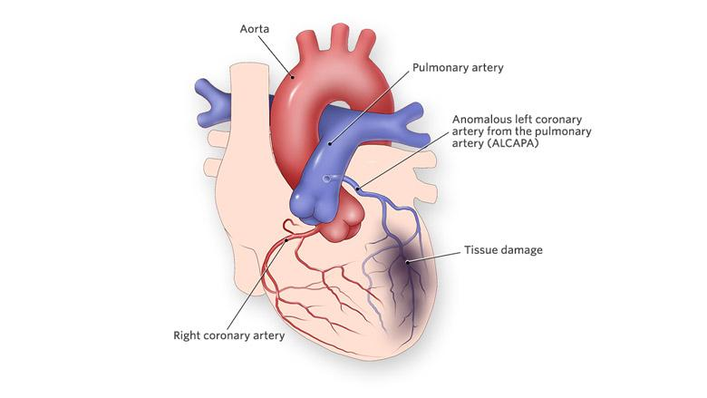
Congenital Heart Disease
Valvar aortic stenosis
Congenital defect most often associated with sudden death in children
Approximately 5% of children with this disease die, although this has become quite rare in the modern era
History of syncope, chest pain, evidence of severe obstruction and left ventricular hypertrophy (LVH) are risk factors
Coronary artery anomalies
Frequently associated with sudden death in children and adolescents
Most common abnormality associated with SCD is origin of left main coronary artery from the right sinus of valsalva
Coronary artery courses between pulmonary artery and may be intramural in its course
Exercise results in a rise in pulmonary and aortic pressure, which is thought to compress the left main coronary artery resulting in ischemia due to compression or kinking
Anomalous origins of right coronary artery from left sinus of valsalva much more common but rarely is a cause of SCD

Slide 8
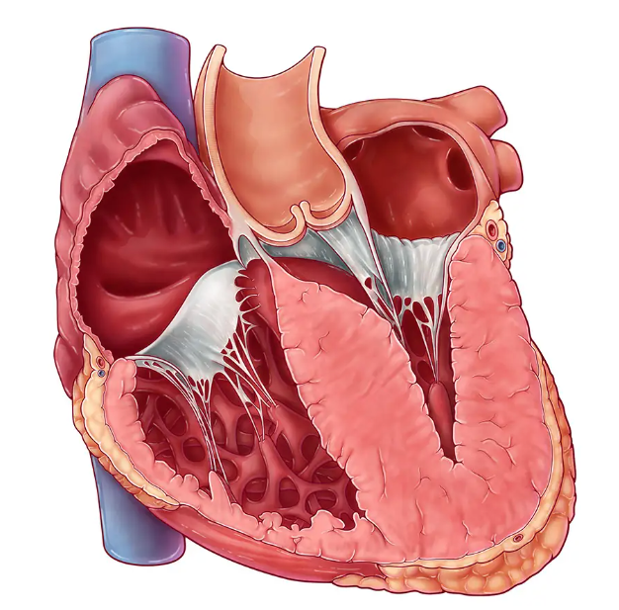
Cardiomyopathy
All 3 types of cardiomyopathy are associated with sudden death in the pediatric population; sudden death may sadly be the only manifestation
Hypertrophic Cardiomyopathy (HCM)
The most common cause of sudden death in the athletic adolescent
Annual risk of SCD is 2% per year
Risk factors for SCD include family history of SCD, symptoms, ventricular arrhythmias, and presentation at an early age
Many patients with HCM have obstruction of left ventricular outflow tract (LVOT).
Mechanism of death is arrhythmic and may be secondary to development of dynamic obstruction with exercise and resultant loss of cardiac output, or may be related to cardiac ischemia
Even patients without LVOT are at risk of SCD
Dilated cardiomyopathies also associated with SCD, although risk lower than in adults
Arrhythmogenic cardiomyopathy (arrhythmogenic right ventricular cardiomyopathy) is a specific form associated with exercise-induced ventricular arrhythmias and sudden death.
Myocarditis has often been found on pathology of patients with SCD of unknown etiology. Symptoms before SCD may be absent or may include overt heart failure or subtle findings such as tachycardia
Pediatric patients may have complete heart block or ventricular arrhythmias

Slide 9
Cardiac Arrhythmia
A primary conduction system abnormality may result in sudden death.
Wolff Parkinson White Syndrome (WPW)
Can result in A. Fib with rapid conduction across the accessory pathway, leading to V. Fib and sudden death.
Mechanism of Arrhythmia formation is from an accessory bundle of Kent.
Long QT Syndrome
A group of channelopathies that affect ventricular repolarization
Mechanism of death is polymorphic ventricular tachycardia (torsades de pointes)
Acquired long QT may be seen in electrolyte abnormalities
Brugada Syndrome
Autosomal dominant disorder caused by a mutation in the SCN5A gene in approximately 30% of patients
SCD associated with fever, drugs, nighttime electrolyte disorders, or after a large meal
EKG findings include coved ST segment elevations in V1-V3
Sudden death results from V. Fib or V. Tach

Slide 10
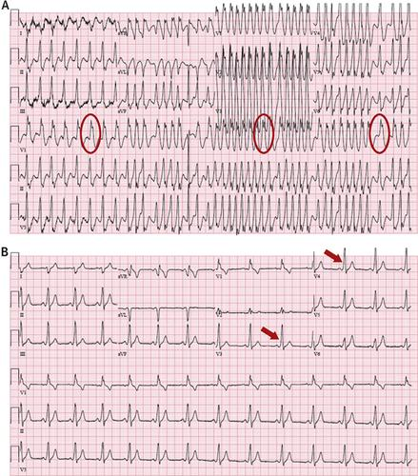
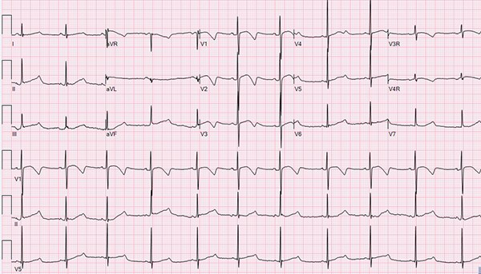
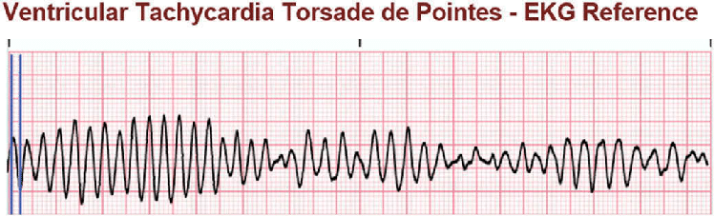
Cardiac Arrhythmia continued
Prolonged QT
WPW & A. Fib

Slide 11
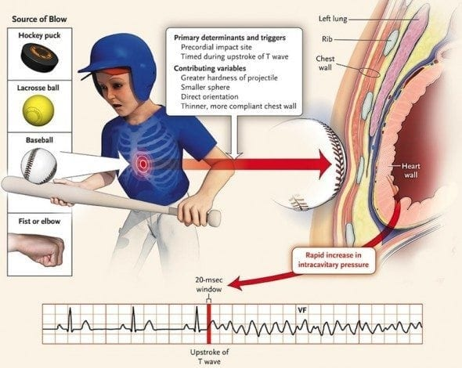
Miscellaneous Causes
Commotio Cordis
An almost universally fatal condition that follows blunt non-penetrating trauma to the chest (e.g. from a baseball or hockey puck)
Occasionally, innocent-appearing chest blows incurred at home or at a playground may be fatal
Patients experience immediate V. Fib in the absence of identifiable cardiac trauma (such as a contusion, hematoma, or lacerated coronary artery)
Risk highest in children before adolescence
Historically, death results from V. Fib that is unresponsive to resuscitative efforts in 85-90% of children
Immediate direct current (DC) defibrillation may be effective, if available, particularly if employed immediately.
However, reported to be successful only in 25% of cases.

Slide 12
Prevention of Sudden Cardiac Death
The probability of survival to hospital discharge for a young patient who experiences an out-of-hospital cardiac arrest is <20%.
The presence of immediate Automatic External Defibrillators (AEDs) when combined with standard cardiopulmonary resuscitation (CPR) at the site of exercise (gym, track, football arena, basketball court) may improve survival substantially.
Identifying those at risk is crucial in prevention of SCD.
Assess for prodromal symptoms, family history and physical exam.
The AAP has a downloadable pre-participation physical evaluation.
It is paramount to carefully evaluate any child who experiences syncope in association with exercise, since this may be the last opportunity to diagnose a life threatening condition.
Chest-protecting equipment has not been shown to prevent commotio cordis. Prompt bystander CPR and rapid Defibrillation by an AED has the best chance of leading to survival.
Family survivors of victims of SCD should be evaluated for genetic causes (HCM, LQTS).
Not just athletes should be assessed for risk, but even non-athlete patients.

Slide 13
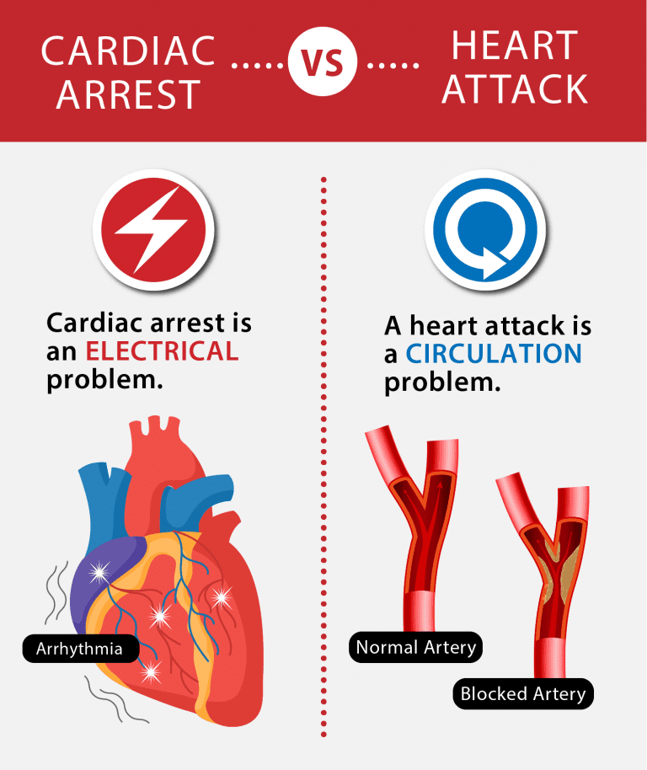
What is a Sudden Cardiac Arrest?
This is NOT the same thing as a heart attack.
Heart attacks are due to an occluded coronary artery and should be thought of as a circulation problem which leads to cardiac ischemia
In a heart attack, the person is conscious, responsive, breathing, has a pulse, and the symptom they will have is chest pain from the cardiac ischemia
Sudden cardiac arrest is an electrical problem to a lay person, and to us an arrhythmia
The arrhythmia causes the heart to malfunction and stop beating
A person presenting with a sudden cardiac arrest will have sudden loss of consciousness often without any preceding symptoms

Slide 14
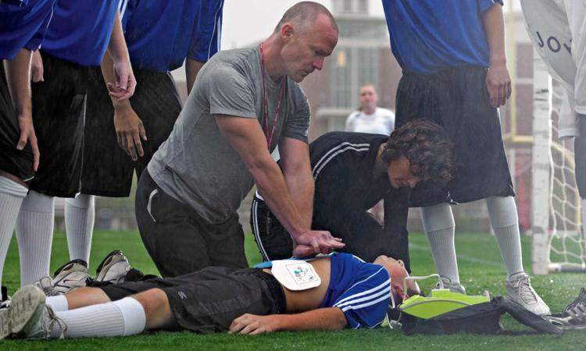
Signs and Symptoms of a Sudden Cardiac Arrest: What You must Know
If symptoms do present at all, they include the following:
Excessive fatigue or shortness of breath upon exertion/with exercising
Chest pain or discomfort with exercise
Fainting or dizziness with exercise
Loss of Consciousness
Often, a person will have a sudden collapse, be unresponsive, not breathing or ineffectively breathing, and have no pulse
Sudden Cardiac Arrest can happen without any warning, and lead to death within minutes if a person does not get immediate help.
That is why it is critical that immediate treatment includes CPR and AED use after somebody at the scene has identified an arrest has occurred

Slide 15
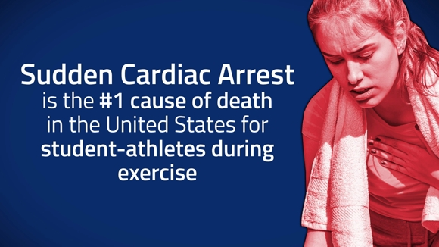
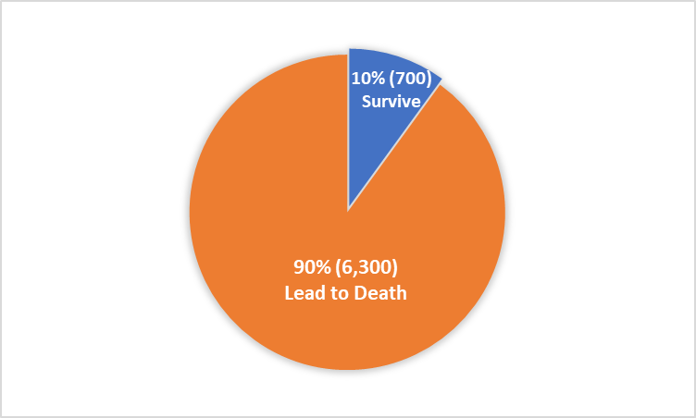
Sudden Cardiac Arrest Statistics
There are over 350,000 out-of-hospital cardiac arrests (OHCA) annually.
Over 7,000 OHCA ‘s are children younger than 18 years old.
90% of sudden cardiac arrests lead to death.
Although SCD is a rare event for most schools, even one event carries a heavy burden on families, schools, communities and our state.
Sudden cardiac arrest in student athletes may be more visible, but sudden cardiac death also occurs in young non-athletes. Sports-related SCAs account for 39% of SCAs in children ages 18 years old or less.

Slide 16
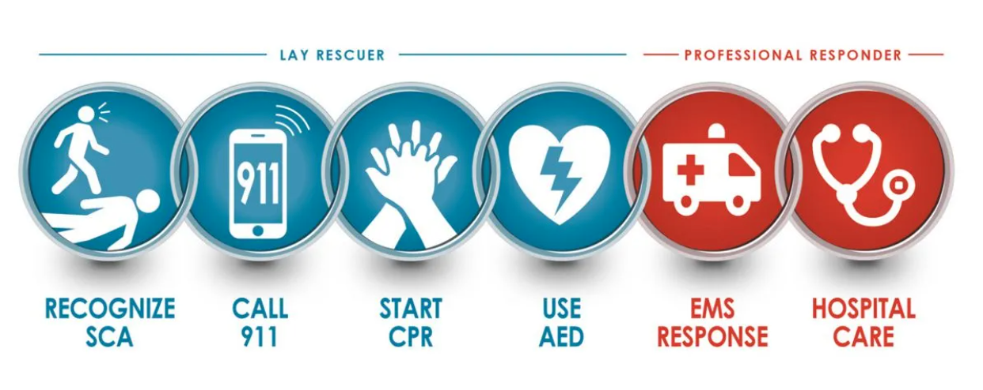
The Cardiac Chain of Survival
According to the American Heart Association, CPR and use of an AED should be provided within 3 minutes of a collapse in order to be effective.
The longer the delay in this, the greater the chance of loss of life.
Average EMS response time is 6-12 minutes.
That’s why it’s vital to have laypersons trained in CPR/AED use and working AEDs on site with prompt action by bystanders.

Slide 17
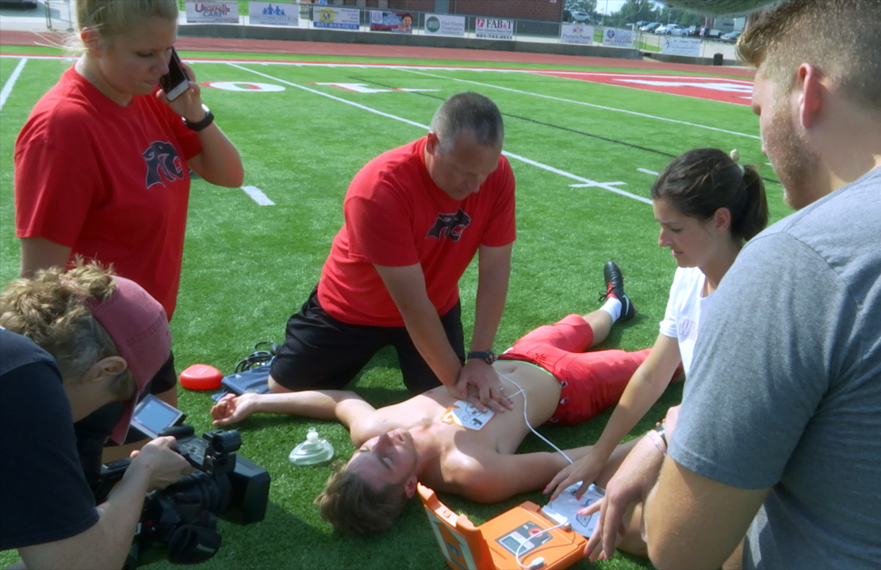
The Cardiac Chain of Survival Continued
Early recognition of Sudden Cardiac Arrest (SCA)
Victim has collapsed and is unresponsive/gasping, gurgling, snorting, moaning or labored breathing/Seizure-like activity.
Activate your school’s emergency response plan
Call any on-site emergency responders/Call 9-1-1 and follow emergency dispatcher’s instructions.
Early CPR
Begin cardiopulmonary resuscitation (CPR) immediately with chest compressions.
Early Defibrillation
Immediately retrieve and use an AED (automated external defibrillator) as soon as possible to restore the heart to its normal rhythm.
Early Advanced Care
Emergency Medical Services (EMS) responders begin advanced life support and transfer to a hospital for post-cardiac arrest care and recovery.

Slide 18


Project ADAM New York’s Goal
To Protect School-Aged Children from Dying from Sudden Cardiac Arrest.
To provide education, provide guidance, and to provide resources to all schools and community programs on developing emergency response plans including CPR/AED training and accessible AEDs.
Our goal is to maximize the number of Project ADAM Designated heart-safe schools in Westchester County and even beyond.
As a Resident Physician, YOU can be part of achieving Project ADAM’s Goal!

Slide 19

Thank you!
You have now completed the module, and it is time to move on to your quiz.

Slide 20
End of Module Quiz
Below is the link for the End of Module Quiz.
https://qfreeaccountssjc1.az1.qualtrics.com/jfe/form/SV_4HMLm4TvhB6J6cu

