Slide 1
Virginia Heart Safe Schools Program
John R. Phillips, MD
Professor of Pediatrics, Pediatric Cardiology
Director of Pediatric Electrophysiology
Medical Director, CHoR Affiliate to Project ADAM
Children’s Hospital of Richmond at VCU

Slide 2
Consider the facts
Sudden cardiac arrest (SCA) is the abrupt loss of heart function in a person who may or may not have a diagnosed heart condition.
SCA is the leading cause of death in athletes during sport
Average survival rate of an out-of-hospital child cardiac arrest in the U.S. is 7.8% but is improved with preparedness.
1 - 8.3 deaths per 100,000 young persons per year.
Although sudden cardiac arrest in athletes may be more visible, SCA also occurs in young non-athletes.
20% of a community is in its schools on any given day
The average school-aged child spends 28% of the day and 14% of his/her total annual hours in school.
Notes:
Although SCD is a rare event for most schools, even one event carries a heavy burden on families, schools, communities and our state.

Slide 3
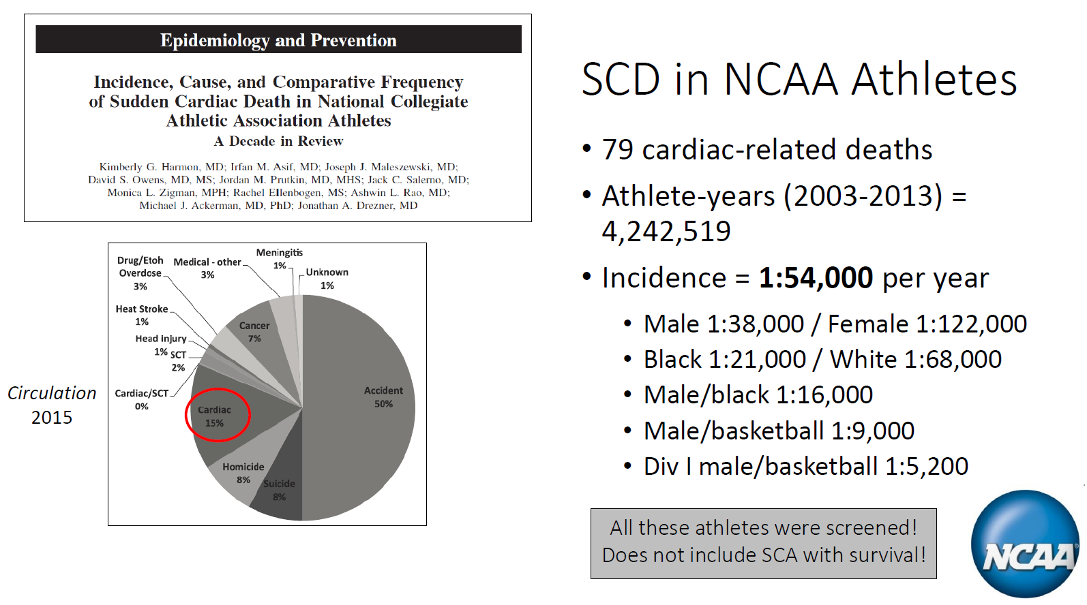
https://doi.org/10.1161/CIRCULATIONAHA.115.015431

Slide 4
Causes of SCD in the Young
Congenital/Genetic
Hypertrophic cardiomyopathy
Long QT syndrome
Brugada syndrome
Arrhythmogenic right ventricular cardiomyopathy
Catecholamine provoked VT
Wolff-Parkinson-White syndrome
History of CHD repair
Coronary artery anomalies
Marfan syndrome
Acquired
Myocarditis/COVID
Substance abuse
Commotio cordis
Notes:
Although rare, this is a list of diagnoses that increase a child’s risk of SCD. Many will be diagnosed by family history or a personal history of chest pain or syncope during exercise.
These diagnoses are rare and often are diagnosed from a known parent or family member.
Further, when a child is known to have one of these diagnoses they can receive treatment and restrictions to significantly decrease their risk for arrhythmia events.
Which is why a more detailed risk assessment tool has been put forth by the PACES, our pediatric electrophysiology society.

Slide 5
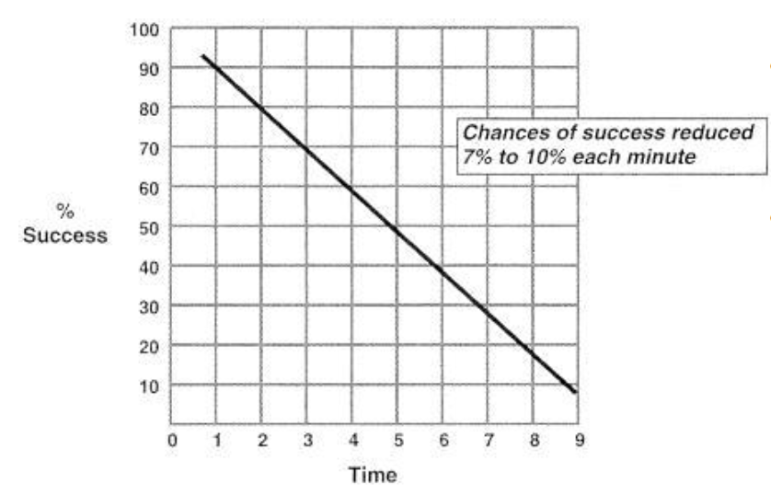
Time to Defibrillation…every second counts
Single greatest factor affecting survival is time to defibrillation
Prompt CPR delays degeneration of a shockable rhythm to a non-shockable rhythm

Slide 6
Sudden Cardiac Arrest Warning Signs
Often there is no prior warning sign that identifies a person at risk of SCA.
Possible warning signs, when present, can include:
Fainting or dizziness with exercise
Excessive fatigue or shortness of breath with exercise
Chest pain or chest discomfort with exercise
Palpitations with exercise
Exercise-induced seizure
Sternotomy or thoracotomy (CHD repair)

Slide 7
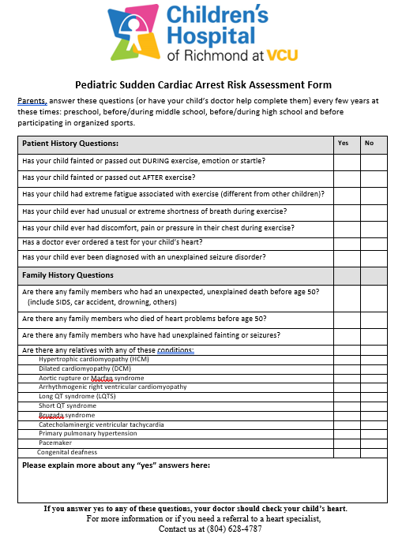
Sudden Cardiac Arrest Risk Factors
Family History
Unexpected or unexplained death before 50y (SIDS, drowning)
Family members who died of heart problems before 50y
Family members with unexplained fainting or seizures
List the names of known conditions

Slide 8
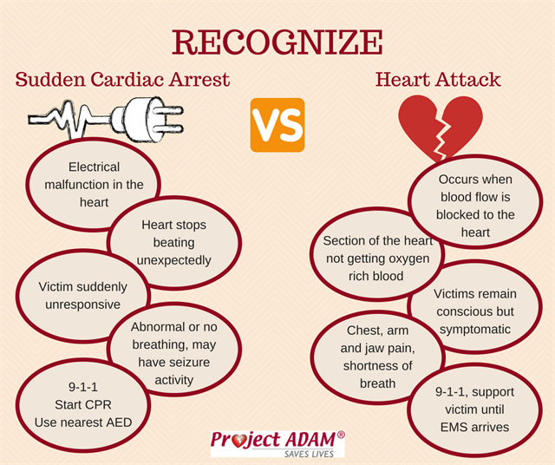
Children are not small adults

Slide 9

The Cardiac Chain of Survival
Early recognition of Sudden Cardiac Arrest (SCA)
Collapsed and unresponsive/Gasping, gurgling, snorting, moaning or labored breathing/Seizure-like activity
Early Access to 911
Confirm unresponsiveness/Call 9-1-1 and follow emergency dispatcher’s instructions/Call any on-site emergency responders
Early CPR
Begin cardiopulmonary resuscitation (CPR) immediately
Early Defibrillation
Immediately retrieve and use an AED as soon as possible to restore the heart to its normal rhythm
Early Advanced Care
Emergency Medical Services (EMS) responders begin advanced life support and transfer to a hospital

Slide 10
Cardiac Preparedness in Schools
Cardiopulmonary Resuscitation (CPR) training for school staff, teachers, coaches, and students.
Cardiac Emergency Response Plans (CERPs) to ensure that all staff are able to respond quickly and decisively to a cardiac arrest on the school grounds.
Automated External Defibrillators (AEDs) to provide rapid defibrillation in the event of sudden cardiac arrest caused by ventricular fibrillation, with ongoing maintenance plans and drills.
Drills to enhance staff familiarity, rapid on-site communication and practiced coordination with local Emergency Medical Services.
Emergency Action Plans (EAPs) for individual students known to be at risk.

Slide 11
Project ADAM Heart Safe Schools
Created in 1999, Project ADAM (Automated Defibrillators in Adam’s Memory) was created in the memory of a young athlete who died suddenly.
It now reaches schools across the country in 29 states
Project ADAM is responsible for more than 200 lives saved!
The Children’s Hospital of Richmond is the first Virginia affiliate of Project ADAM
The Virginia Heart Safe Schools Program led by ChoR assists schools in receiving the Project ADAM Heart Safe School designation.

Slide 12
Project ADAM Heart Safe School Designation 14 requirements for each individual school participating
The placement of the AED(s) makes it accessible from any part of the building or campus within 2-3 minutes.
AED(s) have clear signage.
The AED(s) is checked for performance readiness at least monthly or per manufacturer’s directions and documented each time.
We keep a first responder kit near or attached to the AED which includes: CPR barrier device, scissors, gloves, razor and towel.
A CPR-AED Site Coordinator is identified who oversees the CPR-AED program activities and training.
There is a designated cardiac emergency response team comprised of at least 10% of staff or 5-10 people.
Notes:
The AED should be accessible to a victim within a 2 – 3 minute brisk walk from any point in the school. Local Fire and/or EMS organizations are often willing to help conduct the assessment.
If your school does not have an AED, you will need to acquire rough estimates for the unit(s) and related equipment. If you need assistance with this process, please contact your local Project ADAM affiliate for support
In addition to the proper placement of the AED(s), adequate signage is also important to improving the chance of survival for victims who experience SCA. When you’re posting the signs, think as if you were a visitor who has never been to your school. Could you follow the signage down the hallways to locate the AED(s) in your school in the event of an emergency?
Develop a plan/utilize the AED Maintenance document below if you don’t already have a system in place to track and document maintenance checks. Complete the below School Incident Form and turn it into your local Project ADAM Coordinator anytime the AED is used in an emergency.
Check your AED(s) to make sure they have all the above materials in them and replace any articles that you don’t have to ensure you’re properly equipped for emergencies.

Slide 13
Project ADAM Heart Safe School Designation 14 requirements for each individual school participating
We have a written Cardiac Emergency Response Plan (CERP) that is reviewed annually.
We have a cardiac emergency communication code (overhead page or other) to notify others in the area that an incident is occurring. Staff outside always carry a communication device.
Local Emergency Medical Services (EMS) have been notified of our CPR-AED program.
Our school’s written cardiac emergency response plan has been shared with extracurricular activities and community groups who utilize our campus.
Notes:
5.
Selecting a dedicated point person to lead organizational efforts is an instrumental step in creating and maintaining a functional and sustainable program.
Typically the school nurse is the coordinator, but when there’s not a full time nurse available on campus, appoint someone who is there full time that can organize and lead the annual AED drill and CPR/AED all staff training. Some examples of other appointed coordinators are principals, athletic trainers, health teachers, etc.
It is important to create an annual budget for your school’s AED/CPR program. The budget will help track equipment, training, maintenance costs of the program and should be shared with administration.
6. This team is comprised of at least 10% of school staff and is expected to keep up-to-date CPR-AED training.
Members will also participate in at least one cardiac emergency response drill per year.
If you already have a Medical Response/Emergency Response Team in place at your school, start by asking these staff members. You can also ask your principal if he/she has suggestions/ideas for who to ask to be on the team. Project ADAM recommends that your team members are scattered throughout the school so you have full coverage and are prepared wherever the emergency occurs.

Slide 14
Project ADAM Heart Safe School Designation 14 requirements for each individual school participating
CPR/AED training for the Cardiac Emergency Response Team is updated annually (or every 2 years) and there is a system in place to track retraining.
All faculty and staff know where the AED(s) are located and how to access them.
All faculty and staff have annual awareness training on sudden cardiac arrest (warning signs, recognition, communication procedures, other staff roles, etc.) and our school’s Cardiac Emergency Response Plan.
We conduct at least one annual cardiac emergency response drill (AED drill) to test our emergency plan and communication. A drill summary checklist is utilized for planning purposes and post-drill review.
Notes:
11. Project ADAM strongly recommends that everyone on your Cardiac Emergency Response Team is CPR certified, however, at the bare minimum, we require every member on the team to have annual Hands Only CPR/AED training with observed compression practice if this not possible and they are NOT certified.

Slide 15
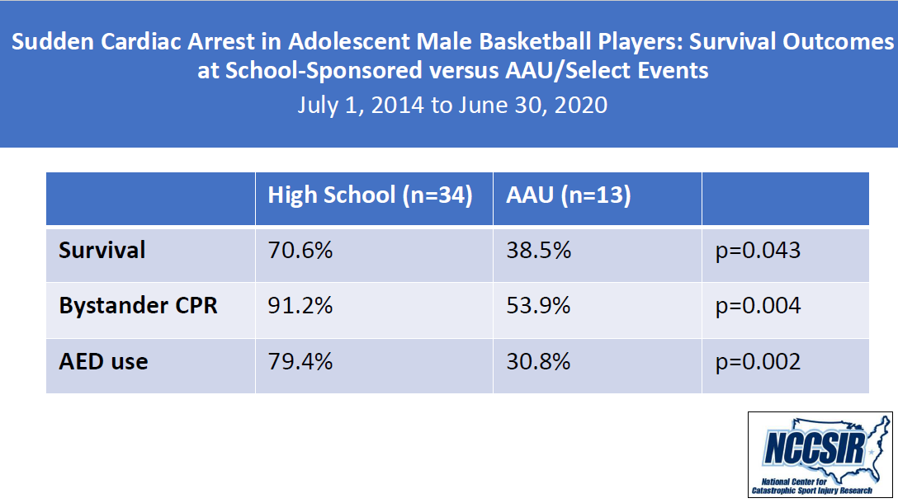
Is this program effective in improving survival?

Slide 16
What’s in it for your school?
You will be creating a healthier community by protecting its most vulnerable
Designation places you in compliance with the federal guidelines for Medical Emergency Response Plan for Schools
Designation places you in compliance with Virginia State AED legislature
Statewide and national recognition for your efforts to improve the health of Virginia’s communities
Notes:
This statement has been endorsed by the following organizations:
American Heart Association (AHA) Emergency Cardiovascular
Care Committee, American Academy of Pediatrics,
American College of Emergency Physicians, American National
Red Cross, National Association of School Nurses, National
Association of State EMS Directors, National Association of
EMS Physicians, National Association of Emergency Medical
Technicians, and the Program for School Preparedness and
Planning, National Center for Disaster Preparedness, Columbia
University Mailman School of Public Health.

Slide 17
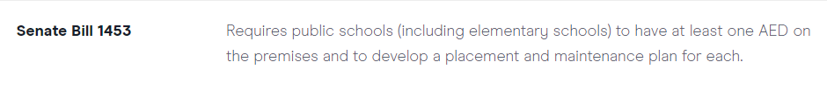
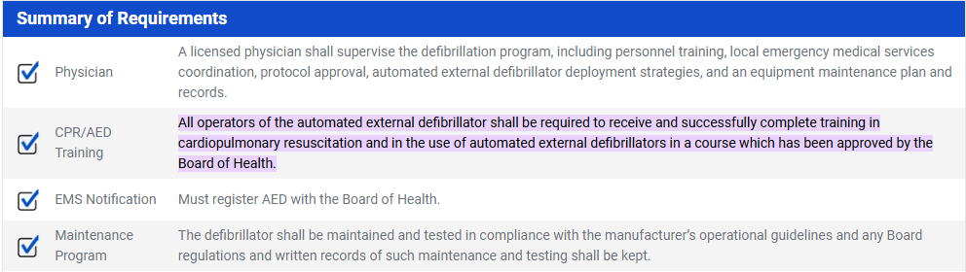
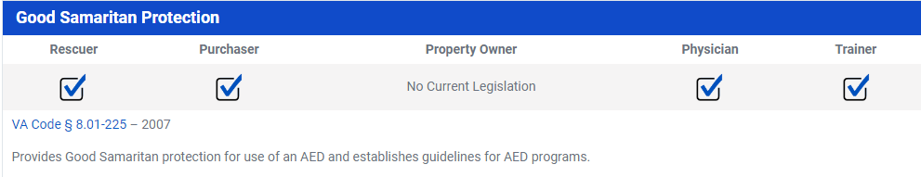
Virginia State AED legislature

Slide 18
How does the Virginia HSSP help?
Sudden cardiac arrest recognition training
Provide AED/CPR education and assistance
CPR training for team members
Assistance with accomplishing the 14 requirements for Heart Safe School designation
Assist youth sports and community groups to expand community safety
Data collection

Slide 19
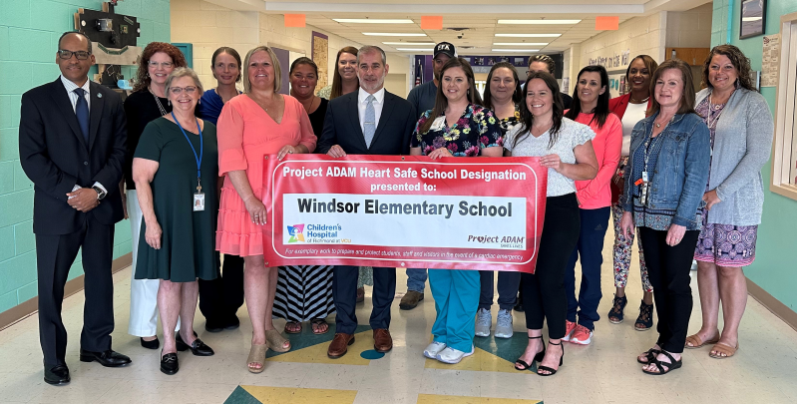
Project ADAM HSS Designation

Slide 20
Project ADAM Website
www.projectadam.com
Understanding Sudden Cardiac Arrest
Being prepared in a cardiac emergency
Implementing Project ADAM in your school
AED/CPR drill training
All staff awareness training video for school staff
AED and CPR training videos
CHoR Project ADAM website
https://www.chrichmond.org/services/childrens-hospital-foundation-heart-center/heart-center-specialities/project-adam

Slide 21
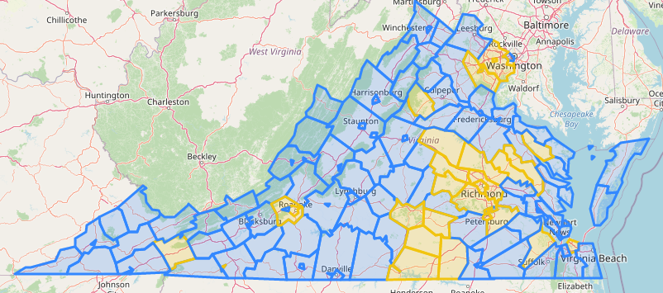
Virginia Heart Safe Schools Program
Partners:
Justin J. Davis Heart Foundation
Gwyneth's Gift Foundation
Richmond AHA
VCUH Sports Medicine

Slide 22
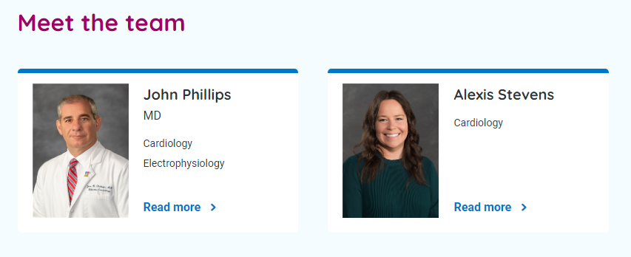
Meet the team

Slide 23

We can make a difference

Slide 24
Thank you!

