Slide 1

Do CPR and AEDs Make a Difference?
Robert Campbell, MD

Slide 2
“We Need CRP and AEDs to Make a Greater Difference”
Robert Campbell, MD

Slide 3
No Disclosures

Slide 4
Do CPR and AEDs Make a Difference?
YES
Robert Campbell, MD

Slide 5
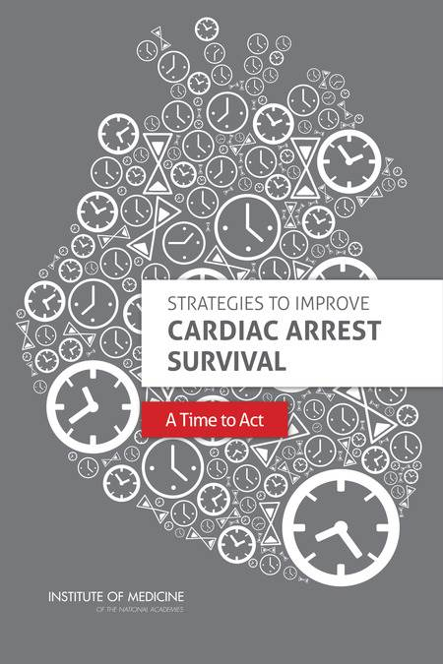
I’d like to thank the Institute of Medicine for helping me with this talk.
Resuscitation. 2013;84:1093-1098

Slide 6
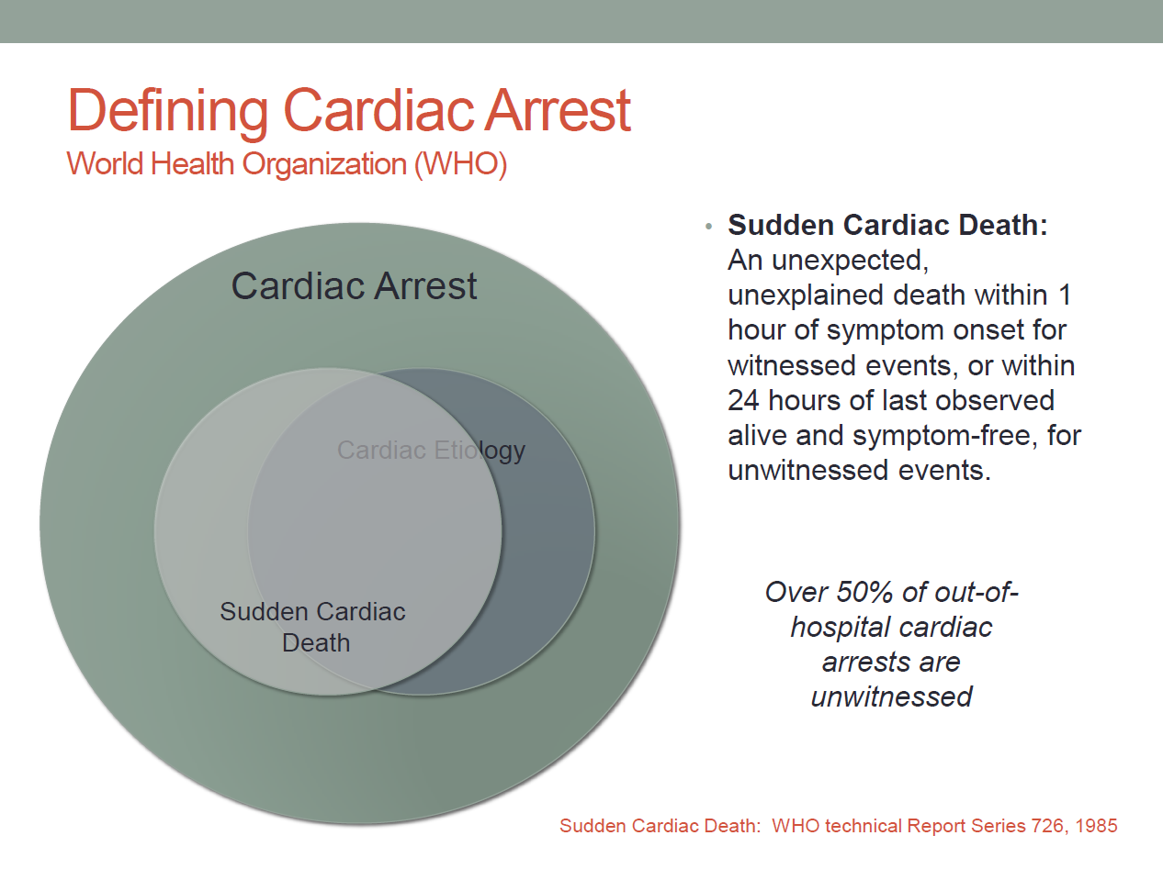
IOM 2014 report

Slide 7
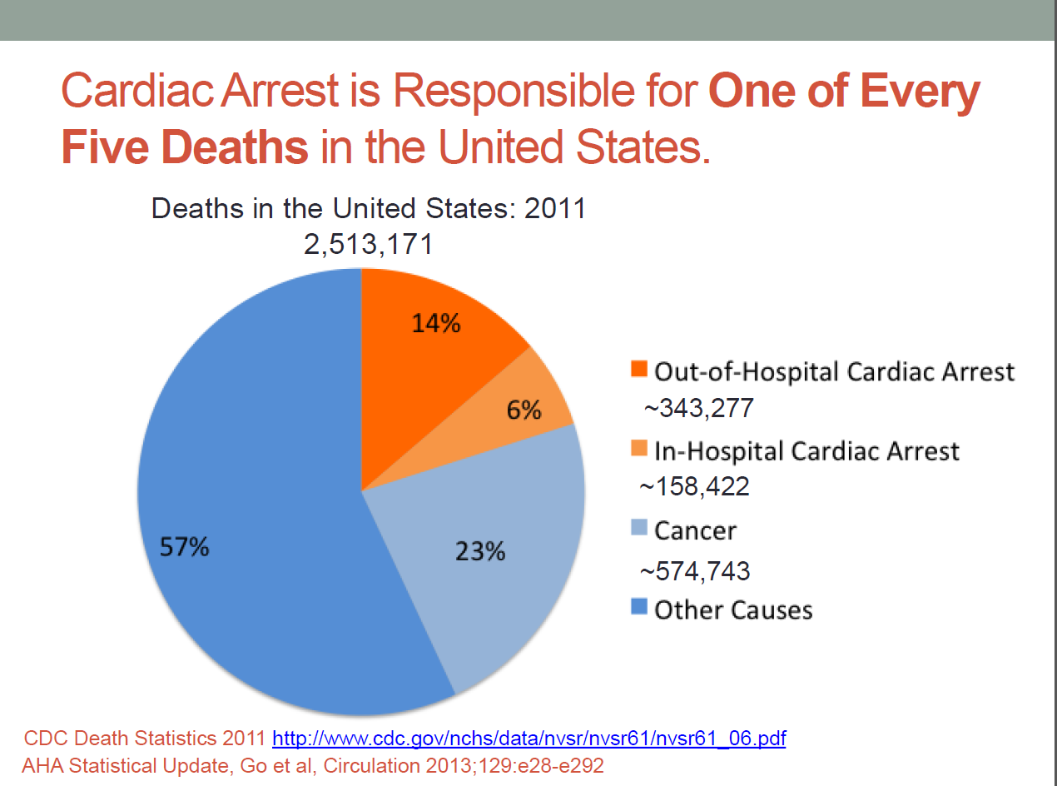
IOM 2014 report

Slide 8

  CPR
  “Didn’t work”; quality poor
  “downtime” with rescue breathing (loss of CPP)
  “fear of failure”; no mouth to mouth
  AEDs
  Fear of litigation
  Dr. Frankenstein’s lab
  SYTEMS
  No database for outcomes
  Poor and disjointed EMS, 911 systems

Slide 9

  CPR
  Compressions only (witnessed)
  Video education
  School mandates
  AEDs
  PAD, AED programs
  AHA statements
  EDUCATION
  Online education; CQI processes; simulators
  SYTEMS
  Move to national databases (e.g. CARES)
  Partnerships (AHA, Red Cross, industry, ADAM, SAVE, SADS)
  EAPs

Slide 10
Primary
Prevention
Diagnose
Treat
Secondary
Prevention
EAP, CPR/AED
Chain of Survival
Non viable
SCD
Self terminate
+ Resusc
SCA (witnessed, unwitnessed)
Viable (“healthy dead”)
– Resusc
No response
SCD
Hospital discharge
Neuro intact
Return to work

Slide 11
Primary
Prevention
Diagnose
Treat
Secondary
Prevention
EAP, CPR/AED
Chain of Survival
Non viable
SCD
Self terminate
+ Resusc
SCA (witnessed, unwitnessed)
Viable (“healthy dead”)
– Resusc
No response
SCD
Hospital discharge
Neuro intact
Return to work

Slide 12

American Heart Association
Chain of Survival
  Early Recognition and Call 911
  Early Cardiopulmonary Resuscitation (CPR)
  Early Defibrillation
  Effective Advanced Care
  Coordination of Care in the Hospital

Slide 13
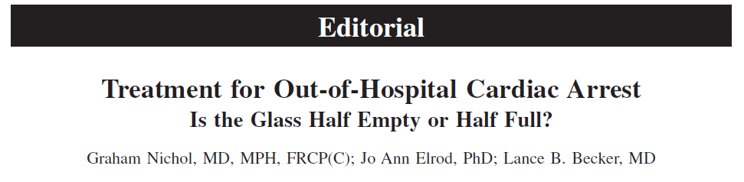
Circulation. 2014;130:1844-1846
“During the past 40 years, knowledge has accumulated that survival increases significantly if the OHCA is quickly recognized and responded to with prompt activation of 911, bystander-initiated cardiopulmonary resuscitation (CPR), lay application of an automated external defibrillator (AED) before arrival of emergency medical services (EMS) providers on scene, advanced life support, and postresuscitation care.”
Resuscitation. 2013;84:1093-1098

Slide 14
CPR

Slide 15

CPR is inherently inefficient; it provides only10% to 30% of normal blood flow to the heart and 30% to 40% of normal blood flow to the brain even when delivered according to guidelines. This inefficiency highlights the need for trained rescuers to deliver the highest quality CPR possible.
Circulation. 2013;128:417-435

Slide 16
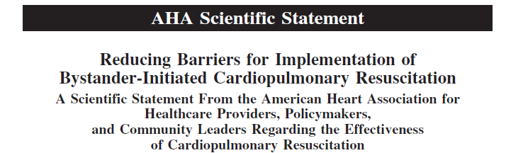
Circulation. 2008;117:704-709
“A number of reports have illustrated that bystander CPR can substantially improve rates of survival from SCA.”
JAMA. 1995;274:1922-1925
Resuscitation. 1993;26:47-52
Resuscitation. 1994;28:195-203
Circulation. 1997;96:3308-3313
Ann Emerg Med. 1993;22:1652-1658

Slide 17
Circulation. 2008;117:704-709
“In places where widespread first responder CPR training has been provided (e.g. as part of community lay rescuer AED programs), survival rates from witnessed SCA associated with ventricular fibrillation have been reported to be as high as 49% to 74%%.”
N Engl J Med. 2002;347:1242-1247
N Engl J Med. 2000;343:1206-1209

Slide 18
Circulation. 2008;117:704-709
  3 important concepts
  High-quality CPR is an important determinant of survival from SCA
  More victims of out-of-hospital SCA should receive bystander CPR
  CPR must be performed effectively by bystanders and healthcare providers

Slide 19
We can even teach young children…..

Slide 20
Child cpr

Slide 21
AED

Slide 22
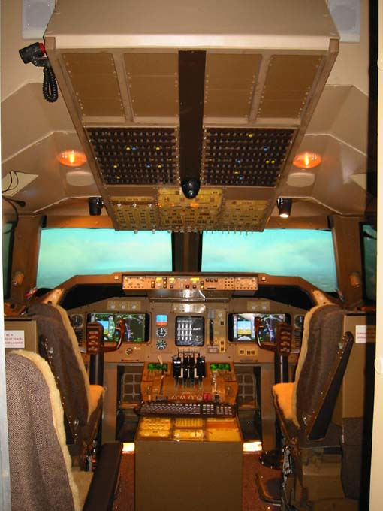
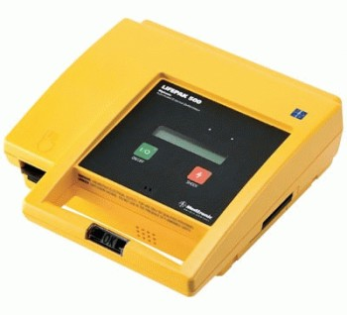
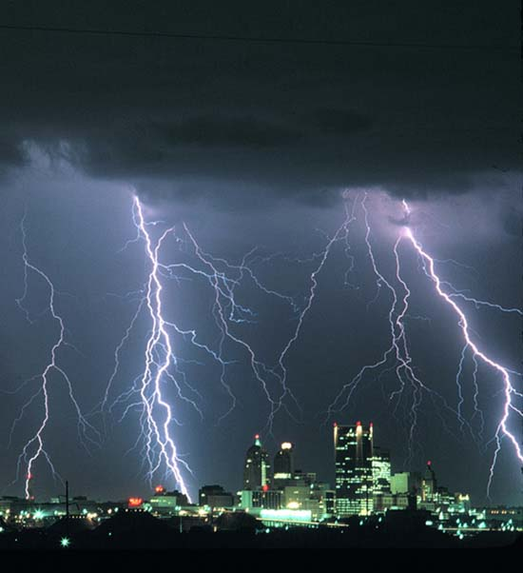
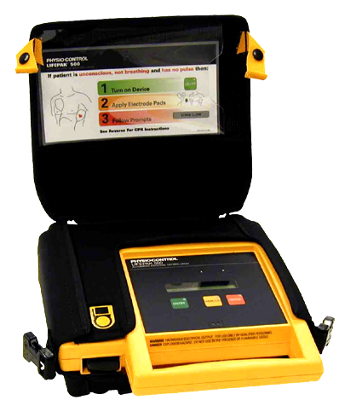

Slide 23
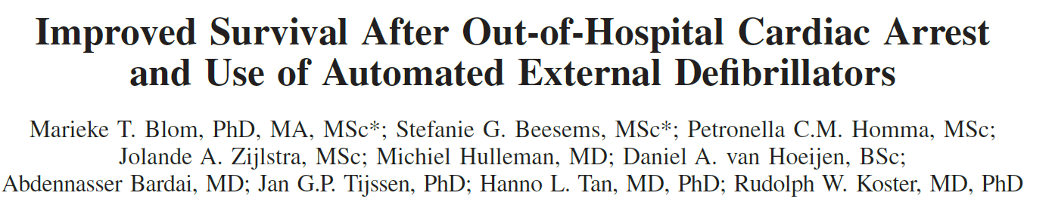
Netherlands
OOH cardiac arrest 2006-2012
AED use associated with increased survival in patients with a shockable initial rhythm
Rates of AED use almost tripled during study period (21% - 59%)
Circulation. 2014;130:00-00

Slide 24
Use and benefits of public access defibrillation in a nation-wide network
Nielsen AM, Folke F, Lipert FK, Rasmussnen LS.
28 month study in Denmark
Shockable rhythms:
More likely to be witnessed
Occur at sports facilities
Related to exercise
Have improved 30-day survival (69%)
65% presenting with shockable rhythm had ROSC upon EMS arrival; 26% were conscious
Resuscitation. 2013 Apr; 84(4)430-4

Slide 25
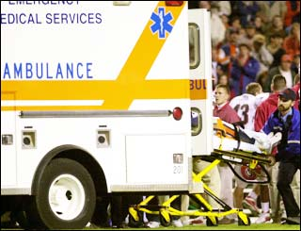
Emergency Action Plan (EAP)
Development of an EAP
Venue-specific
Communication
Personnel
Equipment
Transportation
Practice and Review of EAP
Post-Event Catastrophic Incident Guidelines
Ron Courson

Slide 26
REGISTRY

Slide 27



CARES
  Cardiac Arrest Registry to Enhance Survival
  Established to improve prehospital care at the local level
    Identify cases of OOH cardiac arrest
    Measure how well EMS performs key elements of emergency cardiac care
    Determine outcomes through hospital discharge

Slide 28
CARES Registry
Core Data Elements
Ann Emerg Med. 2009;54:674-683

Slide 29
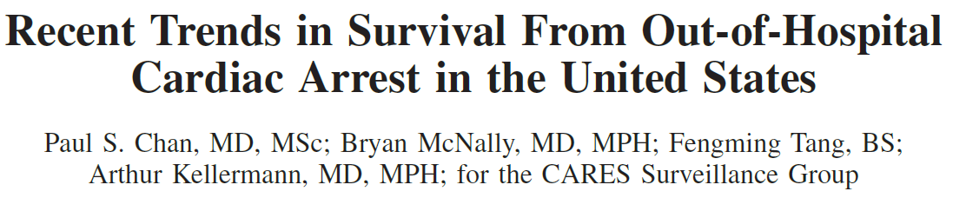
  > 70K SCA victims from 248 EMS agencies
    October 2005 – December 2012
  Survival improvement for both shockable and non-shockable rhythms
  ↑d use of bystander CPR and AED use
Circulation. 2014;130:1876-1882

Slide 30
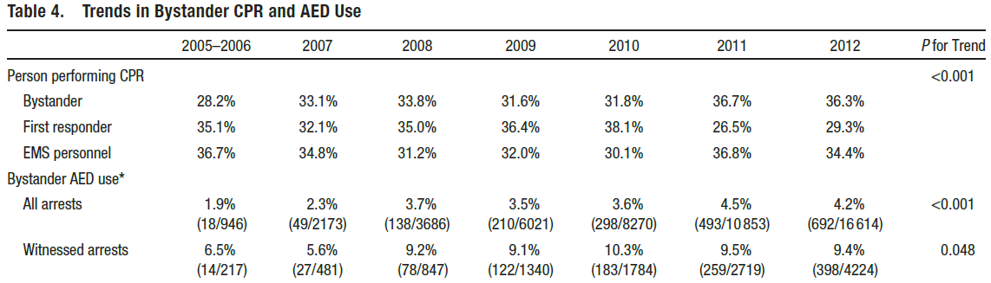
Circulation. 2014;130:1876-1882

Slide 31
SCHOOLS

Slide 32

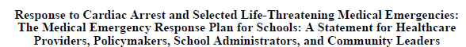
“On any given day, as much as 20% of the combined US adult and child population can be found in schools”
Circulation. 2008;117:704-709

Slide 33
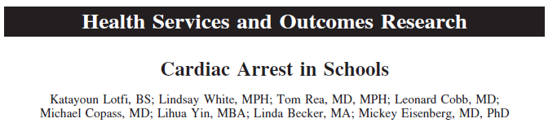
97 cases over 16 years
12 students
33 faculty, staff
45 adults not employed
School based cardiac arrest
1:111 schools
1:8 colleges
1:125 High schools
1:200 preschool-middle
Circulation. 2007;116:1374-1379

Slide 34
Outcomes from sudden cardiac arrest in US high schools: a 2-year prospective study from the National Registry for AED Use in Sports.
Drezner JA, Toresdahl BG, Rao AL, Huszti E, Harmon KG
Br J Sports Med. 2013 Dec;47(18):1179-83
2149 high schools
Prospective observational study (2009-2011)
95% completion for 2 years
School based AED programs – 87% (all but one school reporting an SCA case)
SCA n=59
26 (44%) students
33 (56%) adults
39 (66%) – training or competition
55 (93%) witnessed; 54 (92%) prompt CPR
AED applied 50 (85%); onsite shock 39 (66%)
Overall; 42/59 (71%) survived to hospital discharge
  22/26 students (85%)
  20/33 adults (61%)

Slide 35
Outcomes from sudden cardiac arrest in US high schools: a 2-year prospective study from the National Registry for AED Use in Sports.
Drezner JA, Toresdahl BG, Rao AL, Huszti E, Harmon KG
Br J Sports Med. 2013 Dec;47(18):1179-83
2149 high schools
Prospective observational study (2009-2011)
95% completion for 2 years
School based AED programs – 87% (all but one school reporting an SCA case)
SCA n=59
26 (44%) students
33 (56%) adults
39 (66%) – training or competition
55 (93%) witnessed; 54 (92%) prompt CPR
AED applied 50 (85%); onsite shock 39 (66%)
Overall; 42/59 (71%) survived to hospital discharge
  22/26 students (85%)
  20/33 adults (61%)

Slide 36
Outcomes from sudden cardiac arrest in US high schools: a 2-year prospective study from the National Registry for AED Use in Sports.
Drezner JA, Toresdahl BG, Rao AL, Huszti E, Harmon KG
Br J Sports Med. 2013 Dec;47(18):1179-83
2149 high schools
Prospective observational study (2009-2011)
95% completion for 2 years
2149 high schools
Prospective observational study (2009-2011)
95% completion for 2 years
School based AED programs – 87% (all but one school reporting an SCA case)
SCA n=59
26 (44%) students
33 (56%) adults
39 (66%) – training or competition
55 (93%) witnessed; 54 (92%) prompt CPR
AED applied 50 (85%); onsite shock 39 (66%)
Overall; 42/59 (71%) survived to hospital discharge
  22/26 students (85%)
  20/33 adults (61%)

Slide 37
Outcomes from sudden cardiac arrest in US high schools: a 2-year prospective study from the National Registry for AED Use in Sports.
Drezner JA, Toresdahl BG, Rao AL, Huszti E, Harmon KG
Br J Sports Med. 2013 Dec;47(18):1179-83
2149 high schools
Prospective observational study (2009-2011)
95% completion for 2 years
2149 high schools
Prospective observational study (2009-2011)
95% completion for 2 years
School based AED programs – 87% (all but one school reporting an SCA case)
SCA n=59
26 (44%) students
33 (56%) adults
39 (66%) – training or competition
55 (93%) witnessed; 54 (92%) prompt CPR
AED applied 50 (85%); onsite shock 39 (66%)
Overall; 42/59 (71%) survived to hospital discharge
  22/26 students (85%)
  20/33 adults (61%)

Slide 38
Outcomes from sudden cardiac arrest in US high schools: a 2-year prospective study from the National Registry for AED Use in Sports.
Drezner JA, Toresdahl BG, Rao AL, Huszti E, Harmon KG
Br J Sports Med. 2013 Dec;47(18):1179-83
2149 high schools
Prospective observational study (2009-2011)
95% completion for 2 years
2149 high schools
Prospective observational study (2009-2011)
95% completion for 2 years
School based AED programs – 87% (all but one school reporting an SCA case)
SCA n=59
26 (44%) students
33 (56%) adults
39 (66%) – training or competition
55 (93%) witnessed; 54 (92%) prompt CPR
AED applied 50 (85%); onsite shock 39 (66%)
Overall; 42/59 (71%) survived to hospital discharge
  22/26 students (85%)
  20/33 adults (61%)

Slide 39
Outcomes from sudden cardiac arrest in US high schools: a 2-year prospective study from the National Registry for AED Use in Sports.
Drezner JA, Toresdahl BG, Rao AL, Huszti E, Harmon KG
Br J Sports Med. 2013 Dec;47(18):1179-83
2149 high schools
Prospective observational study (2009-2011)
95% completion for 2 years
2149 high schools
Prospective observational study (2009-2011)
95% completion for 2 years
School based AED programs – 87% (all but one school reporting an SCA case)
SCA n=59
26 (44%) students
33 (56%) adults
39 (66%) – training or competition
55 (93%) witnessed; 54 (92%) prompt CPR
AED applied 50 (85%); onsite shock 39 (66%)
Overall; 42/59 (71%) survived to hospital discharge
  22/26 students (85%)
  20/33 adults (61%)

Slide 40
Outcomes from sudden cardiac arrest in US high schools: a 2-year prospective study from the National Registry for AED Use in Sports.
Drezner JA, Toresdahl BG, Rao AL, Huszti E, Harmon KG
Br J Sports Med. 2013 Dec;47(18):1179-83
2149 high schools
Prospective observational study (2009-2011)
95% completion for 2 years
2149 high schools
Prospective observational study (2009-2011)
95% completion for 2 years
School based AED programs – 87% (all but one school reporting an SCA case)
SCA n=59
26 (44%) students
33 (56%) adults
39 (66%) – training or competition
55 (93%) witnessed; 54 (92%) prompt CPR
AED applied 50 (85%); onsite shock 39 (66%)
Overall; 42/59 (71%) survived to hospital discharge
  22/26 students (85%)
  20/33 adults (61%)

Slide 41
High school automated external defibrillator programs as markers of emergency preparedness for sudden cardiac arrest.
Toresdahl VG, Harmon KG, Drezner JA
J Athl Train. 2013 Mar-Apr; 48(2): 242–247
Key Points
This is the largest study of emergency planning in US high schools to date and the first to analyze the effect of having automated external defibrillators (AEDs) on other aspects of emergency planning for sudden cardiac arrest.
United States high schools with AED programs were more likely to ensure access to early defibrillation, establish emergency action plans, consult local emergency medical services, review and regularly rehearse the emergency action plan, and implement a communication system to activate emergency services.

Slide 42
Response to Cardiac Arrest and Selected Life-Threatening Medical Emergencies: The Medical Emergency Response Plan for Schools: A Statement for Healthcare Providers, Policymakers, School Administrators, and Community Leaders
  The medical emergency response plan includes:
  Creation of an effective and efficient campus-wide communication system
  Coordination, practice, and evaluation of a response plan with the school nurse and physician, athletic trainer, and local EMS agency
  Risk reduction
  Training in and equipment for CPR and first aid for the school nurse, athletic trainers, and teachers and CPR training for students
  In schools with a documented need, establishment of an AED program
Circulation. 2008;117:704-709

Slide 43
AHA Science Advisory
Primary Recommendations
CPR training (as defined below) should be required for graduation from secondary school (Class I; Level of Evidence B). CPR training that is meant to comply with this mandate should at minimum:
Conform to the core teaching objectives for lay provider training described in the most current AHA Guidelines for CPR and ECC (including any interim updates), with special emphasis on:
  Recognizing the need to initiate CPR (including cautions that “gasping” is not “normal breathing”) (Class I; Level of Evidence A).
  Performing high-quality chest compressions with minimal interruptions (Class I; Level of Evidence B).
Provide an opportunity to practice and master psychomotor skills related to CPR by use of an appropriate surrogate for the victim.
Make students aware of the purpose of an AED and the ease and safety of using an AED.
Circulation. 2011;123:691-706.)

Slide 44
AHA Science Advisory
Secondary Recommendations
In schools that provide a CPR training program that includes AED skills practice (a CPR/AED course), students should be given an opportunity to practice and master all steps of CPR and AED use
(Class I; Level of Evidence B), with special emphasis on:
  Minimal interruptions in performance of CPR
  Correct application of pads to an appropriate surrogate for the human thorax
  Proper “clearing” of the patient (checking to see that no one makes contact with the patient) when so instructed by the AED.
Circulation. 2011;123:691-706

Slide 45
NEW TECHNOLOGY

Slide 46
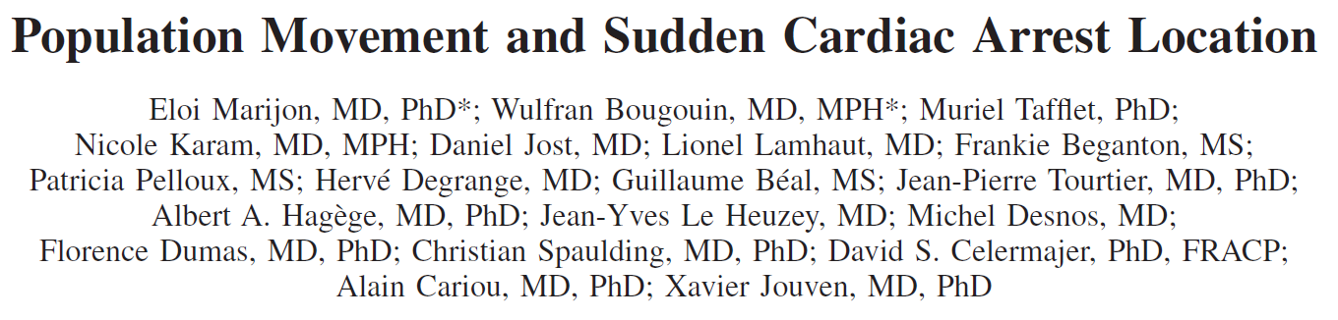
Paris France 2000-2010
SCA “hot spots” related to population movement, not just population density
12% SCAs occur in just 0.75% total Paris area
Circulation. 2015;131:1546-1554

Slide 47
Drone

Slide 48
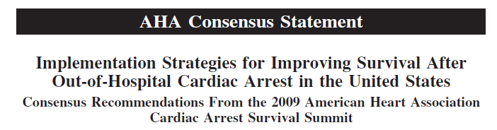
System Component | System Parameter | Strategy
Community | Bystander CPR | CPR training in schools CPR training in the workplace Public service messages Just-in-time smartphone training Performance incentives EMS dispatch-assisted CPR
 | Public-access defibrillation | AED deployment at all public building where > 1 cardiac arrests occur per year AED mapping Cell phone localization
Circulation. 2011;123:2899-2910
Circulation. 2011;123:2898-2910

Slide 49

“We Need CRP and AEDs to Make a Greater Difference”
Summary
Establish a “culture of resuscitation”
Assume ownership for education and awareness

Slide 50
Kylee’s story

