Slide 1
Project ADAM, Advocacy, Public Policy, and Saving Lives
Anoop K. Singh & Stuart Berger
Medical Directors for
Project ADAM (WI & Sacramento)

Slide 2
Today’s Objectives
To identify Sudden Cardiac Arrest as a community/public health issue.
To discuss the work of Project ADAM both nationally and in Wisconsin
To discuss public policy regarding community CPR training and AED accessibility

Slide 3
The Real Objective
To share the story of a young man whose death brought his family, physicians, hospital organizations, schools, and public policy makers together with the goal of saving lives.

Slide 4
At a school in Milwaukee
A 5th grader is sitting in her classroom. She grabs her chest and then collapses.
Her teacher goes to her, feels no pulses, and starts CPR. She has someone activate their emergency plan and an AED arrives from within the school.

Slide 5
At a school in Milwaukee
The AED advises a shock, CPR pauses, and the AED shock restores a pulse.
EMS arrives and she receives two more shocks due to loss of her pulse.
She is transferred to CHW in relatively stable condition.
She has a normal neurological recovery.

Slide 6
Background
The US population between 12-25 years-old is ~60 million
Sudden death (SD) incidence is estimated to be 0.5 deaths per 100,000 person-years
SD is attributed to cardiac causes in 70% of cases (ie- sudden cardiac death [SCD])
Ten percent of SD cases are due to noncardiac causes (seizures, pulmonary embolism, asthma, etc) and 20% are considered unexplained
Vaartjes 2009 – Sudden death in persons younger than 40 years of age: incidence and causes.

Slide 7
Definitions
Sudden cardiac arrest (SCA) is a sudden loss of heart function
Most often the endpoint is a malignant arrhythmia (unstable VT or VF)
Outcome of SCA can be:
Spontaneous resolution (e.g., syncope only)
Successful intervention (aborted cardiac arrest)
Death (SCD)

Slide 8
SCA Etiology in Children
Structural heart problems:
Hypertrophic cardiomypathy (HCM)
Coronary artery anomalies
Arrhythmogenic right ventricular cardiomyopathy (ARVC)
Electrical heart problems:
Long QT Syndrome (LQTS)
CPVT
Wolff-Parkinson-White Syndrome (WPW)
Other problems:
Myocarditis
Commotio cordis
Drug use
Pulmonary hypertension

Slide 9
Why focus on schools?
~20% of the US population is in a school during any given day
Keys for a school are: communication, drills, CPR education for staff and students, and AEDs
Haziniski 2004 – Response to Cardiac Arrest and Selected Life-Threatening Medical Emergencies

Slide 10
AdAM’S STORY AND PROJECT ADAM

Slide 11
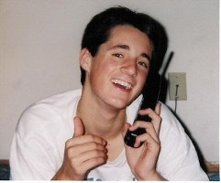
Adam Lemel – A Whitefish Bay, WI high school student
Adam died on January 22, 1999 at the age of 17 doing what he loved: playing basketball with his high school team.
Adam's death was a total shock, a completely healthy young man. He loved sports. He was a bundle of motion and energy that stopped in one short instant. Adam died of an undiagnosed heart problem.
Joe Lemel, Adam’s Father
Adam Lemel
1/6/1982 – 1/22/1999

Slide 12
1999 in SE Wisconsin
A total of 5 young people, including Adam, suffer a cardiac arrest
Three die and two survive their SCA
Diagnoses include cardiomyopathies, coronary anomalies, and arrhythmia syndromes
Interestingly, all events occur during basketball

Slide 13
The Birth of Project ADAM
Joe and Patty Lemel, Adam’s Parents, along with David Ellis, a childhood friend of Adam’s, approached Children’s Hospital of Wisconsin
“We need to do something, these kids are dying and we can prevent this.”
Project ADAM (Automated Defibrillators in Adam’s memory)

Slide 14
Project ADAM Goals
Education – Warning signs, family history, screening, drug abuse…
High school students should learn CPR prior to graduation
CPR-AED Programs in high schools in the state of Wisconsin

Slide 15
Project ADAM as Educators
Powerpoint Presentations/Meetings -Education
Students
Teachers
School Boards
Parents
Coaches/Athletic Directors
School Nurses
Physicians and health care professionals

Slide 16
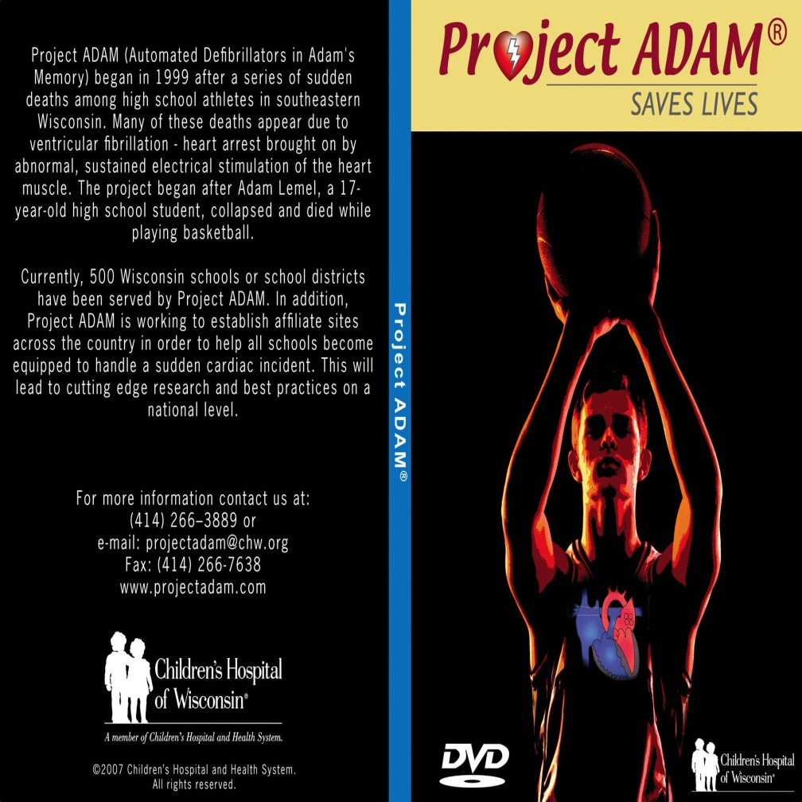
Project ADAM spreading the word
The Manual/DVD
A step by step approach on “how to do it”
Discusses AEDs, training, SCA warning signs, and much more

Slide 17
Project ADAM National Affiliate Formation
Other states were interested in supporting school CPR-AED efforts
An affiliate agreement and model were developed as a blueprint for future programs
Currently, there are 11 affiliate programs

Slide 18
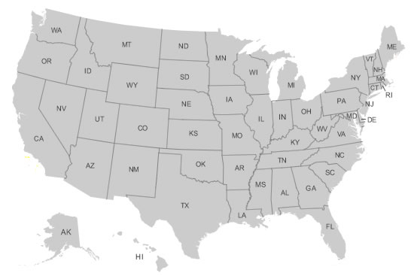
Map of National Program Affiliates
Project ADAM Wisconsin (national office), Children's Hospital of Wisconsin
Project ADAM Sacramento, U.C. Davis
Project S.A.V.E., Georgia, Children’s Healthcare of Atlanta
Project ADAM Florida, Florida Hospital for Children
Youth Heart Watch, Children’s Hospital of Philadelphia
Project ADAM Texas, Cook Children’s Medical Center
Project ADAM Houston, Texas Children’s Hospital
Alabama LifeStart, Children’s of Alabama
Project ADAM Tennessee, East Tennessee Children’s Hospital
Project ADAM Inland Northwest, Providence Sacred Heart Medical Center & Children’s Hospital
Project ADAM Michigan, C.S. Mott Children’s Hospital
Project ADAM Colorado, Children’s Hospital Colorado

Slide 19
Current goals
Community – 100% coverage of all Wisconsin schools for CPR-AED programs
Volunteerism – engage the many youth and parents interested in our mission and vision in their school or community
Advocacy – Advance causes such as mandated CPR education for students
Research – Build and maintain a registry of participating Project ADAM schools

Slide 20
Schools have different needs
Complete
CPR-AED program
AEDs but no comprehensive school program
No AED or emergency action plan

Slide 21
School Support – Tier 1
Project ADAM provides resources for initial start up of school CPR-AED program
Project ADAM program manual and consultation
AED equipment funding support
Creation of cardiac emergency response team
Ongoing communication with school coordinator or champion

Slide 22

School Support – Tier 2
Project ADAM provides additional resources and partnerships to enhance school CPR-AED program
Funding support for equipment and staff training
Introduction of Heart Safe Schools program

Slide 23
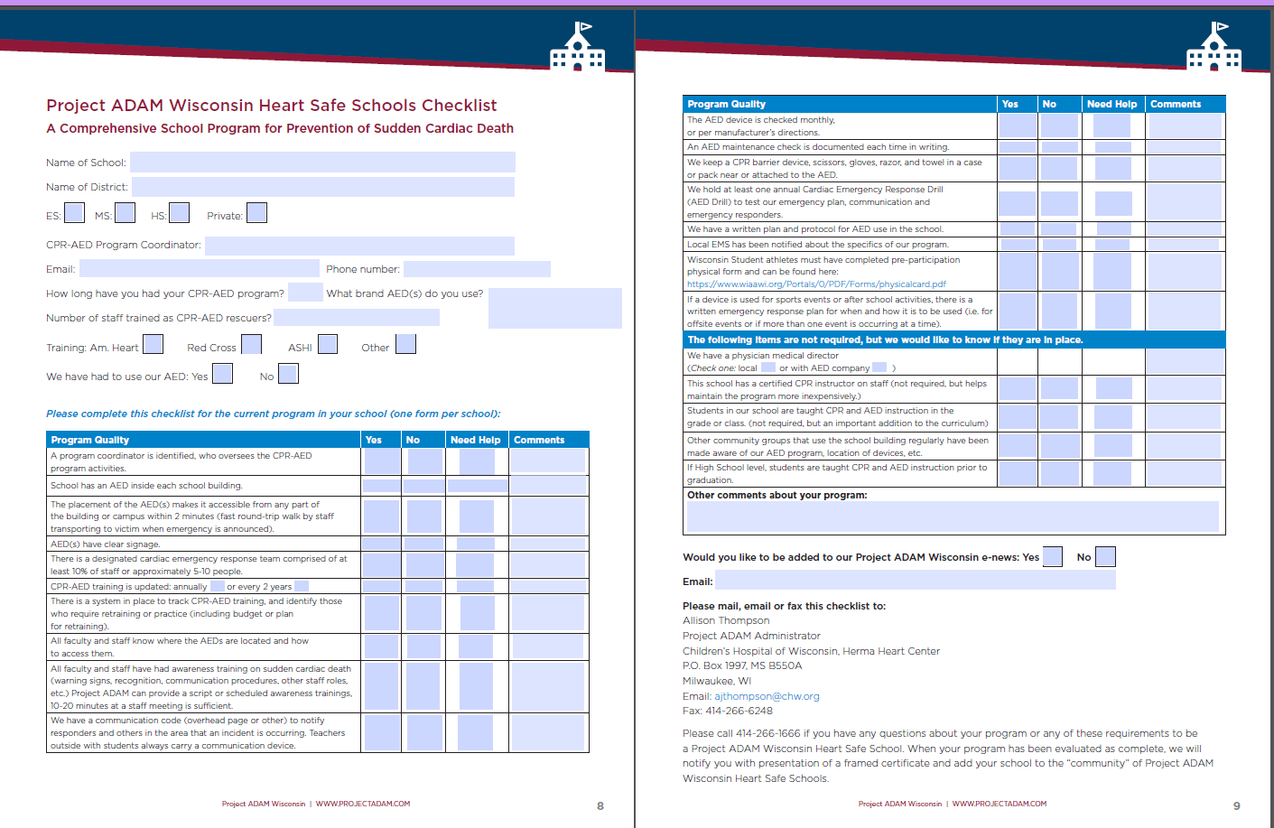
Heart Safe Schools Checklist

Slide 24
School Support – Tier 3
Comprehensive school CPR-AED program in place:
School works towards Project ADAM Heart Safe Schools Designation
Program coordinator joins “Super User” communication

Slide 25
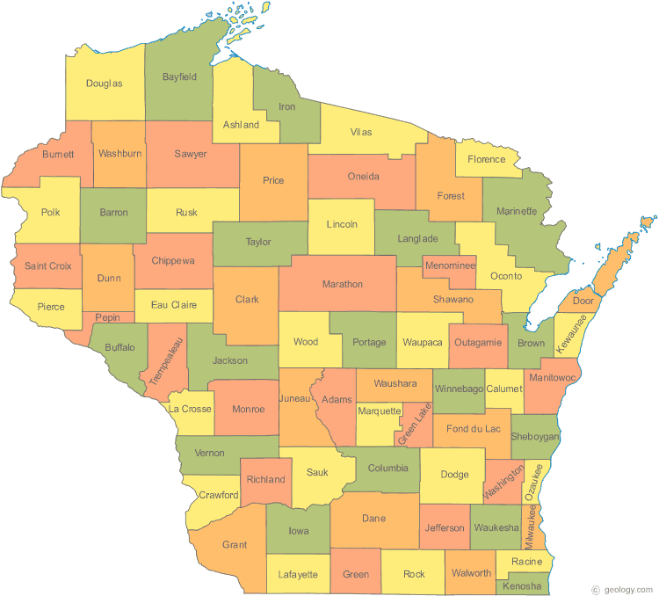
Project ADAM Wisconsin Coordinators

Slide 26
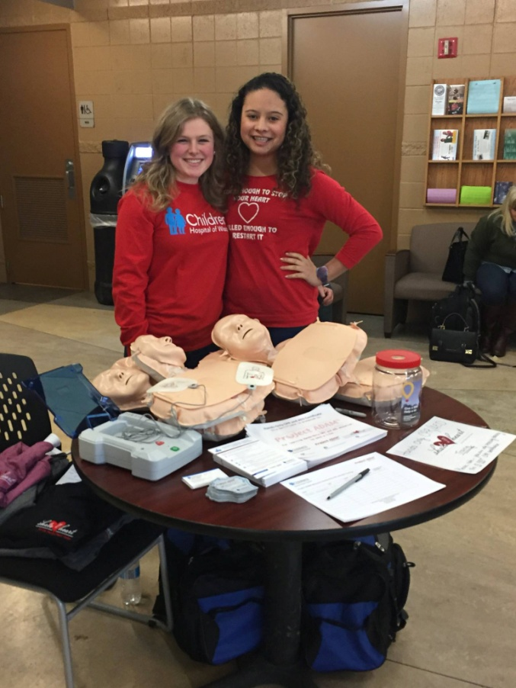
Volunteerism – Youth Advocate Program
Youth in grades 7-12
Participation in local and state wide community events
Building an “army” of advocates to carry out our mission

Slide 27
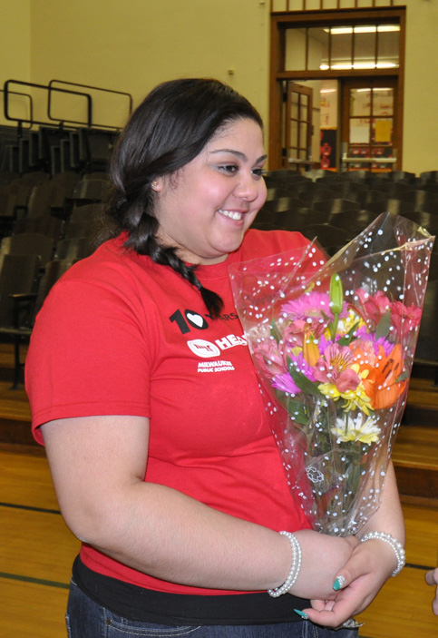
Saving Lives in Schools
Maria is now a senior who survived her cardiac arrest in 5th grade
She was saved by the school’s CPR-AED program and is a voice for Project ADAM

Slide 28
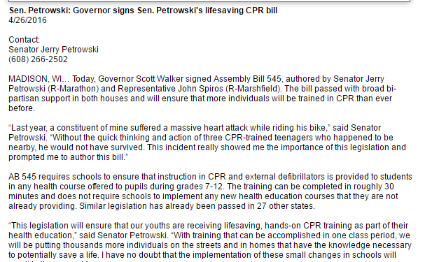
Advocacy

Slide 29
FUTURE DIRECTIONS FOR PROJECT ADAM

Slide 30
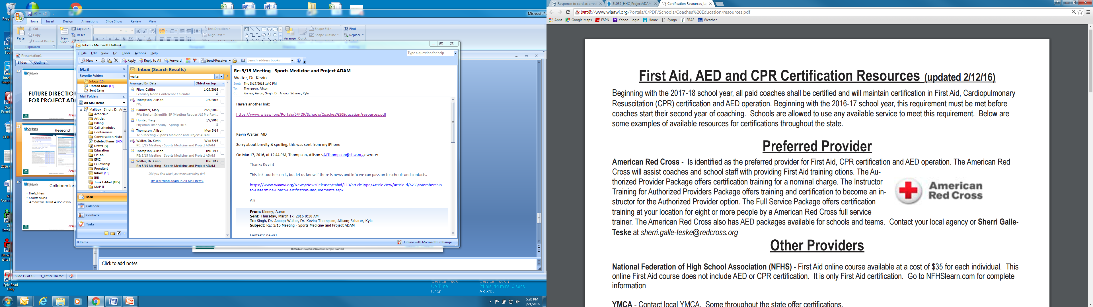
Collaborations
Firefighters
Sports clubs
American Heart Association
High school sports

Slide 31
A societal obligation to respond
VF survival decreases by 7-10% for every 1 minute without defibrillation.
With bystander CPR this increases to 3-4%/min
In some countries CPR training is mandated with as high as 95% of the population trained in CPR and AED use
In the US training on CPR & AEDs is 3%

Slide 32
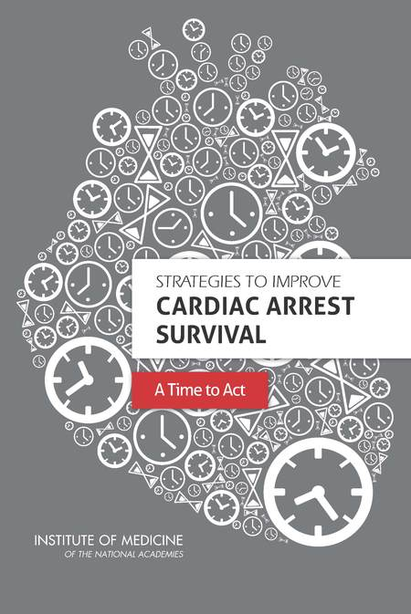
It Takes a Village
Establish a national registry of cardiac arrest
Enhance performance of EMS systems
Develop strategies to improve systems of care within hospital settings
Expand basic, clinical, translational, and health services research in cardiac arrest resuscitation
Educate and train the public in CPR, use of AEDs, and EMS activation
Create a national cardiac arrest collaborative
IOM (Institute of Medicine). 2015. Strategies to improve cardiac arrest survival: A time to act. Washington, DC: The National Academies Press.

