Slide 1
Project ADAM: Iowa Heartland Promoting Heart Safe Schools
​
Brenda Haag, RN, BSN, CPN​
Project ADAM: Iowa Heartland Program Coordinator

Slide 2
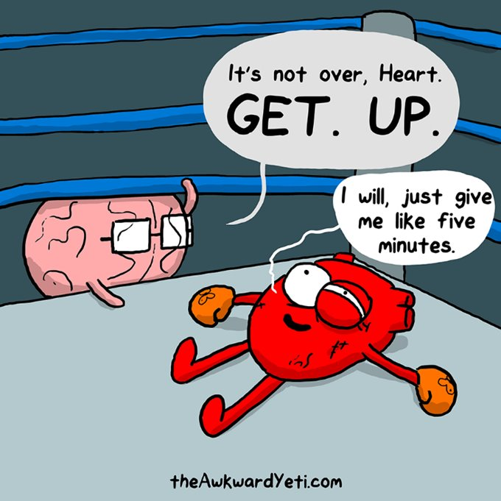
Objectives
Define and discuss the importance of sudden cardiac arrest (SCA)
Discuss Project ADAM and Heart Safe School Designation
Discuss Project ADAM: Iowa Heartland
Project ADAM: Iowa Heartland and Heart Safe Schools

Slide 3
Importance of Sudden Cardiac Arrest

Slide 4
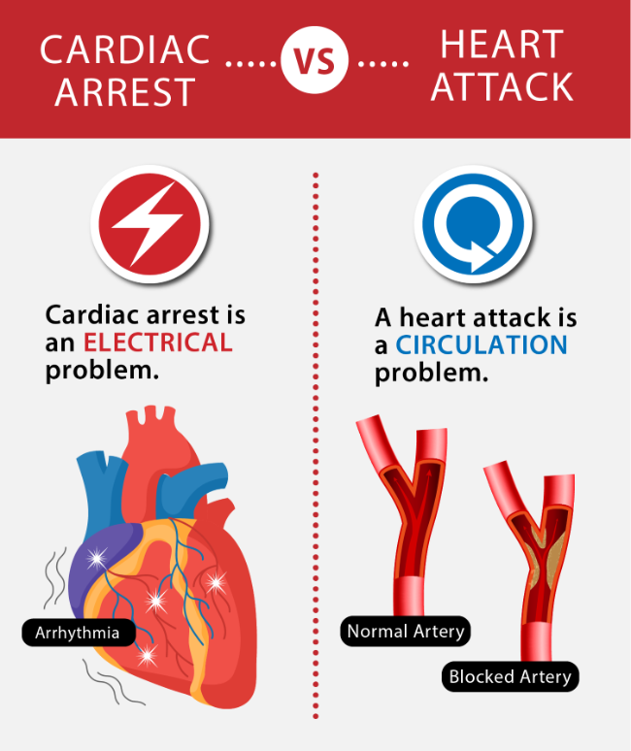
What is Sudden Cardiac
Arrest?
Sudden Cardiac Arrest (SCA) is a condition in which the heart suddenly and unexpectedly stops beating. If this happens, blood stops flowing to the brain and other vital organs.
SCA is an electrical issue, versus a heart attack, which is a “plumbing issue”.
Project ADAM: Iowa Heartland and Heart Safe Schools

Slide 5
Sudden Cardiac Arrest
Individuals of all ages may have conditions that put them at risk for SCA, which can result in neurological impairment or death.
Studies show that a prompt response with bystanders performing Cardio-pulmonary Resuscitation (CPR) and using an Automatic External Defibrillator (AED) could double or triple survival rates.
Trained individuals and teams can save lives.
Project ADAM: Iowa Heartland and Heart Safe Schools

Slide 6
SCA Outcomes
Annual Out-of-Hospital Cardiac Arrest: More than 350,000/year
  7,00 children/per year
Survival rate (overall): 12%
Average EMS response time is 8-10 minutes
  The brain can survive 3-5 minutes before brain damages begins
Every minute defibrillation is delayed, the chance of survival decreases 10%
Project ADAM: Iowa Heartland and Heart Safe Schools

Slide 7

Hands-Only CPR
CPR is inherently inefficient; it provides only 10% to 30% of normal blood flow to the heart and 30% to 40% of normal blood flow to the brain even when delivered according to guidelines
This inefficiency highlights the need for trained rescuers to deliver the highest quality CPR possible
Project ADAM: Iowa Heartland and Heart Safe Schools

Slide 8



SCA and Schools
On any given day, approximately 20% of the community (adults and children) are in schools
SCA is the leading cause of death in young athletes during exercise
Project ADAM: Iowa Heartland and Heart Safe Schools

Slide 9
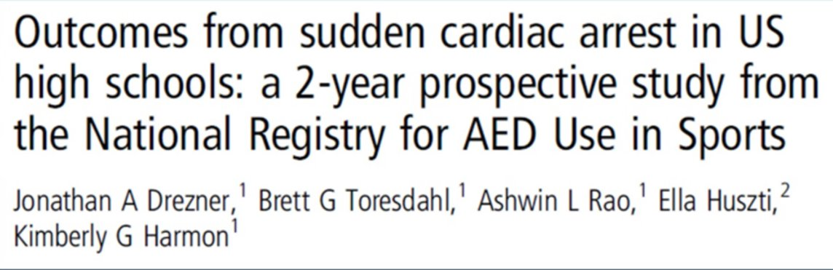
Is there specific evidence that school CPR and AEDs programs are effective in saving lives?
Prospective study of 2,149 schools​
August 1, 2009 - July 31, 2011​
Primary outcome: survival to hospital discharge
59 cases of SCA confirmed during study period​
1 cardiac arrest per 36 schools​
Athletic events were sites for 66% of cases​
SCA occurred in a student in 44% and adults in 56%​
AED was applied in 85% of cases with a shock delivered in 66% of cases
Project ADAM: Iowa Heartland and Heart Safe Schools

Slide 10
Is there evidence that schools CPR and AEDs programs are effective in saving lives?
80% of SCA victims survived to hospital discharge if the school supplied the AED versus 50% if the AED was brought by responding offsite EMS
The survival rate was 79% in schools with an established emergency action plan for SCA versus 44% in those without
Project ADAM: Iowa Heartland and Heart Safe Schools

Slide 11
Project ADAM

Slide 12
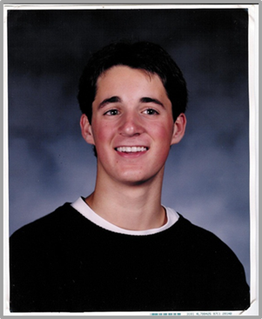

Project ADAM (Automated Defibrillators in Adam’s Memory)
An initiative to prevent SCA and SCD
  Started after Adam Lemel passed away while playing basketball
Commenced November 1999
School CRP-AED Program
Project ADAM: Iowa Heartland and Heart Safe Schools

Slide 13
Project ADAM Mission
Education and awareness of issues around sudden cardiac arrest and sudden cardiac death​
Advocacy for CPR-AED education for all students prior to high school graduation​
Advocacy for CPR-AED programs in all schools​
Advocacy for Cardiac Emergency Response Plans (CERPs) in all schools
Project ADAM: Iowa Heartland and Heart Safe Schools

Slide 14









































































































ESTABLISHED AFFILIATE SITES
Children's Wisconsin/National Office
Children’s Healthcare of Atlanta
Children’s Hospital of Philadelphia
Children’s of Alabama
Providence Sacred Heart
Children’s Hospital
Cook Children’s Medical Center
East Tennessee
Children’s Hospital
U-M Health C.S. Mott Children’s Hospital
Children’s Hospital Colorado
UC Davis Children’s Hospital
Nationwide Children’s
Hospital
Texas Children’s Hospital
Monroe Carell Jr. Children’s
Hospital at Vanderbilt
Arkansas Children’s
Cincinnati Children’s
Golisano Children’s Hospital, Southwest Florida
KU Wichita Pediatrics
Nicklaus Children’s Hospital
Duke Children’s Hospital
Ann & Robert H. Lurie Children's Hospital of Chicago
MUSC Shawn Jenkins Children’s Hospital
Cleveland Clinic Children’s
Ochsner Hospital for Children
Children’s Mercy Kansas City
WVU Medicine Children’s
Rady Children’s Hospital
Riley Hospital for Children at IU Health
Maria Fareri Children’s Hospital
University of Mississippi Medical Center/Children’s Hospital
Le Bonheur Children’s Hospital
University of Iowa Stead Family Children's Hospital
Yale New Haven Children's Hospital
Children's Minnesota / Children's Heart Clinic
St. Louis Children’s Hospital
USA Women and Children’s Hospital
Children's Hospital & Medical Center
Hasbro Children's Hospital
Children's Hospital of Richmond at VCU
Phoenix Children’s Hospital
Kentucky Children's Hospital
Norton Children’s Hospital
Nemours Children’s Health
WA
MN
RI
WI
MI
NY
IA
PA
CT
NE
IL
IN
OH
DE
CA
UT
CO
KS
MO
WV
VA
KY
NC
AZ
AR
TN
SC
MS
AL
GA
TX
LA
FL
42
ESTABLISHED PROGRAMS
32
STATES
USA In Progress Sites
Canada In Progress Site; Alberta, Canada
Updated February, 2024

Slide 15
Over 250 Saves Since 1999

Slide 16
Heart Safe Schools

Slide 17
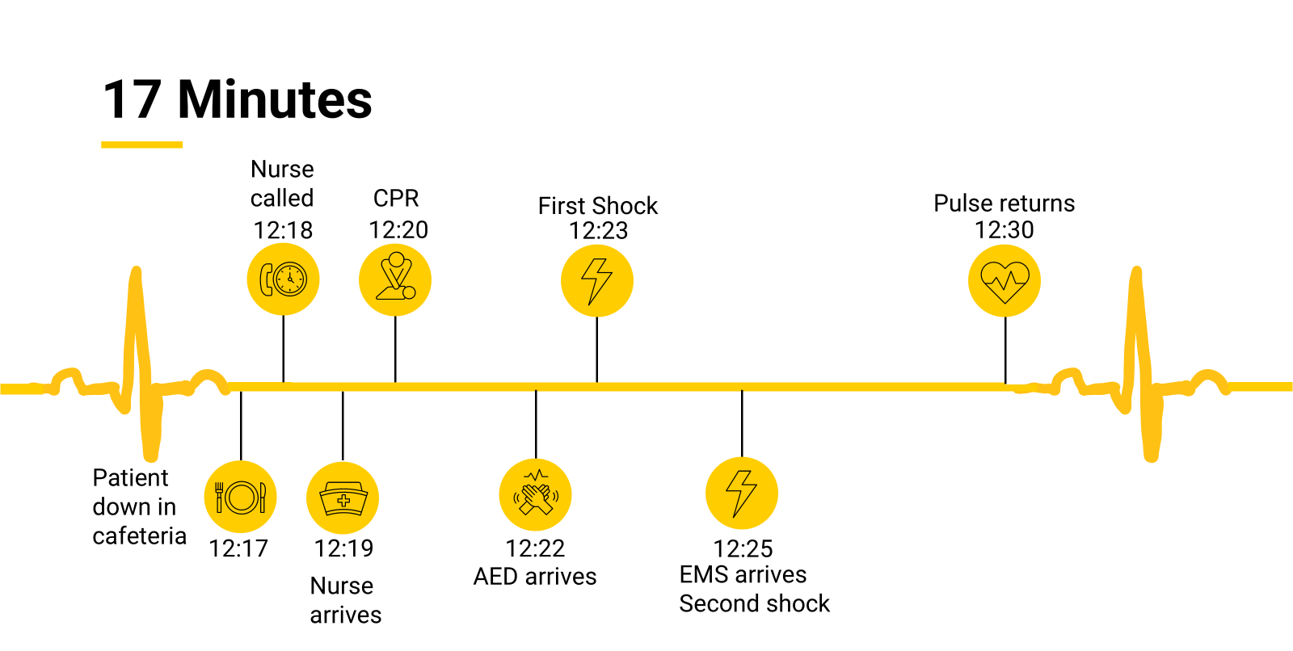
Event Time Line of CPR in Action

Slide 18
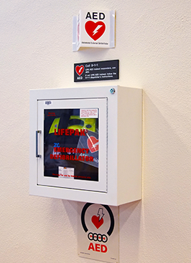
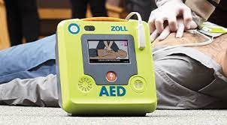

Requirements to Become Heart Safe
A sufficient number of accessible, properly maintained and inspected AEDs
Signs identifying AED locations
Be able to respond within 2-3 minutes
Project ADAM: Iowa Heartland and Heart Safe Schools

Slide 19
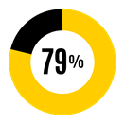
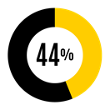
Requirements to Become Heart Safe
A sufficient number of accessible, properly maintained and inspected AEDs, ready to use, with signs identifying AED locations to allow response within 2-3 minutes
A written cardiac emergency response plan
vs
Project ADAM: Iowa Heartland and Heart Safe Schools

Slide 20
Requirements to Become Heart Safe
A sufficient number of accessible, properly maintained and inspected AEDs, ready to use, with signs identifying AED locations to allow response within 2-3 minutes
A written cardiac emergency response plan
A cardiac emergency response team with current CPR/AED training to respond to emergencies during school and after school hours if applicable
At least 10% of staff (of 5~10 staff members) with current CPR/AED training.
Project ADAM: Iowa Heartland and Heart Safe Schools

Slide 21

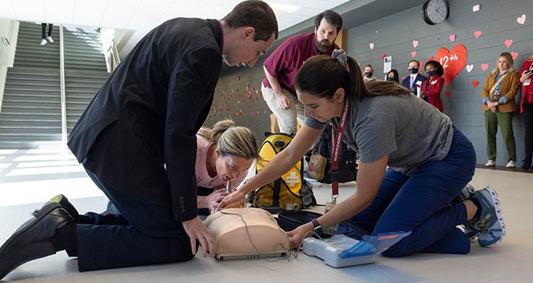

Cardiac Emergency Response Drills
Fire Drill
Tornado Drill
CPR Drill

Slide 22
Heart Safe Schools
What do the schools get??
  Access to medical professionals for education and resources
  Replacement batteries and pads in the event the AED is used
  Local, regional, and state recognition
Project ADAM: Iowa Heartland and Heart Safe Schools

Slide 23
Project ADAM
Iowa Heartland

Slide 24
Jan 2023-October 2024:
19 designated Heart Safe Iowa Schools (many others provided info and working thru the process)
CPR/AED training provided to Iowa MBB, WBB, Gymnastics, Softball, Volleyball, Baseball, Women’s Golf, Soccer
CPR/AED training provided to local groups (cub scouts, youth soccer)
Program Coordinator hired June 2023
First Heart Safe School “Save”.
Second “save” Iowa School working on Designation
Our goal is that every school in Iowa will be designated HEART SAFE!
Project ADAM: Iowa Heartland and Heart Safe Schools

Slide 26
How prepared is your school for a cardiac emergency?
Don’t wait…start working with your school administration/staff to assess your campus and make a plan.​
Utilize your resources ​
  www.projectadam.com​
  Heart Safe Checklist can serve as an initial assessment for your school ​
  Heart Safe School Toolkit can be used to help you learn how to fulfill each criteria on the checklist. ​
Contact our Project ADAM team for further support​
  Project ADAM: Iowa Heartland | University of Iowa Stead Family Children's Hospital (uihc.org)​
Project ADAM: Iowa Heartland and Heart Safe Schools

Slide 27
Thank you
Brenda Haag, RN
Program Coordinator
Brenda-haag@uiowa.edu
UI-Project-ADAM@uiowa.edi
uichildrens.org

