Slide 1

Preventing Cardiac Arrest in Schools by Creating
HEART SAFE SCHOOLS
with Project ADAM Sacramento
Rebecca McCormac, Project ADAM Coordinator
Email: rmccormac@ucdavis.edu Cell: 916.627.9533

Slide 2
Today’s Agenda:
Introduce Project ADAM and the issue of Sudden Cardiac Arrest (SCA)
Identify the steps to achieve and maintain Project ADAM Heart Safe School Designation
Identify the resources available to assist in strengthening Cardiac Emergency Preparedness in your school

Slide 3
What is Project ADAM?
Who was Adam Lamel?
1999 in Grafton, WI a 17 year old student collapsed on the basketball court
CPR was initiated and 911 called
NO AED available
Adam passed away
Joe and Patty Lemel, Adam’s Parents, worked with Children’s Hospital of Wisconsin to establish “Automated Defibrillators in Adam’s Memory”.

Slide 4
Our Mission and Vision
Project ADAM saves lives by empowering schools and communities to be prepared for a Sudden Cardiac Arrest
Eradicate Sudden Cardiac Death through school and community prevention.

Slide 5
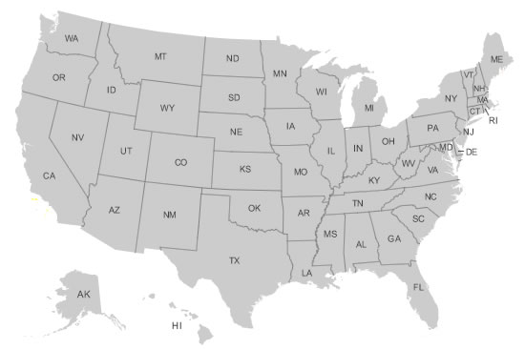
Established Affiliate Sites
Children's Hospital of Wisconsin (National Office)
U.C. Davis Children’s Hospital
Children’s Healthcare of Atlanta
Florida Hospital for Children
Children’s Hospital of Philadelphia
Cook Children’s Medical Center
Texas Children’s Hospital
Children’s of Alabama
East Tennessee Children’s Hospital
Monroe Carell Jr. Children’s Hospital at Vanderbilt
Sacred Heart Children’s Hospital
C.S. Mott Children’s Hospital
Children’s Hospital Colorado
Nationwide Children’s Hospital
Cincinnati Children’s
Arkansas Children’s
Interested Affiliate Sites {notated in blue)
Notes:
Today, Project ADAM is part of 16 healthcare organizations united in a mission to save lives now from sudden cardiac death.

Slide 6

What is SCA - Sudden Cardiac Arrest?
Sudden Cardiac Arrest (SCA) is a condition in which the heart suddenly and unexpectedly stops beating. If this happens, blood stops flowing to the brain and other vital organs.
SCA is an electrical issue, versus a heart attack, which is a “plumbing issue”.
This Photo by Unknown Author is licensed under CC BY-ND

Slide 7
How Does SCA Risk Impact My School?
On any given day, approximately 20 percent of the community is in its schools
Annual Out-of-Hospital Cardiac Arrest: More than 350,000
Survivor rate (overall): 12%
Bystander CPR (overall): 46.1%
Average EMS response time is 8-10 minutes… the brain can only wait 3-5 minutes before brain damage sets in
Every minute defibrillation is delayed, chance of survival decreases 10%

Slide 8

SCA and Athletics
California Interscholastic Federation
One youth athlete dies every 3 days in the United States
SCA is the leading cause of death among student athletes
SCA is the leading cause of death on school campuses
This Photo by Unknown Author is licensed under CC BY
Notes:
Schools not only serve as academic institutions but also as community venues for athletics, performances, concerts, meetings and events.

Slide 9
A Two Year Study….
CPR & AED use in >2,000 schools over a 2-year period revealed:
59 cases of SCA confirmed during study period
1 cardiac arrest per 36 schools
Athletic events were sites for 66% of cases
SCA occurred in a student in 44% and adults in 56%
AED was applied in 85% of cases with a shock delivered in 66% of cases
71% survived to hospital discharge
Drezner 2013 Outcomes from sudden cardiac arrest in US high schools:
a 2-year prospective study from the National Registry for AED Use in Sports

Slide 10
Other Findings…
Most frequent responders were administrative staff, trainers/coaches, visitors, school nurses, and teachers
Survival rates improved by:
School AED (80%) vs EMS AED (50%)
School with emergency action plan (79%) vs schools without plan (44%)

Slide 11
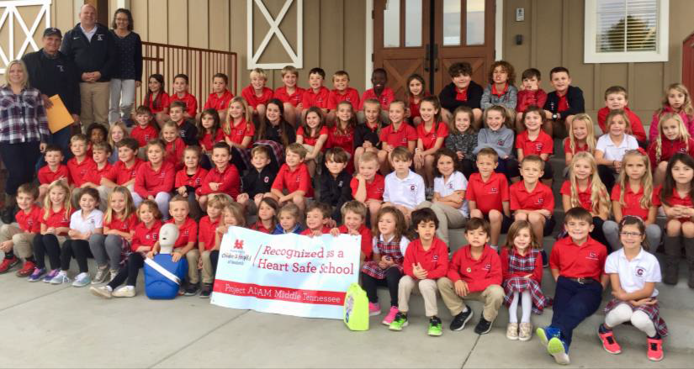
Since Project ADAM was founded in 1999, more than 130 lives have been saved in schools across the country

Slide 12
What is a Heart Safe School?
AEDs are available and accessible.
There is a written emergency response plan and a team of CPR/AED trained staff ready to act in an emergency.
The school conducts regular cardiac emergency response practice drills.

Slide 13
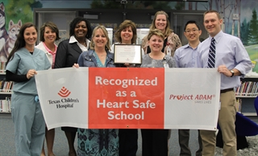
Heart Safe School Designation
Achieving Project ADAM’s Heart Safe School designation means that your school is prepared to appropriately respond to sudden cardiac arrest on campus, thereby increasing potential to save the life of a student, a staff member or visitor.

Slide 14
How to Become a Heart Safe School
Reach out to Rebecca McCormac at rmccormac@ucdavis.edu to find out how Project ADAM Sacramento can support you and visit www.projectadam.com for templates
Review and Complete the steps in the Heart Safe Checklist
Return the checklist to Project ADAM Sacramento

Slide 15
Heart Safe Schools Receive:
Recognition from UC Davis Children’s Hospital for the staff’s lifesaving efforts, by way of a framed Heart Safe School certificate and listing on the UC Davis Children’s Hospital website. Schools can also promote the Heart Safe School logo on official websites and social media sites.
A letter from UC Davis Children’s Hospital recognizing the school for its life saving efforts, for distribution to the district superintendent, students and families.
Contribution to statewide and national research on prevention of sudden cardiac death.

Slide 16
Get the Word Out!
Being prepared for a sudden cardiac emergency is an amazing accomplishment that should be shared with your community. Use our resources to do the following:
Send a press release about your school being Heart Safe
Send a letter to your students and families notifying them of your CPR/AED program and Heart Safe recognition
Invite local media outlets to cover one of the cardiac emergency drills with your staff, to demonstrate how you practice your response and ensure everyone knows where the AED is located on your campus.

Slide 17

California Assembly Bill 1719
Commencing the 2018-2019 school year, if a school district or charter requires a course in health education for graduation from high school, the district or charter shall include instruction in performing compression-only cardiopulmonary resuscitation (CPR).
Information on the use and importance of an automated external defibrillator (AED) is also recommended for inclusion.
Any individual or organization that supports or supervises the instruction of pupils, in compression-only CPR or the use of an AED pursuant to the bill, shall not be liable for any civil damages, providing there is no gross negligence or intentional misconduct.
AB 1719 encourages implementation of its mandates via the most cost-effective means possible.
Notes:
So what is the significance of Project ADAM, Sacramento, to the community?
This enables schools to teach without fear of liability.
This mandate is unfunded
UC Davis’ Project ADAM collaborated with UC Davis School of Medicine to create a CPR and AED training manual, as an inexpensive method of disseminating national evidence-based CPR and AED education to California schools. The manual follows a train-the-trainer model, in which the body of the curriculum is comprehensive and intended for facilitators who will use the manual as a resource when teaching CPR and AED to school staff and student groups. Simplified, age-appropriate outlines, as well as other teaching resources, are included in the manual.

Slide 18
California Assembly Bill 2009
Amendment to the California Education Code and requires school district’s and charter schools electing to offer any interscholastic athletic program to: Adopt an emergency action plan including sudden cardiac arrest response, acquire at least one AED per school with placement being from 3 - 5 minutes of a sudden cardiac arrest emergency, have AEDs available for trainers and coaches at athletic events and campus activities, properly maintain and inspect school AEDs.
Notes:
So what is the significance of Project ADAM, Sacramento, to the community?
This enables schools to teach without fear of liability.
This mandate is unfunded
UC Davis’ Project ADAM collaborated with UC Davis School of Medicine to create a CPR and AED training manual, as an inexpensive method of disseminating national evidence-based CPR and AED education to California schools. The manual follows a train-the-trainer model, in which the body of the curriculum is comprehensive and intended for facilitators who will use the manual as a resource when teaching CPR and AED to school staff and student groups. Simplified, age-appropriate outlines, as well as other teaching resources, are included in the manual.

Slide 19

California Assembly Bill 1639
CA State Department of Education must post on its Internet Web site guidelines, videos, and an information sheet on sudden cardiac arrest symptoms and warning signs, and other relevant materials relating to sudden cardiac arrest
In California public and private schools, pupils who elect to conduct athletic activities, and the pupil’s parent or guardian, must sign and return an acknowledgment of receipt of information on sudden cardiac arrest symptoms and warning signs. This must occur each school year before the pupil participates in an athletic activity.
School athletic directors, athletic trainers, coaches or authorized person, as defined, must remove from participation a pupil who passes out or faints while participating in or immediately following an athletic activity.
The coach of an athletic activity is required to complete a sudden cardiac arrest training course every other school year. Commencing July 1, 2019, penalties will be imposed for coaches who fail to complete a sudden cardiac arrest training course, as specified.
Notes:
So what is the significance of Project ADAM, Sacramento, to the community?
This enables schools to teach without fear of liability.
This mandate is unfunded
UC Davis’ Project ADAM collaborated with UC Davis School of Medicine to create a CPR and AED training manual, as an inexpensive method of disseminating national evidence-based CPR and AED education to California schools. The manual follows a train-the-trainer model, in which the body of the curriculum is comprehensive and intended for facilitators who will use the manual as a resource when teaching CPR and AED to school staff and student groups. Simplified, age-appropriate outlines, as well as other teaching resources, are included in the manual.

Slide 20
Resources and Templates Available
Visit www.projectadam.com:
CERP templates
Drills
Letter templates
Training Logs
AED Maintenance Logs
ETC…..

Slide 21
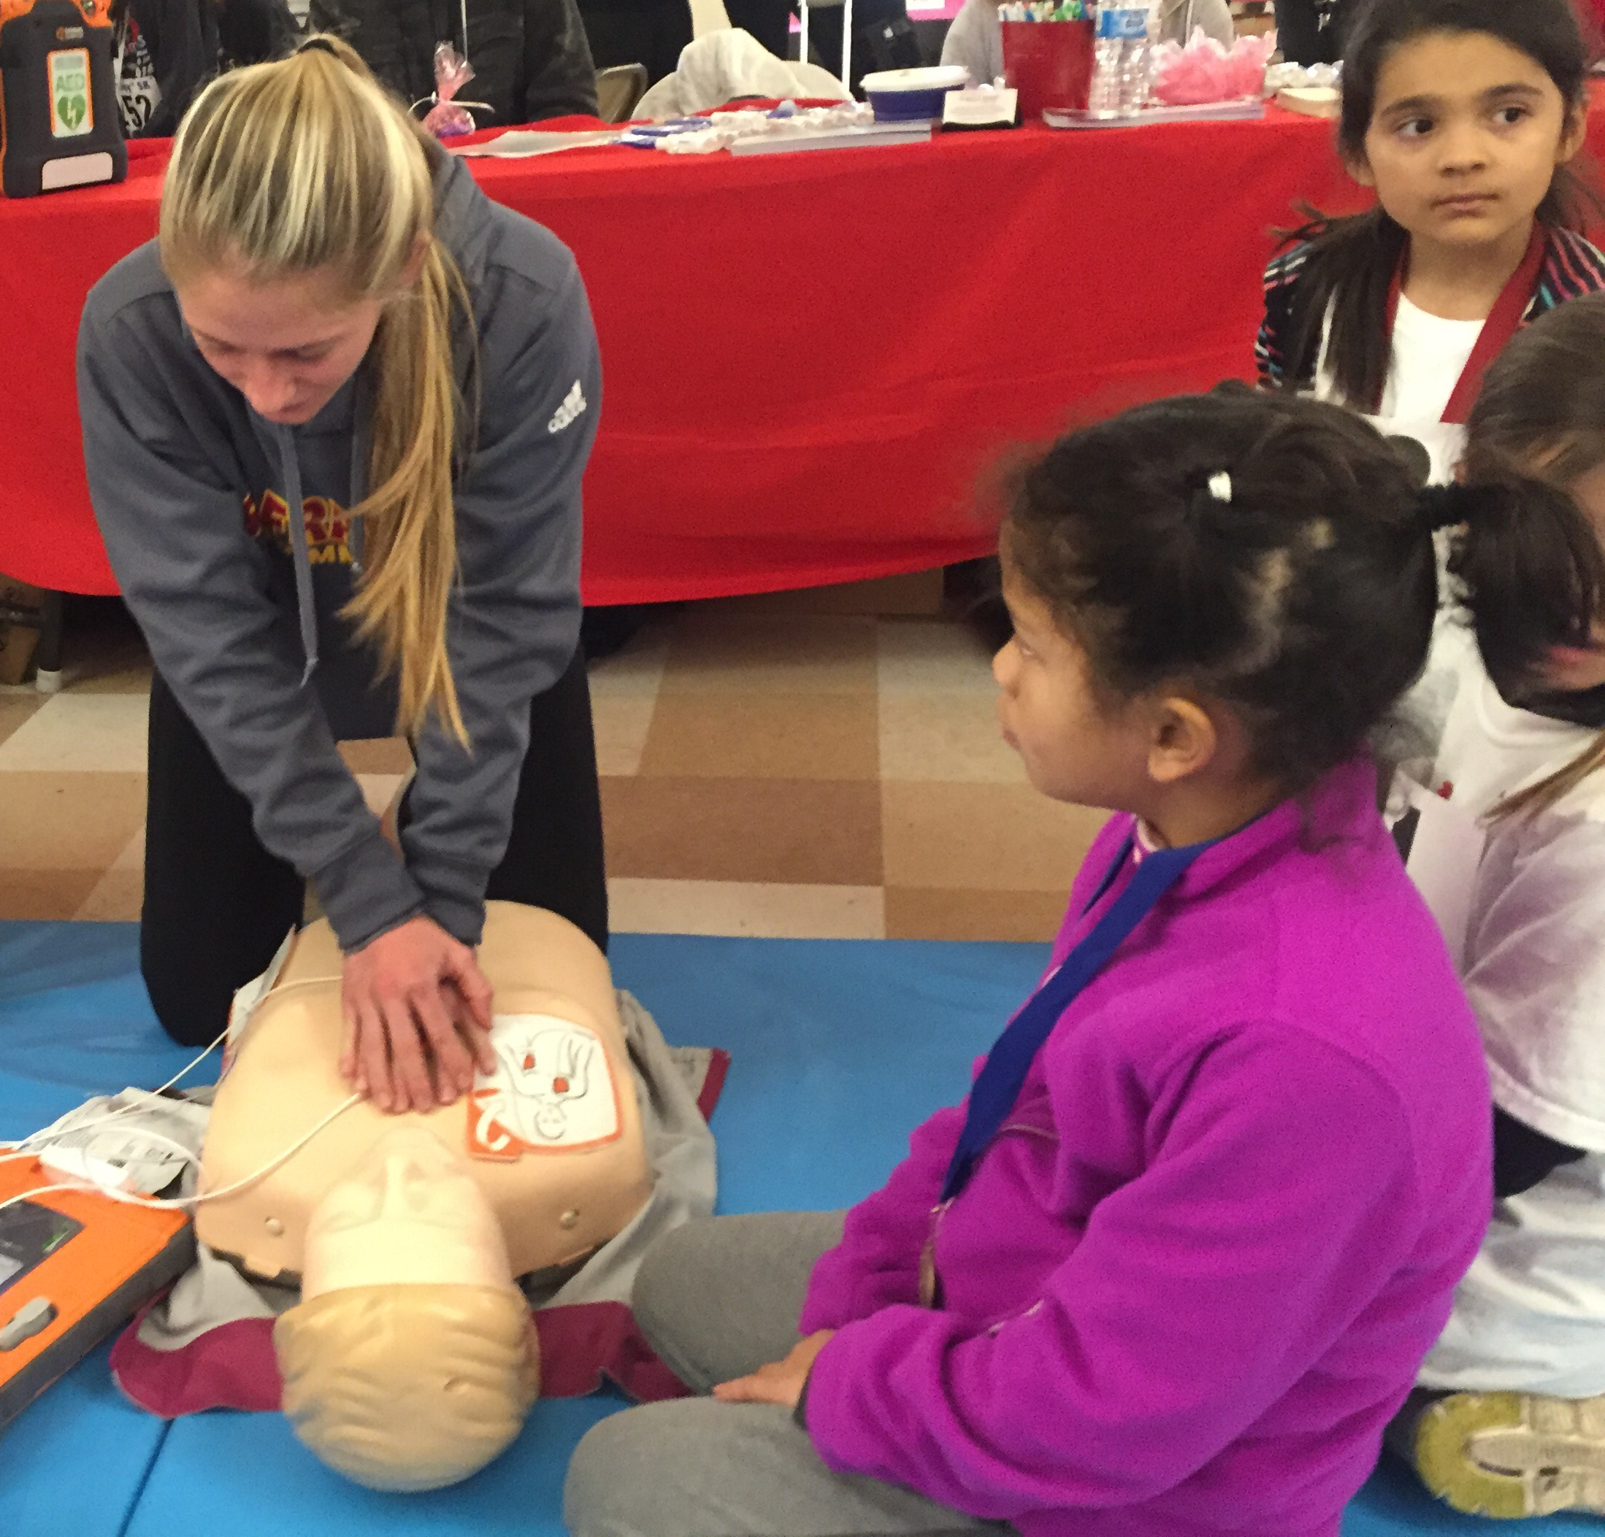
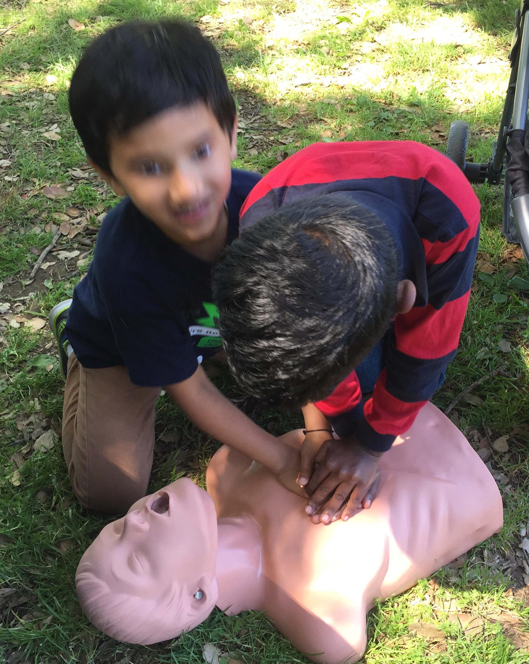
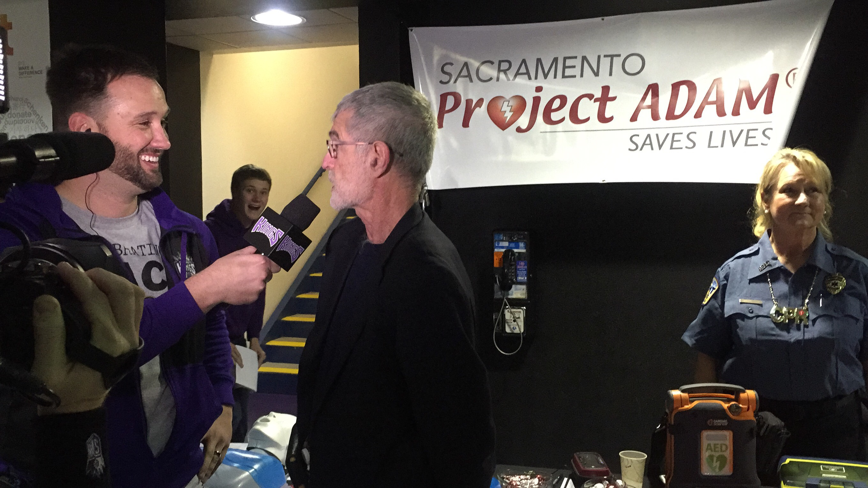
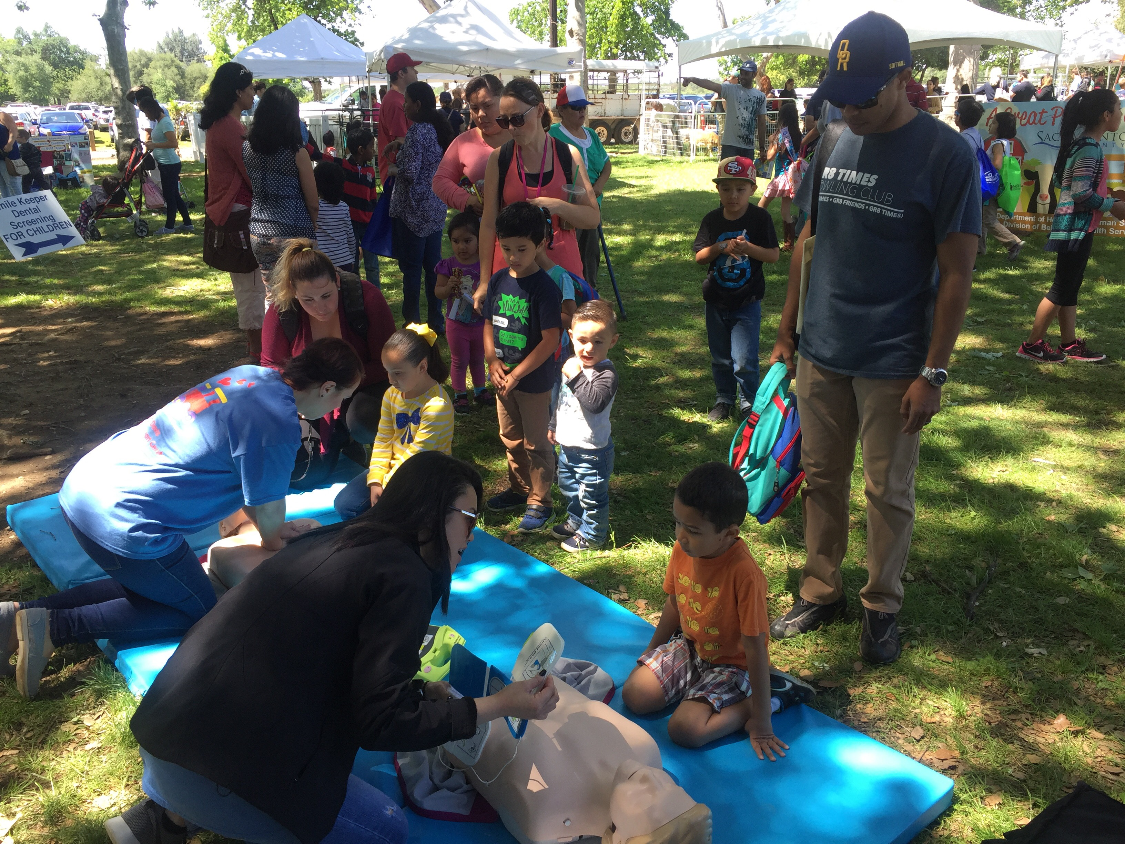
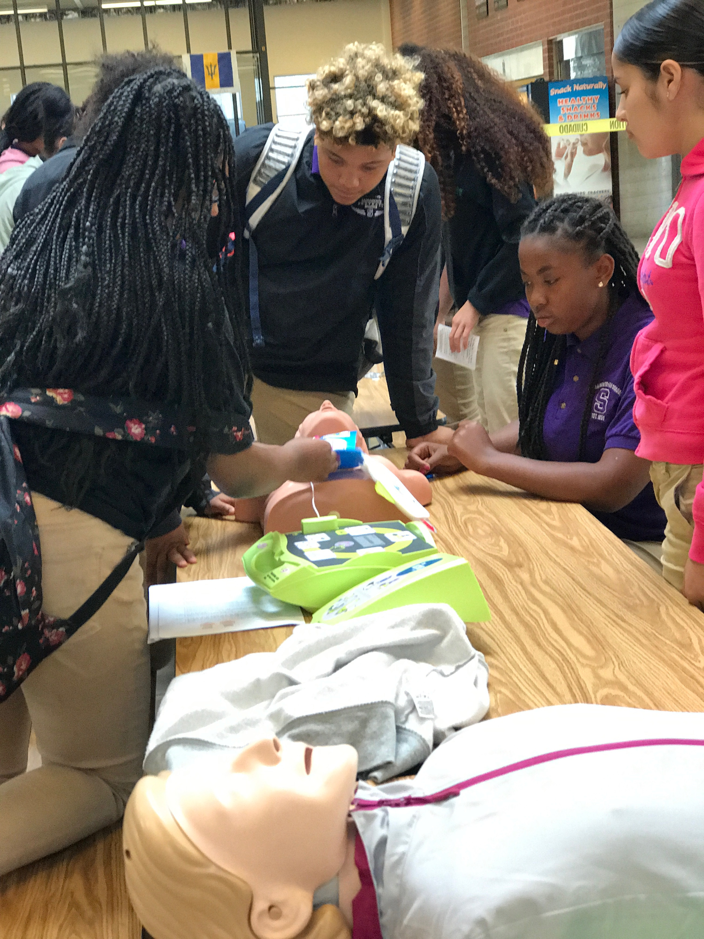
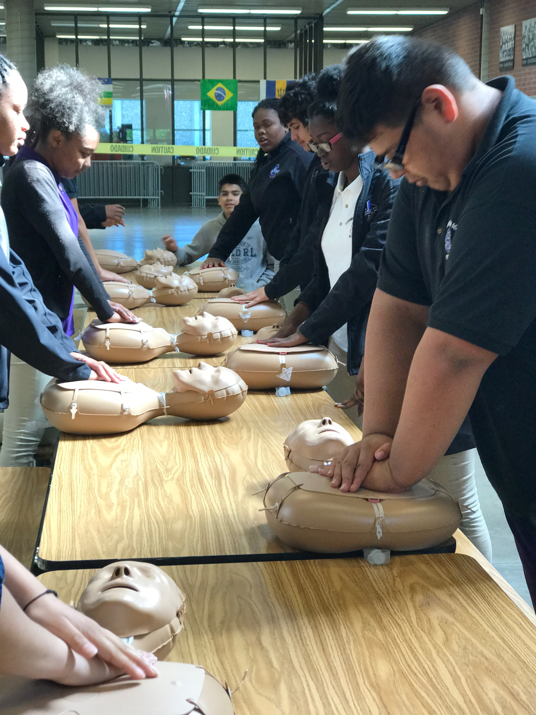

Slide 22

Thank You

