Slide 1
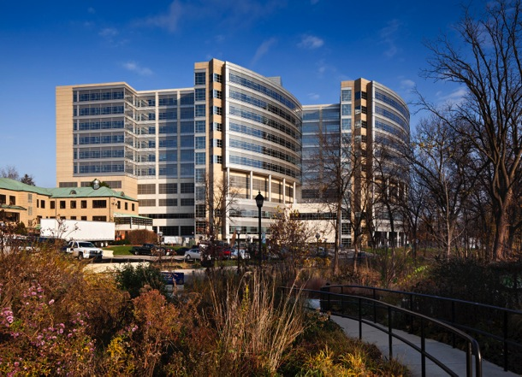
Heart Safe Schools: CPR, AEDS, CERPS Project ADAM
Gwen Fosse MSA BSN RN
Clinical Outreach Specialist, Project ADAM Michigan Coordinator
gfosse@med.umich.edu

Slide 2
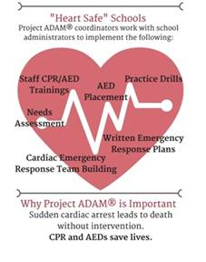
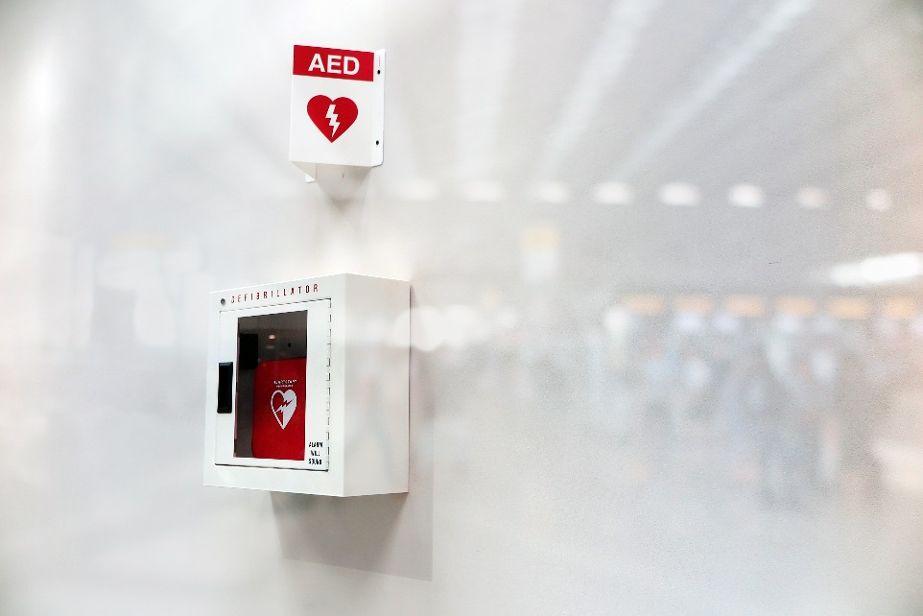


Slide 3
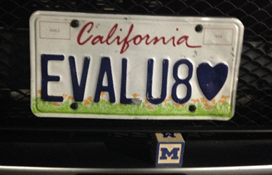
http://www.localheart.org/idc/groups/heart-public/@wcm/@cmc/documents/downloadable/ucm_465190.pdf Accessed 4/3/15

Slide 4
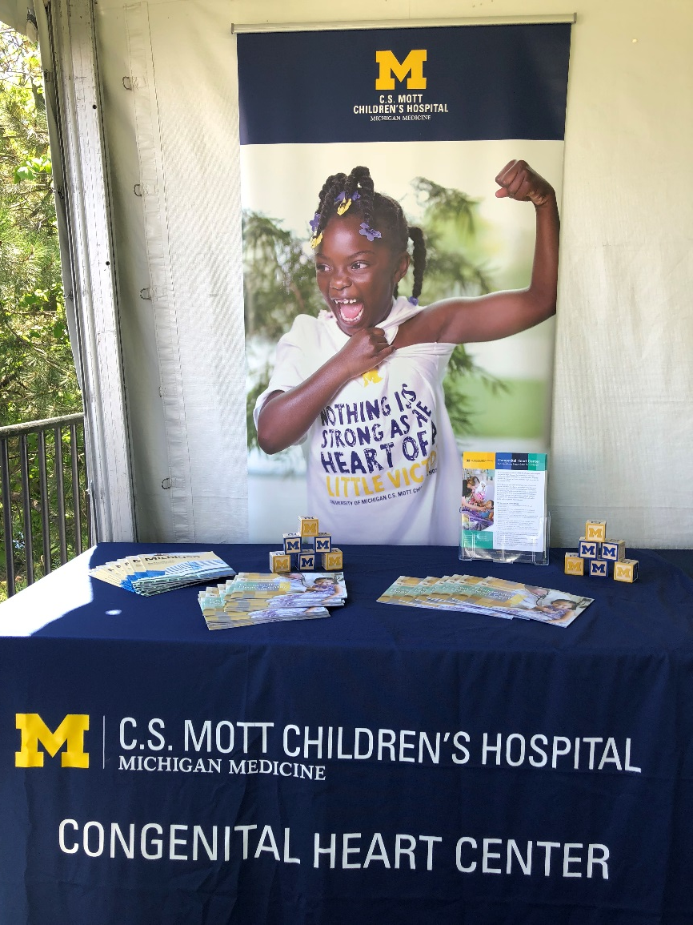
Thanks to……
Project ADAM National and Affiliate Coordinators
  Project ADAM MI - Monica Goble MD
C. S. Mott Children’s Hospital –University of Michigan Congenital Heart Center – Sudden Cardiac Death in Young (SCDY) Prevention Committee
Mi Dept. of Health & Human Services – Michigan Alliance for Prevention SCDY
3

Slide 5
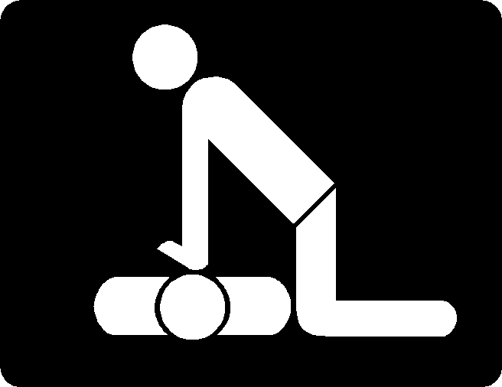
Objectives
List conditions that create risk for sudden cardiac arrest (SCA)
Define primary and secondary prevention for sudden cardiac death (SCD) in the young.
Describe collaboration of Project ADAM and Michigan’s strategies
Raise awareness about the opportunity for collaboration between hospitals, professionals, and schools/communities to implement strategies to respond to SCA
Outline elements of prevention of SCD in school settings

Slide 6
Background Information
Sudden cardiac arrest (SCA), often resulting from disruption in the heart’s electrical system (usually from ventricular fibrillation), occurs in approximately 360,000 people/year in community settings. (Mozaffarian et al., 2015)
Individuals of all ages may have conditions that create risk for SCA which can result in neurological impairment or death.
While the survival rate of SCA is low, studies show that a prompt response with bystander Cardio-pulmonary Resuscitation (CPR) and Automatic External Defibrillator (AED) availability could double or triple survival rates. (Institute of Medicine,2015). Trained teams in schools can save lives.
State laws vary – some require AEDs but not CERPs, CPR, etc.

Slide 7
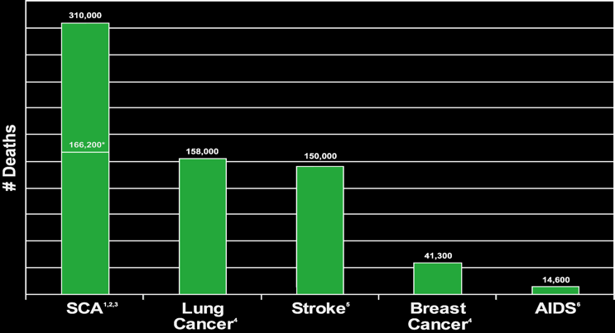
Number of Deaths in the US
¹ Vital Statistics of the U.S., Data Warehouse, National Center for Health Statistics.; ² Chugh SS, et al. J Am Coll Cardiol. 2004;44:1268-1275; ³ Nichol G, et al. JAMA. 2008;300:1423-1431.; ⁴ Department of Health and Human Services. Centers for Disease Control and Prevention: ⁵ Avert Organization: www.avert.org; ⁶ 2008 Heart and Stroke Statistics Update. American Heart Association.

Slide 8
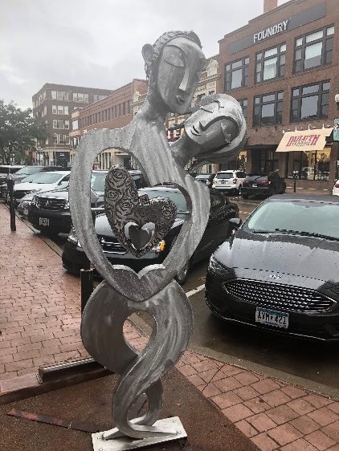
Causes of sudden cardiac death
Structural / Functional Abnormalities – PUMPING & RHYTHM
  Coronary artery disease (most common overall)
  Myocardial Infarction, hypertrophic cardiomyopathy, coronary artery anomalies, myocarditis, dilated cardiomyopathy, congenital heart defect (pre/post-op), Marfan’s syndrome
Electrical Abnormalities - RHYTHM
  Long QT syndrome, Wolff-Parkinson-White, catecholaminergic polymorphic ventricular tachycardia, arrhythmogenic RV dysplasia, Brugada syndrome, heart block, Short QT syndrome
Miscellaneous
  Drugs, Stimulants, Pulmonary HTN, Commotio cordis

Slide 9
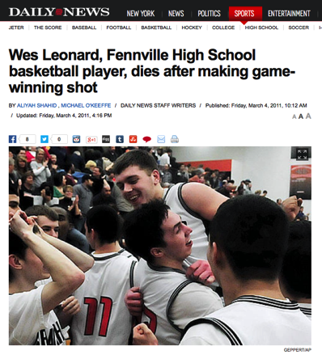

When it all goes wrong –
What can happen without adequate planning and preparation
New York Daily News
Sports Illustrated
ESPN
ABC national TV news
https://vimeo.com/133198608
2:10-3:17
Notes:
Long video that requires internet connection – I usually just show from about 2:10 to 3:17 stop with Gary Leonard statement – can control by scrolling at the bottom of the video

Slide 10
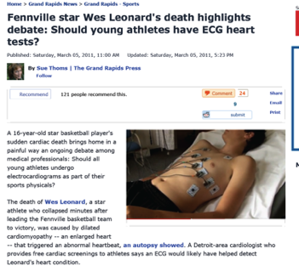
Prevention – Lessons from Wes
On 3/3/2011, 16 year old Wes Leonard collapsed minutes after making the winning shot in a state HS basketball playoff game in overtime. He suffered SCA
Lessons in prevention
Primary - ? Screening
  learn the cause of death (molecular autopsy, address the family for primary prevention)
Secondary – lack of CPR and defibrillation – assess and change

Slide 11
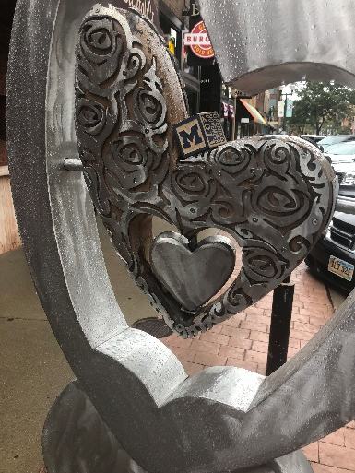
Primary Prevention – Prevent the arrest
Ideal screening does not yet exist
Detection of a risk diagnosis is fantastic and compelling!!! but not uniformly achievable- remains controversial, false negatives, misinterpreted reassurance…….inadequate manpower
“Universally accepted” - Regular PCP visits for all children with the recommended cardiac evaluation – family and patient history, physical exam – further work up if indicated. ***BUT it does NOT catch all
AHA, ACC, and others have not endorsed general EKG or echo screening - insufficient supportive evidence of a uniform, reliable method. Circulation 2014 Maron B et al.
  Data are not conclusive about effectiveness of interventions to prevent SCA– Activity restrictions may not be followed and/or do not guarantee prevention of an event
29

Slide 12



Secondary Prevention – prevent the death from the arrest
Emergency Preparedness: Controversy FREE!
Chain of survival
  Community Education and Advocacy:
  MDHHS Michigan Alliance for Prevention of SCDY & U of M SCDY Prevention Committee with many organizations, family foundations and other health institutions
Cardiac Emergency Response Plan and Team, CPR/AED Certification, AEDs, Cardiac Emergency Response Drills, and Athletic Pre-participation Screening with MHSAA form

Slide 13
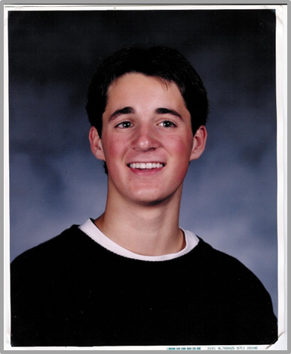
Project ADAM – *In memory of Adam Lemel with Children’s Hospital of Wisconsin –
Automated Defibrillators in Adam’s Memory
Wisconsin1999: Adam had SCA playing basketball
His parents and physician initiated this program
Support schools in being prepared for SCA
  Through staff/student CPR and AED training
  SCA awareness education for students, staff, families
    school, athletics & other
  Cardiac emergency drills
  Fundraising ideas, advocacy, education, and support
National affiliates – a network of experience - Helps schools in Wisconsin and other states implement programs
Facebook page, E-Newsletter
Making a Differencehttps://chw.wistia.com/medias/5m5o0qylyo 4:35
http://www.chw.org/childrens-and-the-community/resources-for-schools/cardiac-arrest-project-adam/ (Mr. Lemel at 1 minute)

Slide 14

Project ADAM – Automated Defibrillators in Adam’s Memory
Mission:
Project ADAM saves lives by empowering schools and communities to be prepared for a sudden cardiac arrest.
Vision: Eradicate sudden cardiac death through school and community prevention.
http://www.projectadam.com/ProjectADAM and www.mottchildren.org/projectadam
Congenital Heart Center

Slide 15
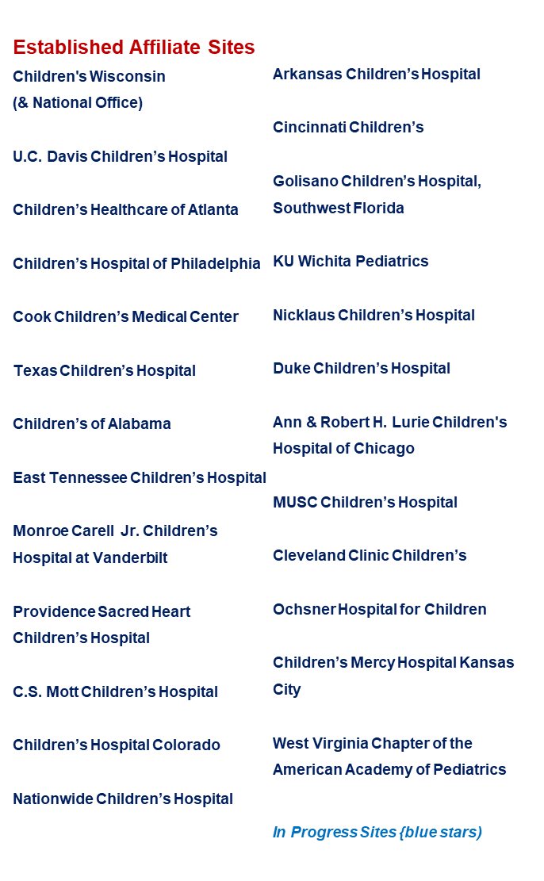
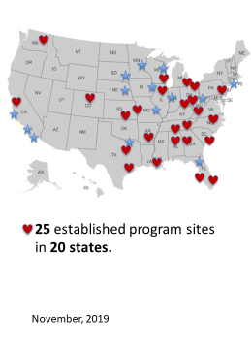
Notes:
Continually need to update

Slide 16


























Notes:
Continually need to update

Slide 17
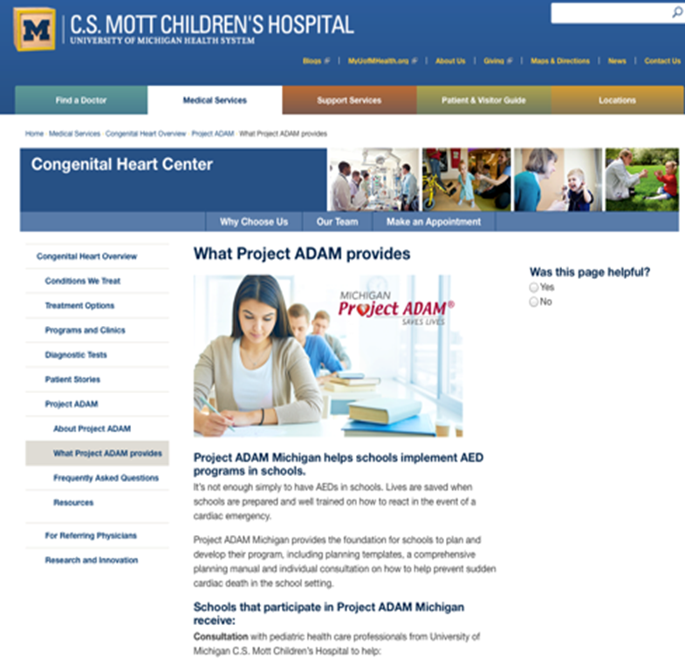
Project ADAM Michigan
‘Our Work’
Collaborative state effort –
  DHHS Michigan Alliance for Prevention of SCDY & U of M SCDY Prevention Committee with many others
Advocacy – legislation
Education- lay and professional (medical examiners)
Affiliate networking
  Collective national work
Communication – email updates
Connecting resources
www.mottchildren.ort/projectadam

Slide 18
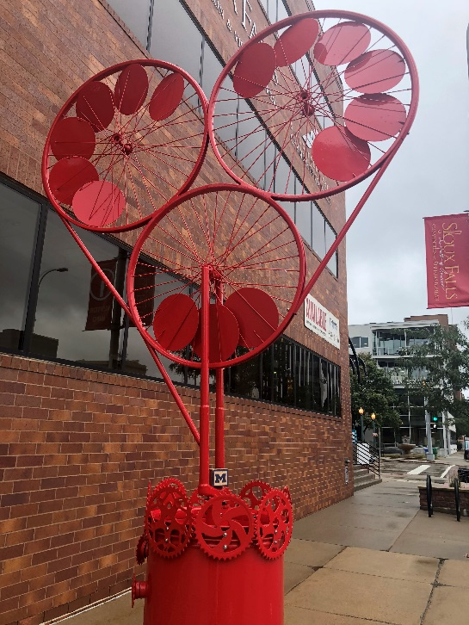
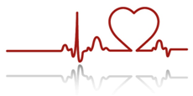
Engage Schools - administrator, nurse, coach….
Contact person in the school is essential
Do your teachers, coaches (team captains), EMS, community members, etc. know the plan?
DO THEY KNOW….
What to do if a student or anyone collapses?
What does a sudden cardiac event looks like?
Where the AED is and what it’s for?
  Use it as a monitor – it will tell you if its needed
How to do Hands Only CPR?
The venue’s address?
  Planned and Practiced Response

Slide 19
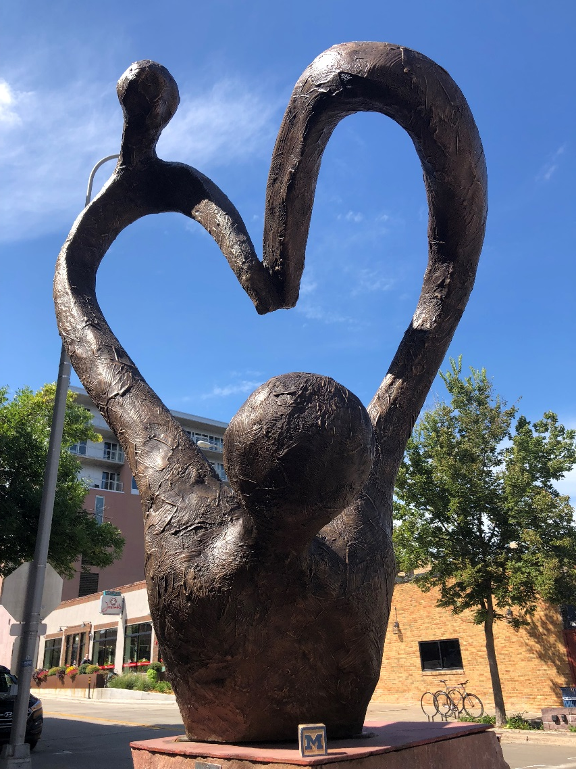
Two initial questions from Jocelyn Leonard for school teams, students, or anyone who could be a responder…..
Can you kill someone by doing CPR?
Can you kill someone with an AED?
Can you kill someone by standing by instead of being a bystander responder????????

Slide 20
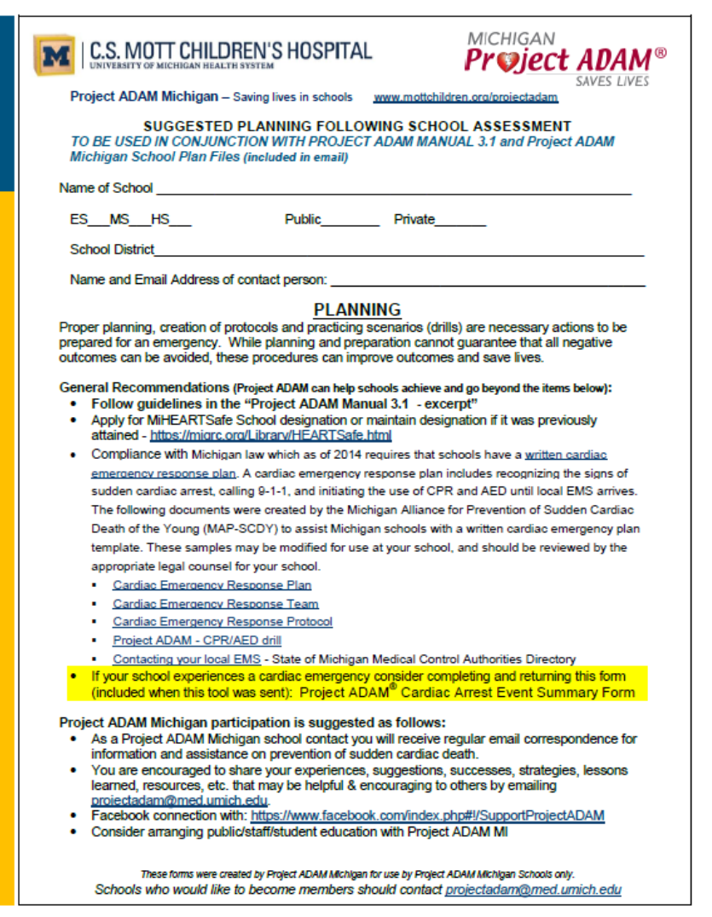
Project ADAM MI – email projectadam@med.umich.edu
Suggested Planning Guide for Schools
ASSESS Current State
Guide: TO BE USED IN CONJUNCTION WITH PROJECT ADAM tools
Name of School, details, contacts
Planning – CERP, Team
CPR, AEDs
Drills, reports – debriefing
Athletes
Education/Communication

Slide 21


Recognition
Unconscious + Unresponsive + Pulseless
(caveats: seizure activity, gasping/agonal breathing, drifting in & out of consciousness may precede arrest)!
And - ARREST VS. ATTACK

Slide 22
MI HEARTSafe School Award Program – Minimum Criteria migrc.org/miheartsafe
A written cardiac emergency response plan.
A cardiac emergency response team with current CPR/AED certification to respond to emergencies during school and after school hours if applicable.
At least 10% of staff, 50% of coaches including 100% of head coaches, and 50% of P.E. staff with current CPR/AED certification.
A sufficient number of accessible, properly maintained and inspected AEDs, ready to use, with signs identifying AED locations to allow response within 2-5 minutes.
The performance of at least one cardiac emergency response drill per year. Collaboration with local Emergency Medical Services is encouraged.
All athletic pre-participation screening completed with the standard Michigan High School Athletic Association form

Slide 23



Outline
Intro
Barriers to school SCA preparedness
Developing a CERT / Activation of CERT
AEDs / Training / Drills
EMS integration
Ongoing and annual review
Legal considerations
Special considerations
School-sponsored and shared-use agreements
AHA public policy recs/summary
61

Slide 24
Project ADAM MI Guide - AEDs
Learn about AED vendors and resources in your state
Follow recommendation from Project ADAM for placement & maintenance of AEDs
  School’s response team must assess placement of the AED(s) to assure accessibility from any part of the building/campus within 2-3 minutes
Consider placement of AEDs for sports and other extracurricular activities
  Consider having loaners to travel with groups for athletic or other events if destination does not have an AED onsite
If additional AEDs are recommended assistance may be available from - sources are provided
47

Slide 25
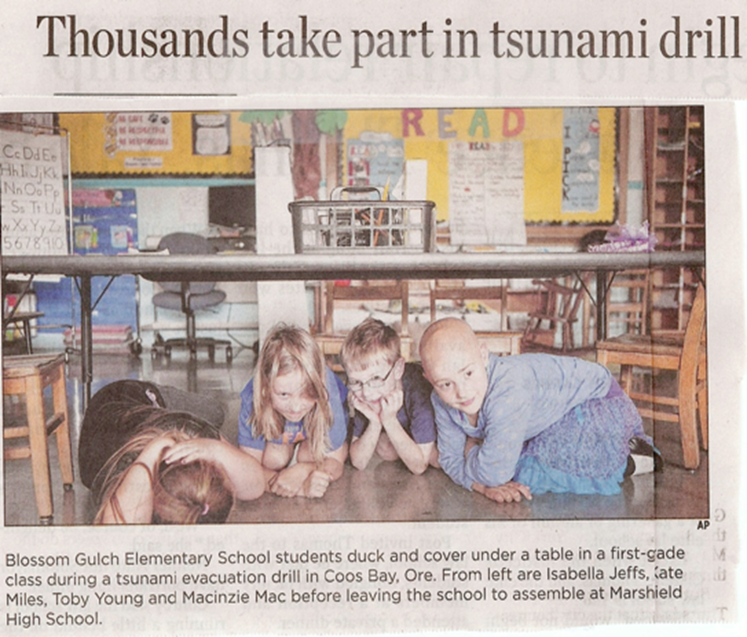
Emergency School Drills
All Michigan schools have state mandated:
  Fire drills (6)
    Last death in MI in school fire 1927 – school board treasurer purposely detonated an explosion in Bath Consolidated Schools before committing suicide - Peters, Justin (December 18, 2012). ""We Still Look at Ourselves as Survivors": More Than Eighty Years Later, Remembering the Deadliest School Massacre in American History". Slate. The Slate Group. Retrieved Dec. 22, 2012.
  Tornado drills (2)
  Lockdown drills (2)
How about a Sudden Cardiac Arrest drill(s)?
  Confirm defibrillator location
  Team exercise – coordinate with EMS
  Review use of AED
  Practice scenarios with staff and students
  Assess and debrief

Slide 26
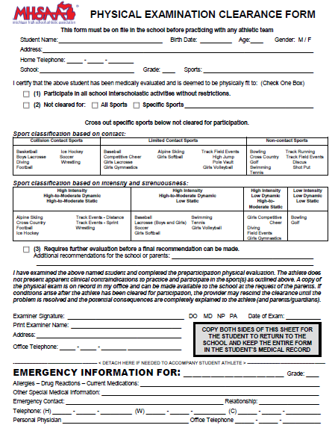
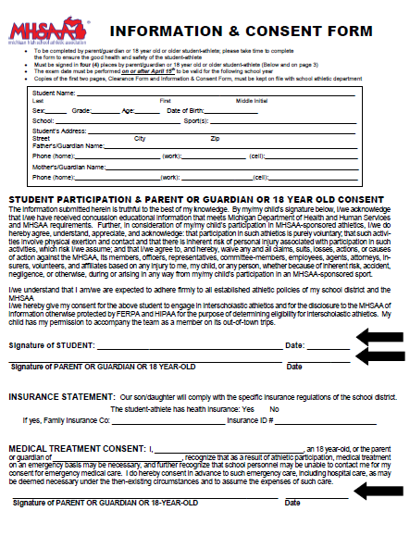
Yearly exam by PCP for all children – all kids count!
  Address all systems, counseling (drugs, behaviors, etc.) – risk factors for more common causes of sudden death
  Include 12 cardiac questions for all kid

Slide 27
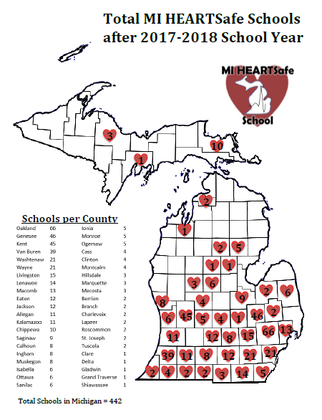
Oct. 2018
Notes:
Not updated from the last year – we now have 490 schools currently designated – clearly rural areas are not as well represented ☺

Slide 28

Everybody like awards……
Notes:
Student successfully resuscitated in Branch County (HCM)

Slide 29
SCA Preparedness in MI (Project ADAM)
Prevention of Sudden Cardiac Death – Partnering with Project ADAM for Heart Safe Schools
Authors: Gwen Fosse RN BSN MSA¹, Monica Martin Goble MD¹, Debra Duquette CGC², Sravani Avula MD³, Allison Thompson BS⁴, Stuart Berger MD⁵
C.S. Mott Children’s Hospital Congenital Heart Center, Ann Arbor, MI¹, Michigan Department of Health & Human Services², Children's Hospital of New Orleans/LSUHSC , New Orleans, LA ³, Children’s Hospital of Wisconsin, Milwaukee, WI⁴, Ann & Robert Lurie Children’s Hospital , Chicago, IL⁵
Sudden cardiac arrest preparedness in Michigan: Partnering with Project ADAM to develop a HEARTSafe Schools state model
Progress in Pediatric Cardiology
Volume 45, June 2017, Pages 43-48
Monica Goble | Sravani Avula | Debra Duquette | Randy Gillary | Gwen Fosse | Robert A. Swor | Mike Bowers | Mark Russell | Nancy Cutler

Slide 30
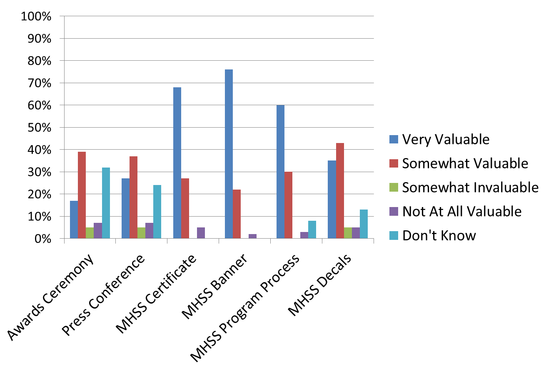
MI HEARTSafe School Responses

Slide 31
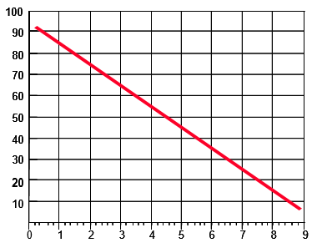
Urgency of Treatment – SCA Survival
Resuscitation Success vs. Time
Chance of survival reduced 7-10% for every minute delay
% Survival Rate
Delay in Defibrillation (minutes)
Cummins RO, 1998. Annals of Emergency Medicine 18: 1269-1275.
11

Slide 32
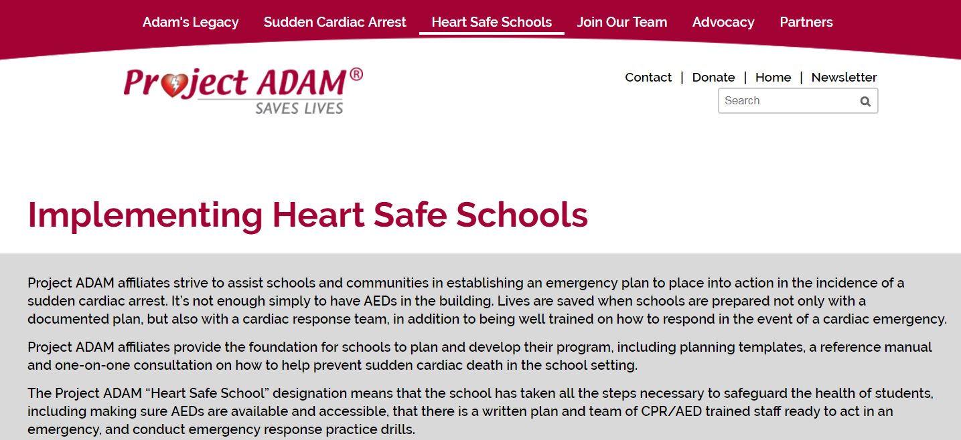
Project ADAM – National Web Site
Heart Safe Schools
https://www.projectadam.com/Heartsafeschools

Slide 33
Project ADAM – Need to tailor for state/area/organization
54 different state laws address either CPR, AEDs or CERPs in schools.
15 states and the DC have no laws related to CPR, AEDs, or CERPs.
CPR:
6 states require CPR training for all teachers,
In 3 states it is only required for PE teachers and coaches. (Apart from laws, many schools require PE teachers and coaches to be certified.)
Some specify that CPR training must include test demonstration on a mannequin, meaning that on-line course certifications are not accepted. In states requiring it for all teachers, it may be a requirement for teacher certification and recertification.
AEDs:
17 states require (4 states urge) schools to have an AED
CERPs:
4 states require a CERP, while 1 state encourages a CERP. Michigan is one of the 4 but implementation is not well addressed.
    In 2 states only athletic departments must have a CERP.
    Source: Education Commission of the States. State Legislation: By State. Retrieved from http://www.ecs.org/state-legislation-by-state/. Accessed on August 25, 2015.
55
Notes:
This is probably outdated but there is an interactive map on the P ADAM web site

Slide 34
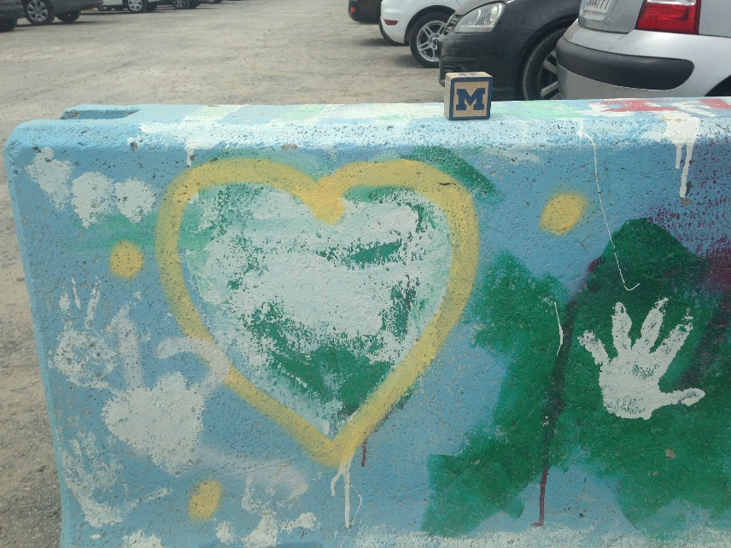
Preparedness in Schools – Michigan Legislation - Advocacy
Michigan HB 4317 - Effective July 1, 2014, all Michigan schools (K-12) will have a cardiac emergency response plan to address:
Maintenance of AEDs
Cardiac emergency response team and its activation
Communication throughout school campus
For high schools (9-12): a training plan
Local EMS integration
Passed in Dec. 2016 – CPR education for students

Slide 35
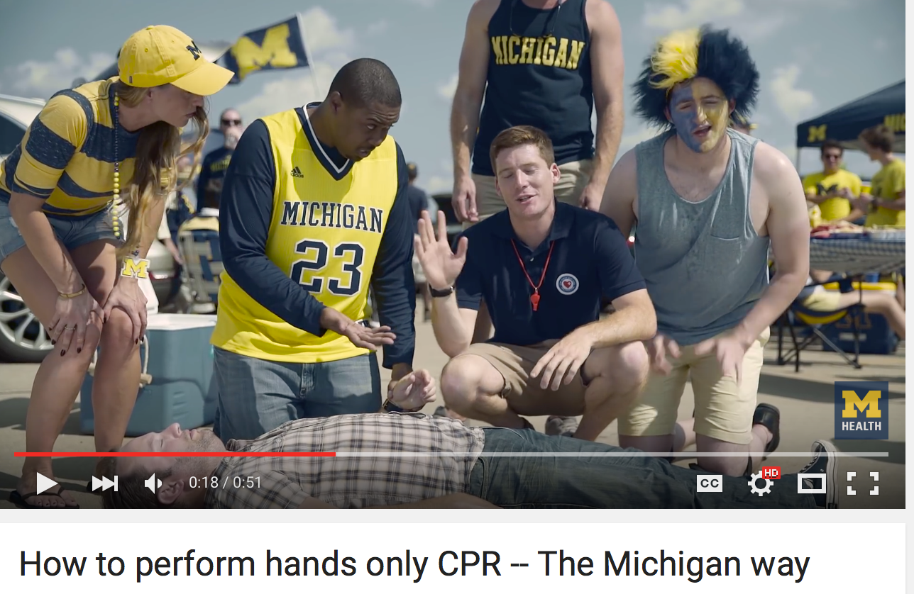
CPR Education - Hands Only CPR:
http://heart.arizona.edu/learn-cpr
www.heartrescuenow.com
www.heart.org/handsonlycpr (AHA 2012)
The Michigan Way - https://www.youtube.com/watch?v=QLyxKFSwX5M

Slide 36
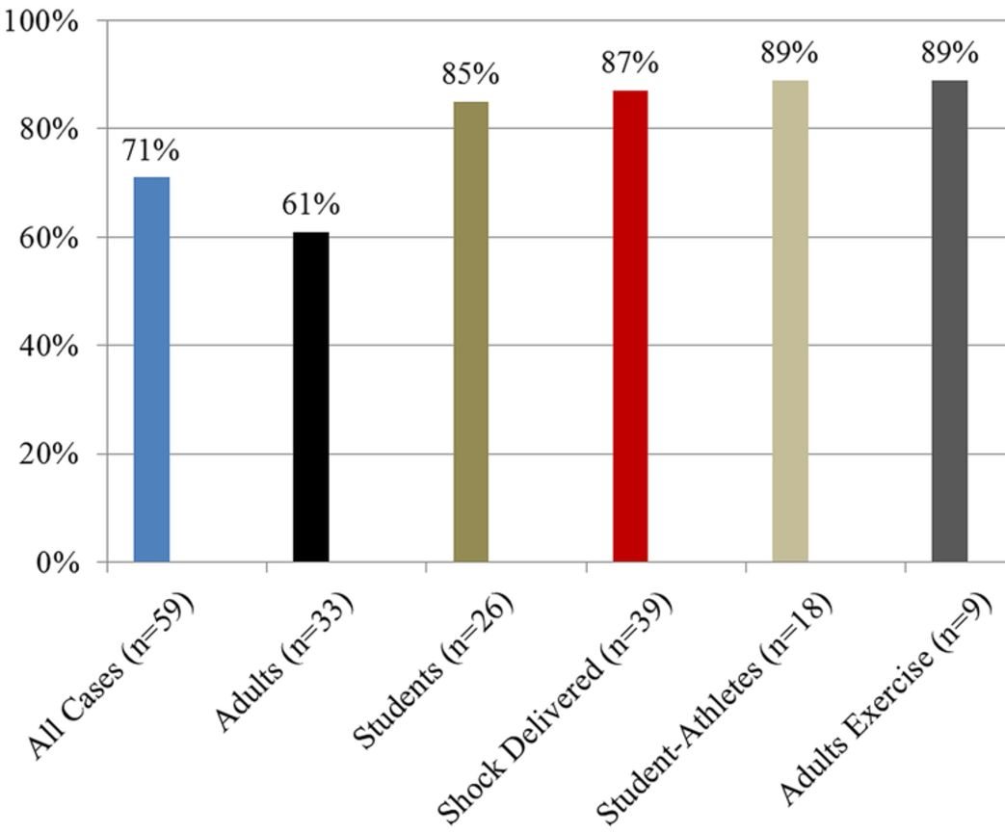
AEDs in schools save lives
2149 US high schools, prospective observational study of SCA
School- based AEDs programs in 87%
80% survival to hospital d/c if AED supplied by school vs 50% if brought by EMS (OR 4.0)
79% survival with Emergency Action Plan vs 44% without (OR 4.6)
Survival to hospital discharge
Drezner J A et al. Br J Sports Med Oct. 2013;0:1-6

Slide 37
Claire – Project Save – When it all goes right
https://www.youtube.com/watch?v=yg3Ry_DzJgI (5 min – EMS)
https://www.youtube.com/watch?v=r9blaWHHSls (2:32)**(1-1:51)
Notes:
You can view these links and see what part you may want to show

Slide 38
Conclusions:
Regardless of superb screening, there is no magic to always prevent SCA – proper response is key
Survival depends on CPR, AEDs, EMS, advanced life support and care, and planning. The lack of anyone of these decreases the opportunity for survival
AEDs require a management plan and must be kept accessible.
  They are suitable for children. Ideally child adaptations are used for those under 8 years of age and less.
SCA in a sporting event is more likely to be witnessed with the opportunity for response if preparation has occurred. That should not be confused to make one think that most arrests occur at a sporting event. Link et al Circ 2015

Slide 39
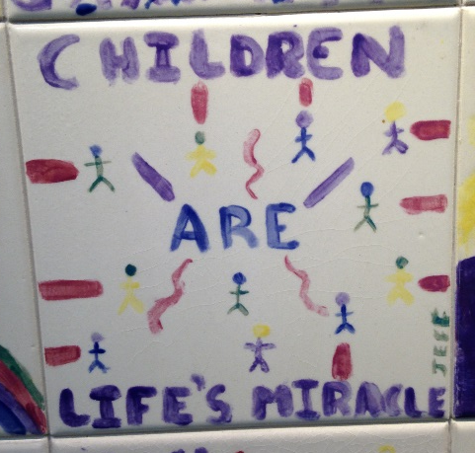
Conclusions:
Sudden, unexpected death is always a tragedy. Professionals and hospitals are in a position to benefit from contributing to this prevention work and to improve outcomes through enhanced knowledge, increased awareness, and advocacy to reduce this cause of tragic, premature death
Notes:
So don’t forget about the community benefits that may be attractive to the hospitals in your future
And those hospitals may also be interested in becoming Project ADAM affiliates – it can be a great way to engage with school based health centers, school nurses, adolescent health initiatives, and communities through school administrators.

Slide 40

CONGENITAL HEART CENTER

