Slide 1
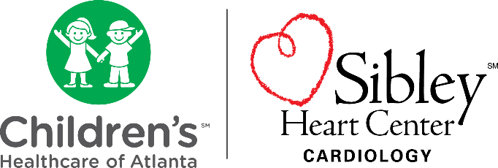

STOP IT!
Preventing Sudden Cardiac Arrest in the Young
Robert M. Campbell, MD
Children’s Healthcare of Atlanta
campbellr@kidsheart.com
Richard Lamphier, RN
Children’s Healthcare of Atlanta
richard.lamphier@choa.org
January 10, 2020

Slide 2
No Disclosures
Affiliations:
Project SAVE
Project ADAM
SADS Foundation

Slide 3
Learning Objectives
At the completion of this webinar, the learner will be able to:
Describe the purpose of Project S.A.V.E. and how the program improves prevention of sudden cardiac arrest in children, adolescents and others in Georgia communities.
Recognize warning signs and symptoms of pediatric heart conditions to prevent sudden cardiac arrest.
Identify resources developed by Project S.A.V.E. and describe how they can be utilized in your practice.

Slide 4
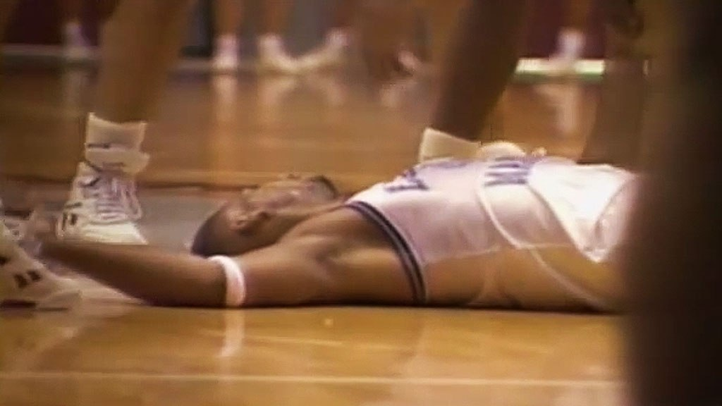
How could this happen to a perfectly
healthy athlete?
How could this happen….?

Slide 5

Not just athletes
How could this happen….?

Slide 6

Us too!

Slide 7
Prevent SCD
Prevent SCA
Diagnose

Slide 8
SCA Differential Diagnosis
Genetic
Structural/Functional
HCM
Other CM (DCM, RCM, ARVC, LVNC)
Coronary Artery Anomalies
Aortic Rupture/Marfan
Myocarditis
Left Ventricular Outflow Tract Obstruction
Mitral Valve Prolapse (MVP)
Coronary Artery Atherosclerotic Disease
Postoperative Congenital Heart
Disease
Electrical
Long QT Syndrome (LQTS)
Wolff-Parkinson-White
Syndrome (WPW)
Brugada Syndrome
Catecholaminergic Polymorphic
Ventricular Tachycardia (CPVT)
Short QT Syndrome
Complete Heart Block (CHB)
Other
Drugs and Stimulants
Primary Pulmonary Hypertension (PPH)
Commotio Cordis
Other
Drugs and Stimulants
Primary Pulmonary Hypertension (PPH)
Commotio Cordis

Slide 9
Primary Prevention

Slide 10
Warning signs and symptoms
1

Slide 11
Clinical Presentation of Pediatric Patients at Risk for Sudden Cardiac Arrest. 2016
A total of 450 patients (257M/193F; median 10.1 years; range 0-21yrs) were enrolled
SCA was the initial presentation in 7
CPVT patients had the highest incidence of SCA (45%), but normal physical evaluations
Patients with LQTS and HCM were most likely referred because of family history
ALCA-R patients presented with exercise related symptoms or signs
Cardiac subspecialty evaluation (Level 2) revealed pertinent family history, patient history, and exam findings above and beyond the information obtained through the initial referral
Journal of Pediatrics. 2016

Slide 12
Key SCA Warning Signs / Symptoms
Exercise, emotion, startle seizure or syncope
Exercise chest or shoulder pain or SOB
Sudden, unexpected, unexplained death before age 50 years
Family history known genetic aortopathy, cardiomyopathy, channelopathy
Notes:
(Click for each of the three remaining bullets (checks) to appear.)

Slide 13
Misdirects

Slide 14
Misdirects
Respiratory Symptoms
Chest Pain
Seizures, Neurologic, Vasovagal
Palpitations
Drowning/Near Drowning
SIDS
Febrile Seizure
Congenital Deafness

Slide 15
Screening
2

Slide 16
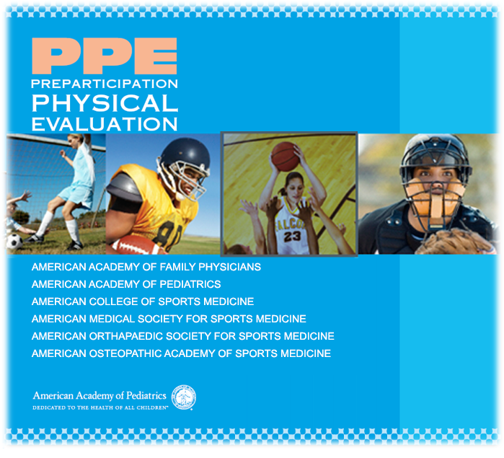
Notes:
AAP 4th Edition PPE (Q2 2010)

Slide 17
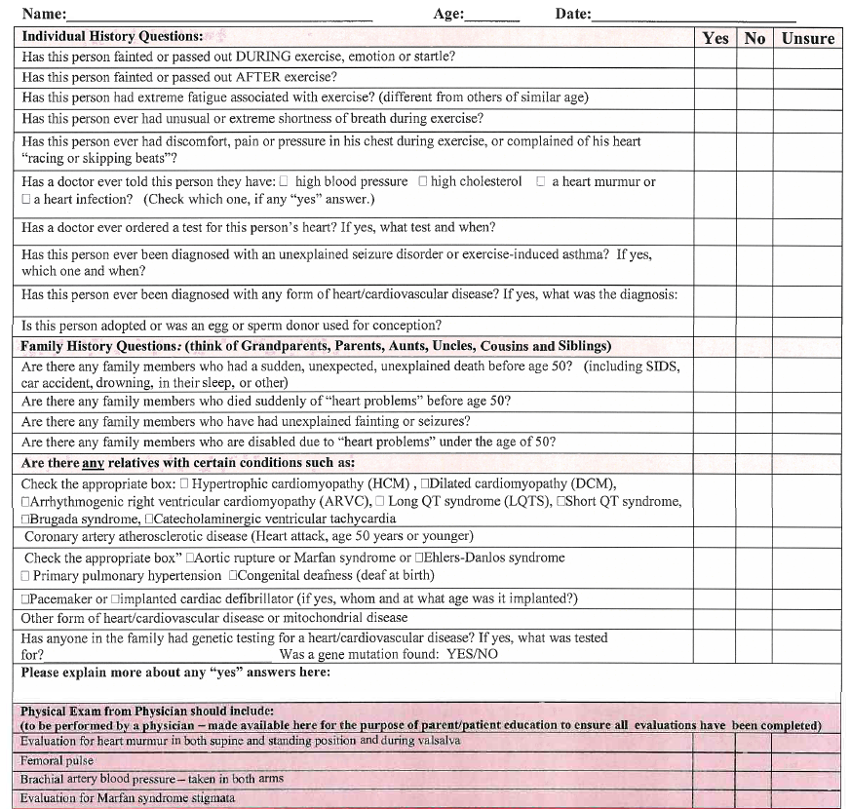
Cardiovascular Risk Assessment
https://www.choa.org/~/media/files/Childrens/medical-services/cardiac/risk-assessment-form.PDF

Slide 18
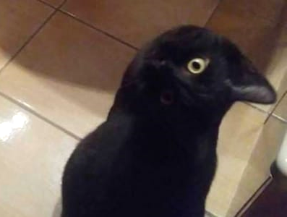
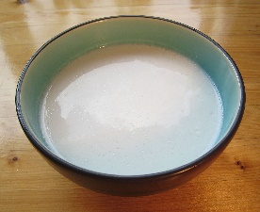
You See What You Know

Slide 19
SCA Differential Diagnosis
What About ECG Screening?
Structural/Functional
HCM
Other CM (DCM, RCM, ARVC, LVNC)
Coronary Artery Anomalies
Aortic Rupture/Marfan
Myocarditis
Left Ventricular Outflow Tract Obstruction
Mitral Valve Prolapse (MVP)
Coronary Artery Atherosclerotic Disease
Postoperative Congenital Heart
Disease
Electrical
Long QT Syndrome (LQTS)
Wolff-Parkinson-White
Syndrome (WPW)
Brugada Syndrome
Catecholaminergic Polymorphic
Ventricular Tachycardia (CPVT)
Short QT Syndrome
Complete Heart Block (CHB)
Other
Drugs and Stimulants
Primary Pulmonary Hypertension (PPH)
Commotio Cordis
Other
Drugs and Stimulants
Primary Pulmonary Hypertension (PPH)
Commotio Cordis

Slide 20
SCA Differential Diagnosis
Expected ECG Findings
Structural/Functional
HCM
Other CM (DCM, RCM, ARVC, LVNC)
Coronary Artery Anomalies
Aortic Rupture/Marfan
Myocarditis
Left Ventricular Outflow Tract Obstruction
Mitral Valve Prolapse (MVP)
Coronary Artery Atherosclerotic Disease
Postoperative Congenital Heart
Disease
Electrical
Long QT Syndrome (LQTS)
Wolff-Parkinson-White
Syndrome (WPW)
Brugada Syndrome
Catecholaminergic Polymorphic
Ventricular Tachycardia (CPVT)
Short QT Syndrome
Complete Heart Block (CHB)
Other
Drugs and Stimulants
Primary Pulmonary Hypertension (PPH)
Commotio Cordis

Slide 21
SCA Differential Diagnosis
Possible ECG Findings
Structural/Functional
HCM
Other CM (DCM, RCM, ARVC, LVNC)
Coronary Artery Anomalies
Aortic Rupture/Marfan
Myocarditis
Left Ventricular Outflow Tract Obstruction
Mitral Valve Prolapse (MVP)
Coronary Artery Atherosclerotic Disease
Postoperative Congenital Heart Disease
Electrical
Long QT Syndrome (LQTS)
Wolff-Parkinson-White
Syndrome (WPW)
Brugada Syndrome
Catecholaminergic Polymorphic
Ventricular Tachycardia (CPVT)
Short QT Syndrome
Complete Heart Block (CHB)
Other
Drugs and Stimulants
Primary Pulmonary Hypertension (PPH)
Commotio Cordis

Slide 22
SCA Differential Diagnosis
Predictably Normal ECG
Structural/Functional
HCM
Other CM (DCM, RCM, ARVC, LVNC)
Coronary Artery Anomalies
Aortic Rupture/Marfan
Myocarditis
Left Ventricular Outflow Tract Obstruction
Mitral Valve Prolapse (MVP)
Coronary Artery Atherosclerotic Disease
Postoperative Congenital Heart Disease
Electrical
Long QT Syndrome (LQTS)
Wolff-Parkinson-White
Syndrome (WPW)
Brugada Syndrome
Catecholaminergic Polymorphic
Ventricular Tachycardia (CPVT)
Short QT Syndrome
Complete Heart Block (CHB)
Other
Drugs and Stimulants
Primary Pulmonary Hypertension (PPH)
Commotio Cordis

Slide 23
10 issues to be addressed before ECG screening
Who to screen?
When to screen?
Who performs screen and interpretation?
Where to screen?
What are the validated normal ECG values?
Overread? Vs Underread?
Follow-up after positive ECG screen?
Database for ECG screen outcomes?
Is ECG screening suggested or mandated?
Costs?

Slide 24
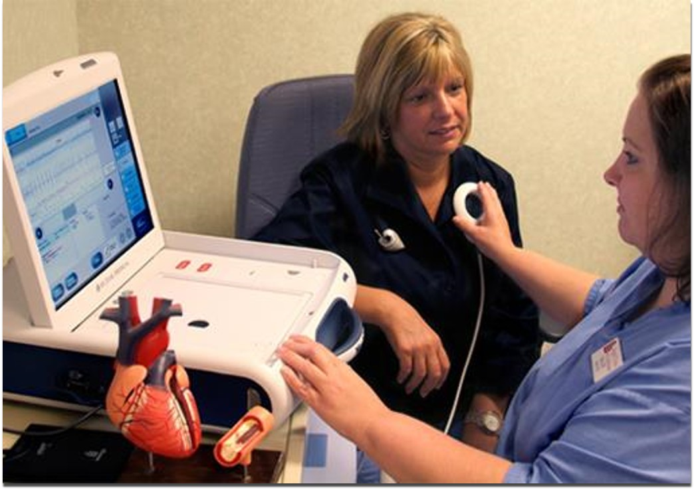
30 YO F s/p VF arrest 5 weeks postpartum
LVEF 20 %
ICD, Amiodarone
Fast Forward 5 years
At ICD Follow-up: “Any change in family history?”
  Mom’s 40YO brother found dead in bed, autopsy negative
  Mom’s 5 YO daughter referred to SHC arrhythmia clinic
    Asymptomatic QTc 475ms w/abnormal T-waves
    Genetic testing reveals LQTS2 mutation
    Mom, daughter, and mom’s niece were LQTS2 gene positive (deceased brother obligate positive)

Slide 25
Secondary Prevention

Slide 26


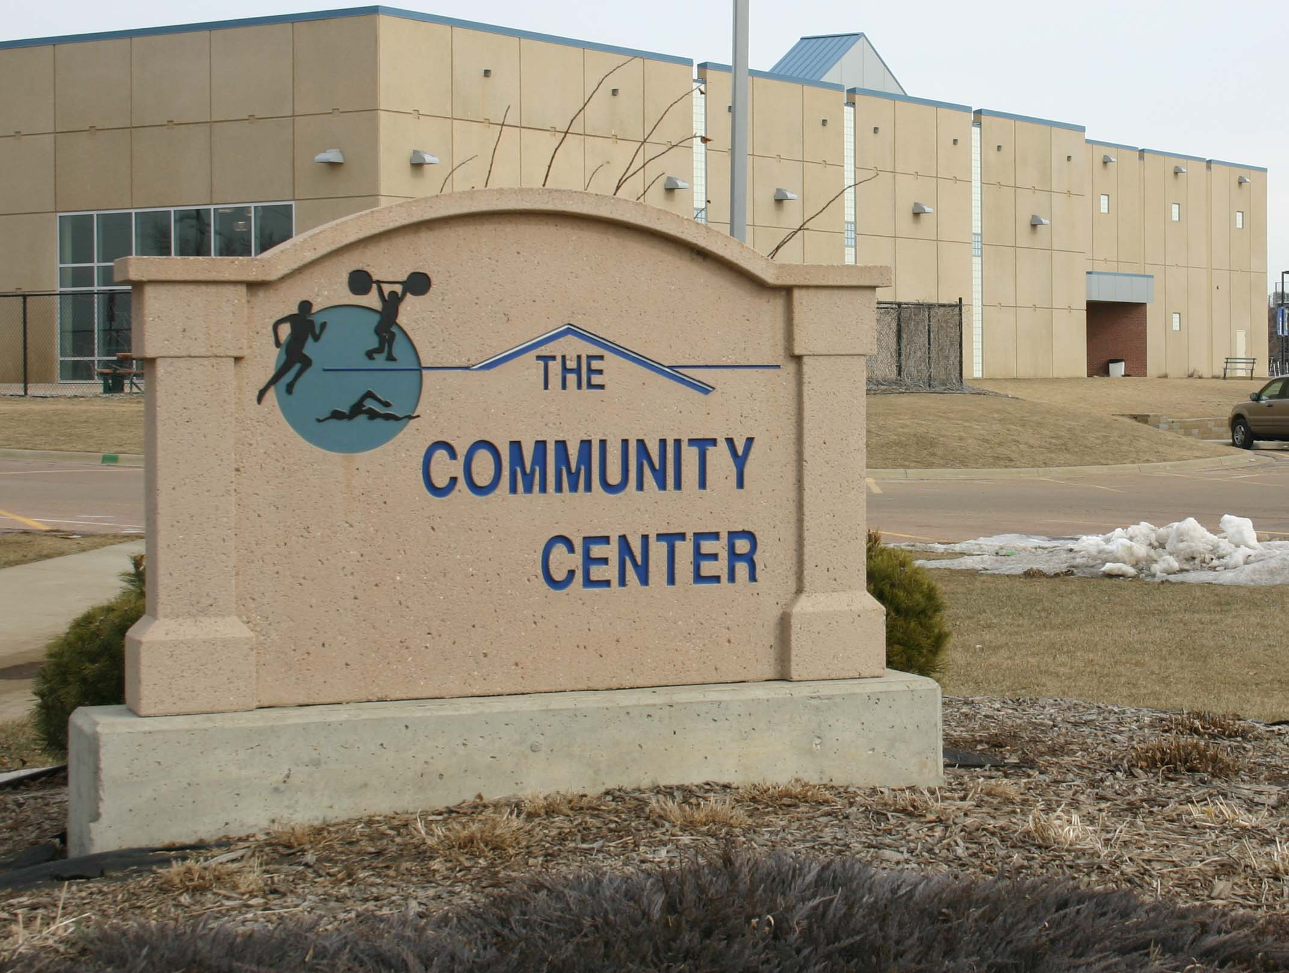
Primary Focus
Notes:
Schools have 20% of the Countries population during school days,
AL- coaches are usually parents who get off work @ 3 or 4, may have little or no training
CC Boys and Girls clubs Metro Atlanta have 150-450 kids/day

Slide 27

Practice Chain of Survival (AHA)
Early Recognition and Call 911
Early Cardiopulmonary Resuscitation (CPR)
Early Defibrillation
Effective Advanced Care
Coordination of Care in the Hospital
Assume the Worst – Hope for the Best

Slide 28

“CPR is inherently inefficient; it provides only10% to 30% of normal blood flow to the heart and 30% to 40% of normal blood flow to the brain even when delivered according to guidelines. This inefficiency highlights the need for trained rescuers to deliver the highest quality CPR possible.”
Circulation. 2013;128:417-435

Slide 29
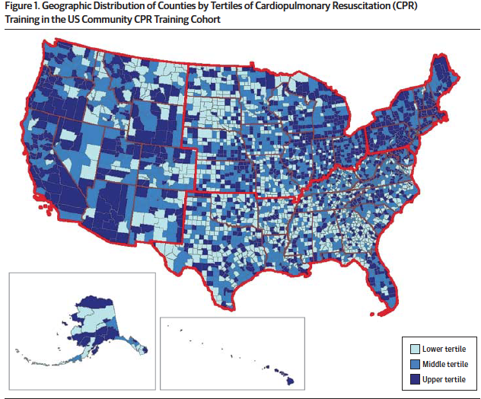
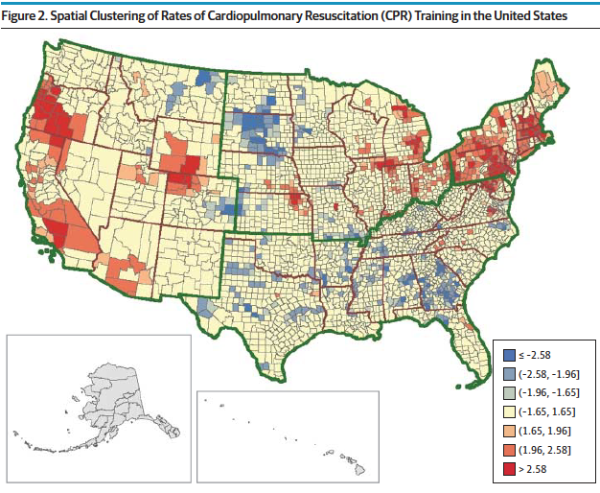
Rates of CPR Training in the United States
13.1 million persons in 3143 US counties received CPR training. Median rate 2.39%.
Anderson, ML. JAMA 2014; 174(2):194-201

Slide 30
Barriers to AEDs in Schools
Schools that did not have AEDs
263 Reported Most Common Barriers
  80% Limited Financial Resources
  24% Legal Issues / Liability
  13 % Didn't Know Where to put It
  10% Reported School Policy
  1% did not think an AED was Cost-Effective
Drezner, Jonathan et al BJSM Vol 47 Issue
Notes:
The places that need it the most often have the least resources

Slide 31
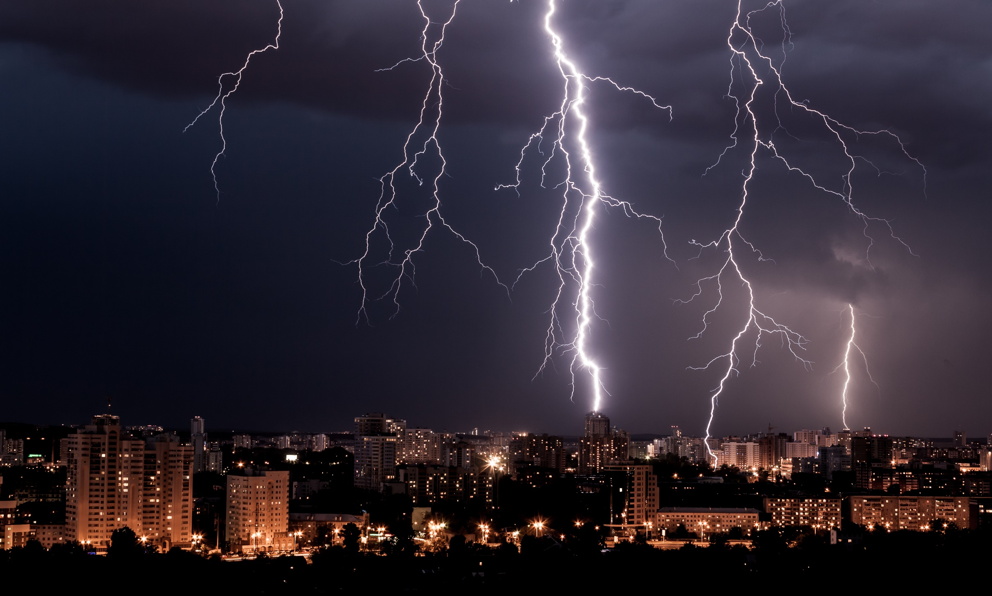
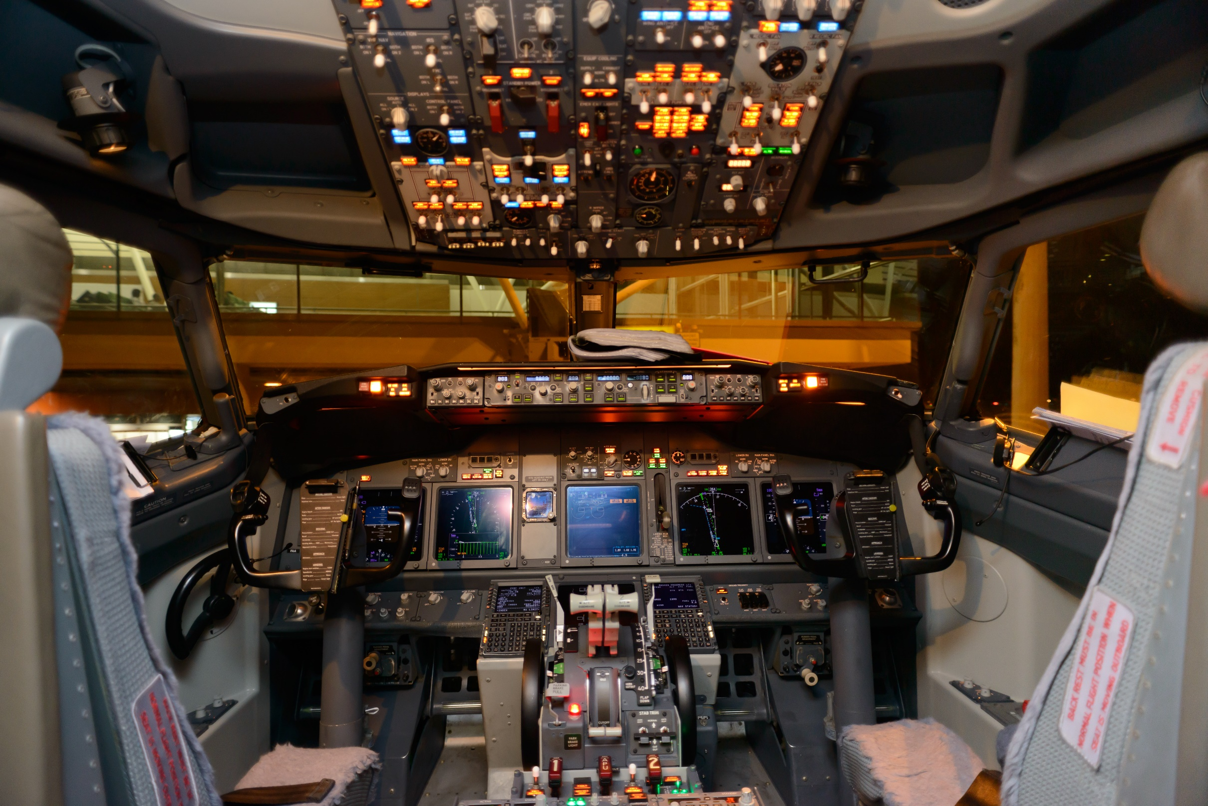
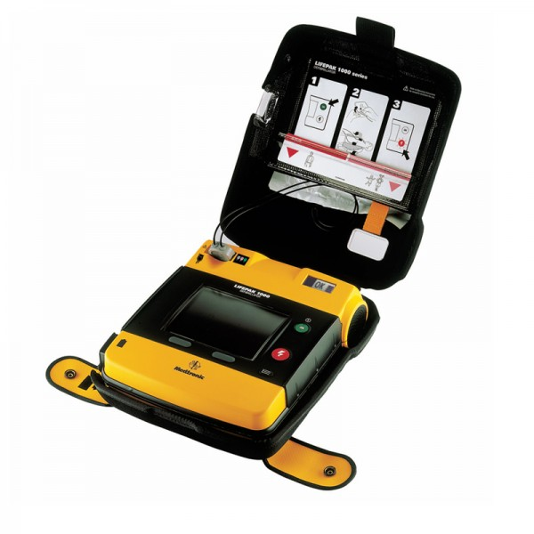
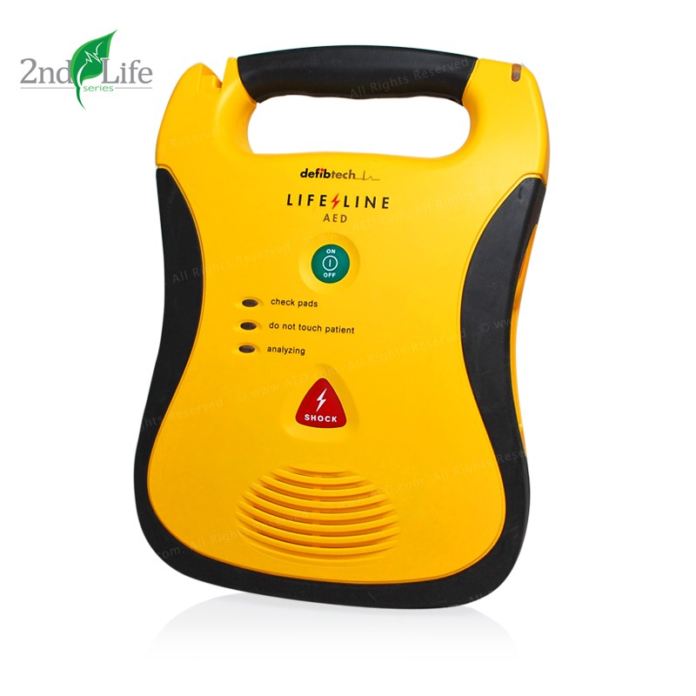


Slide 32
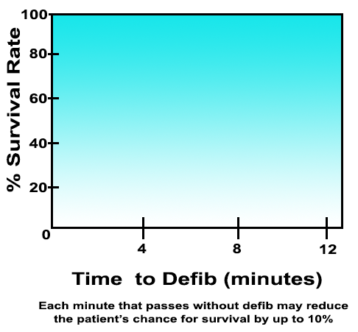
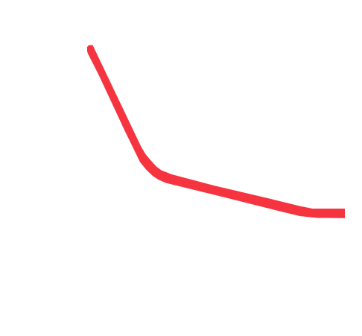
Early Defibrillation Impacts Survival
Notes:
Early defibrillation matters (FYI The red line is set to take 12 seconds to draw)

Slide 33
Emergency Action Plan

Slide 34
Venue
Equipment
Do you have an AED?
Buildings
Building Names
EMS Access Points
Construction
Locked gates
How many?
Accessibility
Budget for replacement pads & batteries
Doors – keys or access codes
Elevators or stairs
Notes:
Still working on design
County lines, cell towers full? Mention concerts/sporting events, Atlanta’s big Chicken, is their construction between venue and EMS-secondary route
Can you get a shock off in less than 3 minutes??? Closer to 1

Slide 35
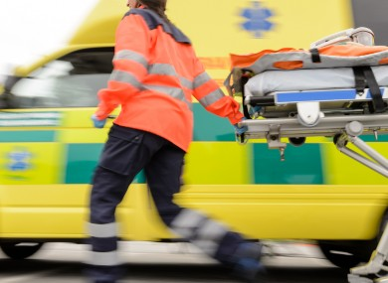
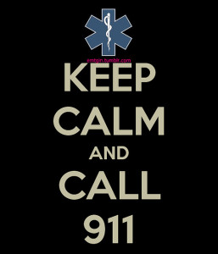


Communication
Notes:
First call 911
Land Lines vs Cellular
Who Activates the Communication Tree
Do they know what to say? Is it a Secretary that says Mr. France isn’t breathing? We are briefed at races for communicating over radio
Public relations team
administrators

Slide 36

First Responder
Training:
AED special circumstances
Incorporate with fire safety-HR Training
What does a cardiac/medical emergency look like?
Hands Only CPR/AED
Notes:
Hairy Chest
Hands Only CPR
Talk about male having pain/female upset stomach Not GI Symptoms
Seizure Activity
Respiratory Distress
80% Bystander syndrome

Slide 37

Practice Drills
Assign tasks
Bring AED to every emergency
Emphasize early CPR
Debrief
Notes:
Teachers work well with specific tasks, Leave AED alarm on,
Take Times, and names Who recognized SCA, when was CPR started, when did the AED get there, When was 1st shock delivered
What went well, invite EMS director to drills-tell Madison story

Slide 38
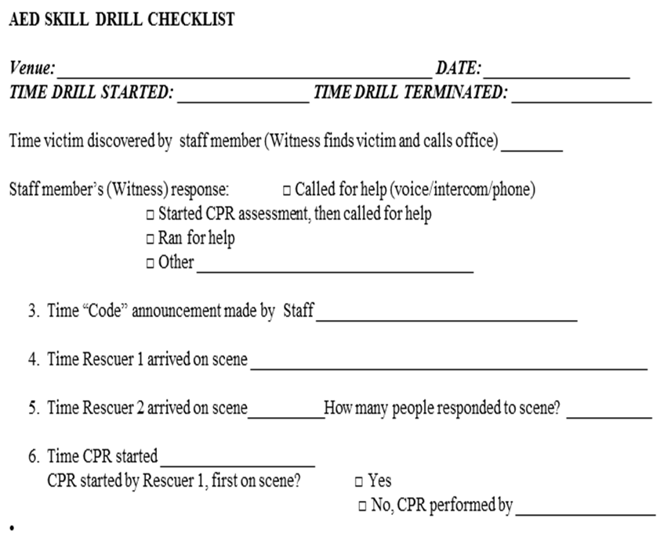
School-Based AED Program
Sample Checklist
Notes:
Measurable outcomes data

Slide 39

Everybody has a plan until they get punched in the mouth.

Slide 40

Video

Slide 41
Inequities in SCA Resuscitation in Youth
Importance of awareness of inequities
Identification of socioeconomic disadvantage
Disparities exist in SCA education and training

Slide 42
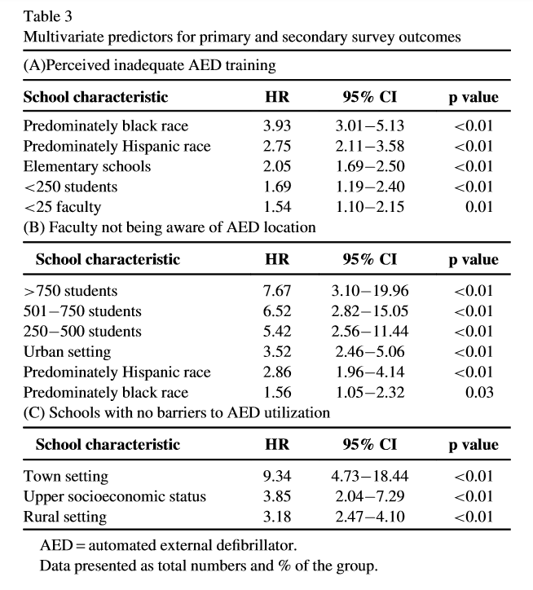
Disparities in AED training in public schools
Saberian, et al. Am J Cardiol. 2018;00:1-5

Slide 43


Slide 44
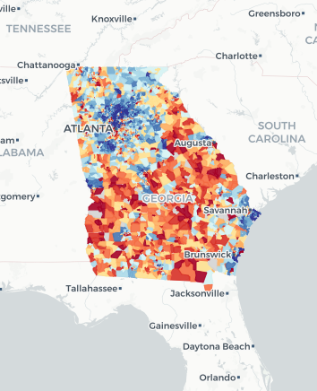
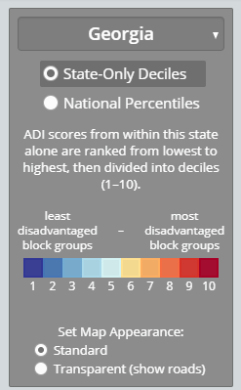
The Neighborhood Atlas
Area Deprivation Index (ADI):
  Ranking by SE status disadvantage
  Includes factors for income, education, employment, and housing quality
  Uses 2015 American Community Survey 5yr estimates

Slide 45


Slide 46
How successful is Project S.A.V.E.?
Over 1,400 Schools and Community Centers
123 Lives Saved
60 Children
63 Adults
(2 School Nurses)
Notes:
(Click for each line to appear (5))

Slide 47
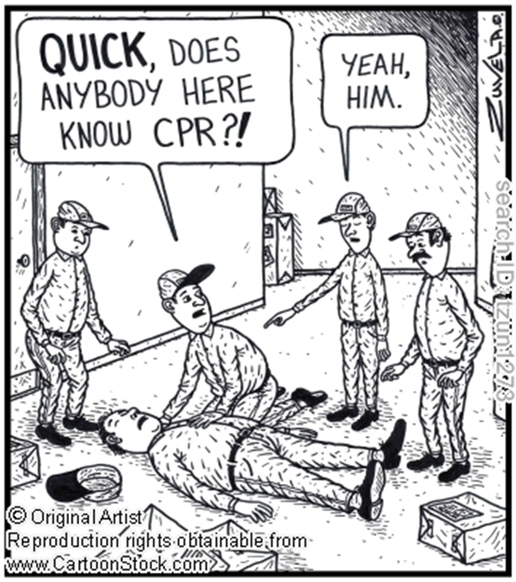
CPR & AEDs Work

Slide 48
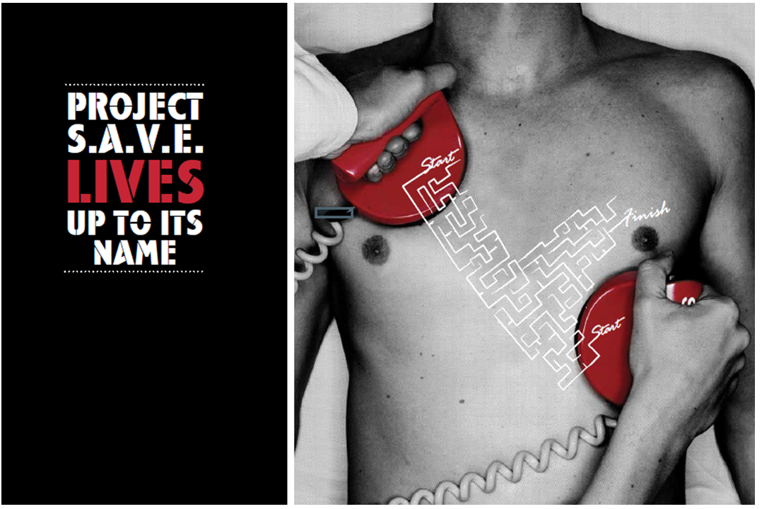

Slide 49
Summary
Warnings signs and symptoms
are important
Secondary prevention with CPR and AEDs and Emergency Action Plan can save lives
Our challenge to you:
  Use Cardiovascular Risk Assessment Survey to screen your patients
  Learn CPR and AED use
  Champion local emergency
  action plans in your community

Slide 50
References
Dalal A, Czosek RJ, Kovach J, von Alvensleben JC, Valdes S, Etheridge SP, Ackerman MJ, Auld D, Huckaby J, McCracken C, Campbell R. Clinical Presentation of Pediatric Patients at Risk for Sudden Cardiac Arrest. J Pediatr. 2016 Oct;177:191-6
Campbell RM, Berger S, Ackerman MJ. "Pediatric Sudden Cardiac Arrest​". (published online on March 26, 2012) Pediatrics Vol. 129 No. 4 April 1, 2012
pp. e1094 -e1102.
https://www.youtube.com/watch?v=r9blaWHHSls
https://www.choa.org/~/media/files/Childrens/medical-services/cardiac/risk-assessment-form.PDF
https://www.choa.org/medical-services/cardiac-care/project-save-program

Slide 51
Robert M. Campbell, MD
Children’s Healthcare of Atlanta
campbellr@kidsheart.com
Richard Lamphier, RN
Children’s Healthcare of Atlanta
richard.lamphier@choa.org

