Slide 1












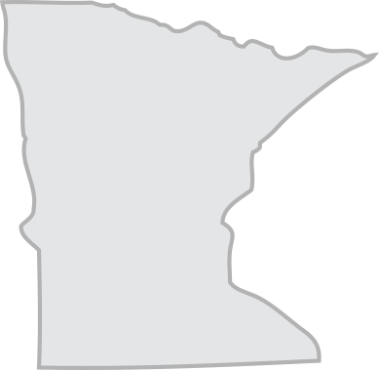
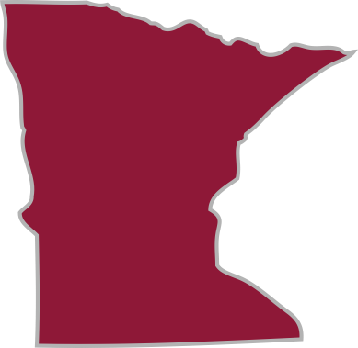



















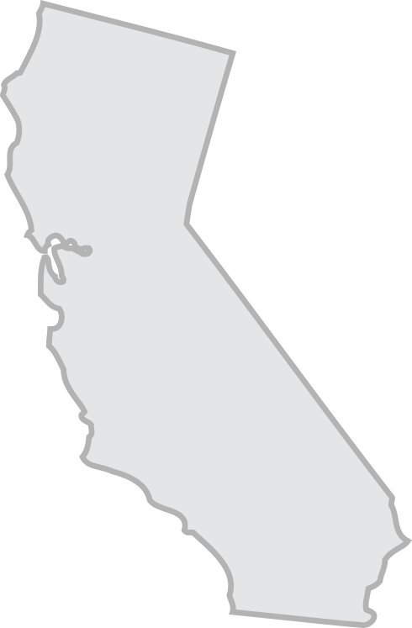

















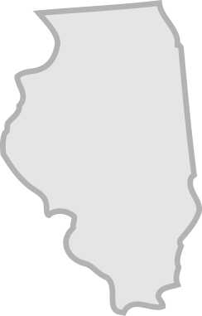















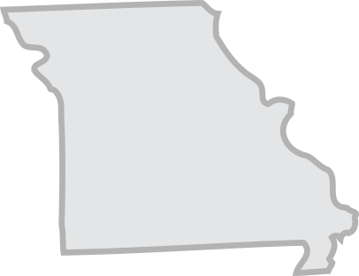







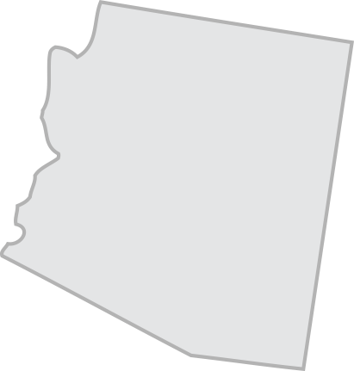







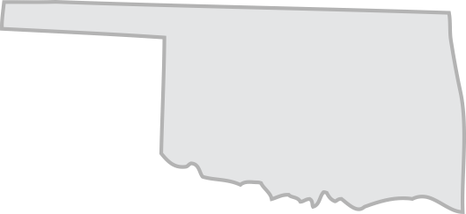
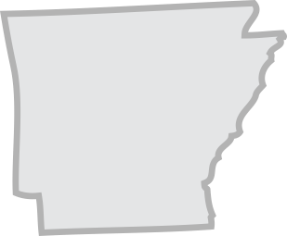
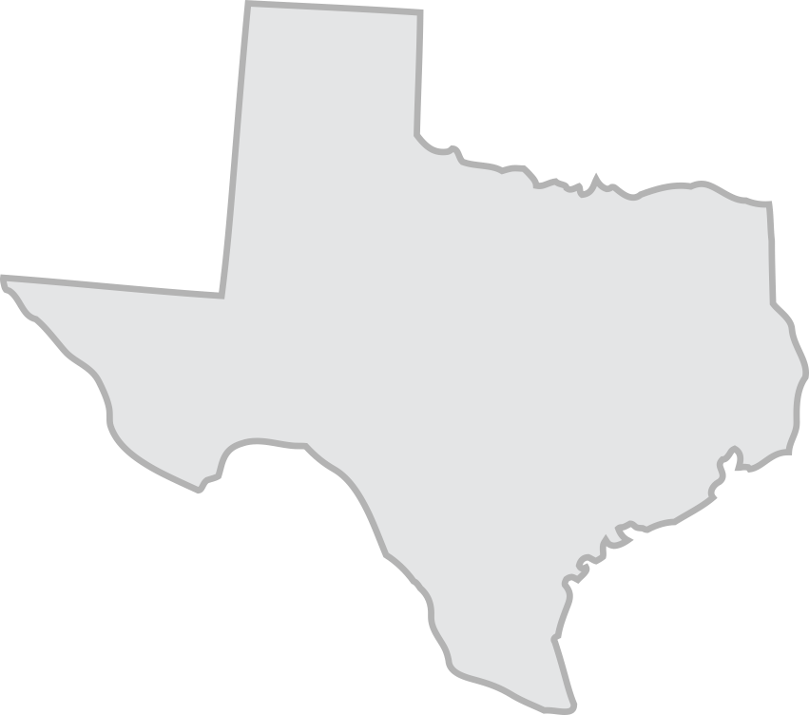

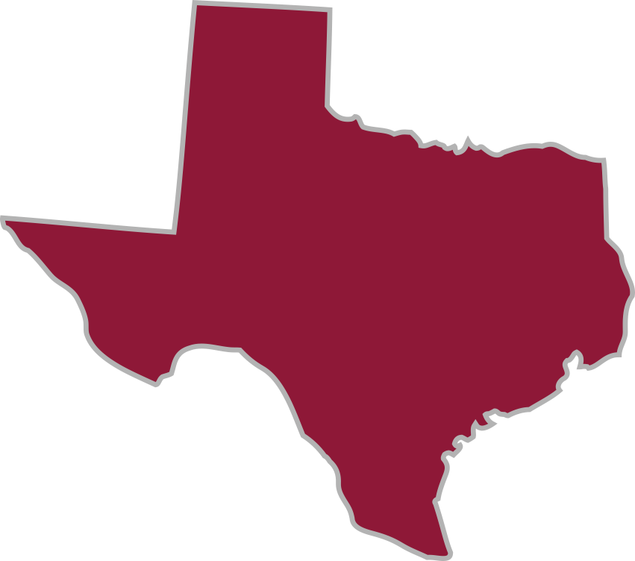
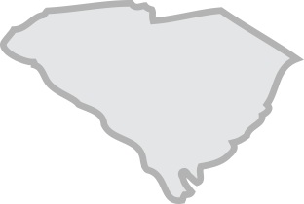

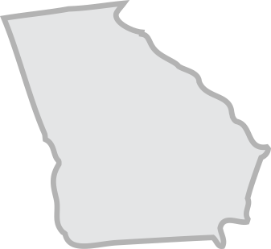




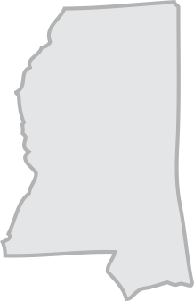
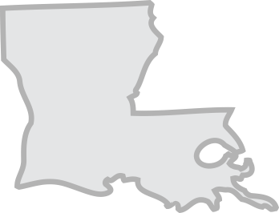

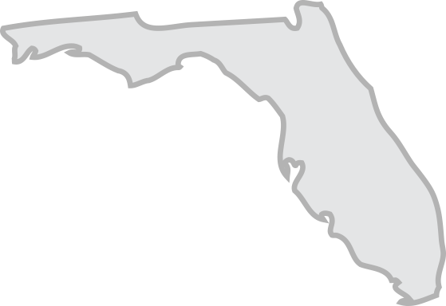
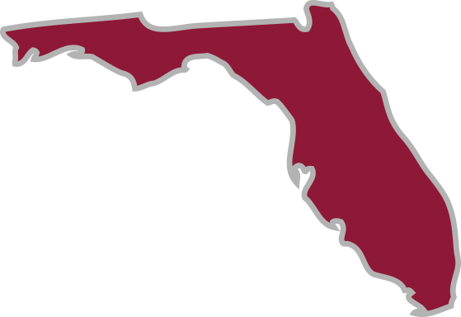
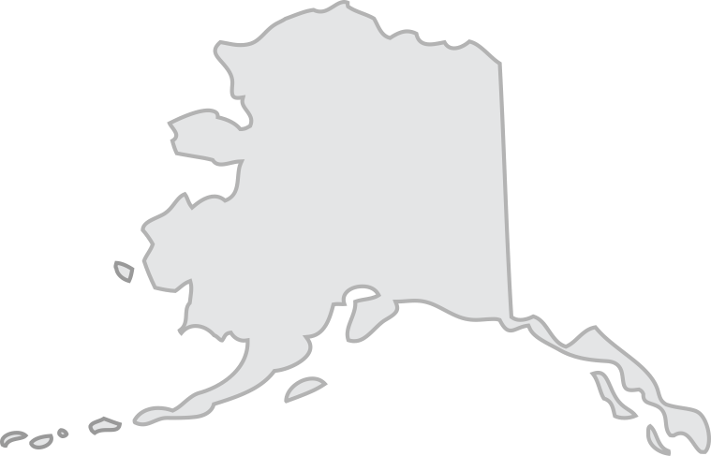



ESTABLISHED AFFILIATE SITES
Children's Wisconsin/National Office
Children’s Healthcare of Atlanta
Children’s Hospital of Philadelphia, PA/NJ
Children’s of Alabama
Providence Sacred Heart Children’s Hospital
Cook Children’s Medical Center
East Tennessee Children’s Hospital
U-M Health C.S. Mott Children’s Hospital
Children’s Hospital Colorado
UC Davis Children’s Hospital
Nationwide Children’s Hospital
Texas Children’s Hospital
Monroe Carell Jr. Children’s Hospital Vanderbilt
Arkansas Children’s
Cincinnati Children’s
Golisano Children’s Hospital
KU Wichita Pediatrics
Nicklaus Children’s Hospital
Duke Children’s Hospital
Lurie Children's Hospital of Chicago
MUSC Shawn Jenkins Children’s Hospital
Cleveland Clinic Children’s
Ochsner Hospital for Children
Children’s Mercy Kansas City
WVU Medicine Children’s
Rady Children’s Health San Diego
Riley Hospital for Children at IU Health
Maria Fareri Children’s Hospital
Le Bonheur Children’s Hospital
University of Iowa Healthcare-Stead Family Children’s Hospital
Yale New Haven Children's Hospital
Children's Minnesota / Children's Heart Clinic
St. Louis Children’s Hospital
USA Women and Children’s Hospital
Children’s Nebraska
Hasbro Children's Hospital
Children's Hospital of Richmond at VCU
Phoenix Children’s Hospital
Golisano Children’s at UK
Norton Children’s Hospital
Nemours Children’s Health
UCSF Benioff Children’s Hospital San Francisco
Children's Hospital of Pittsburgh
University of Utah/ Primary Children's Hospital
John Hopkins All Children’s Hospital Tampa
Dayton Children’s Hospital
Dell Children’s Hospital
El Paso Children’s Hospital
Children’s Hospital of Los Angeles
Alaska Children’s Heart Center
Children’s National Hospital
Miller Children’s & Women’s Hospital
Golisano Children's Hospital, University of Rochester Medical Center
WA
MN
RI
WI
MI
NY
CT
NE
IA
PA
NJ
IL
IN
OH
DE
CA
UT
CO
KS
MO
WV
VA
KY
NC
AZ
AR
TN
SC
MS
AL
GA
TX
LA
AK
FL
53
ESTABLISHED PROGRAMS
34
STATES
Updated February 2026

Slide 2











































Slide 3












