Slide 1
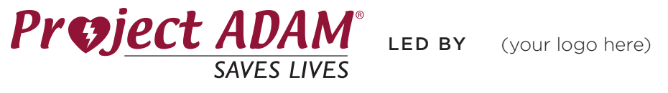
Project ADAM Staff Presentation
Notes:
Note* for this training please allow 10-15 minutes to go through the presentation.
-ask to present at an all staff meeting if possible; if not can be done in groups during grade-level/subject planning times
-include the campus map highlighting AEDs on slide 6
-remind the staff that it is important for everyone to be aware of SCA and the basics of CPR/AEDs
Sudden Cardiac Arrest training for staff to keep up with Heart Safe Application/Renewal

Slide 2
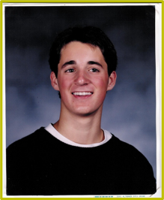
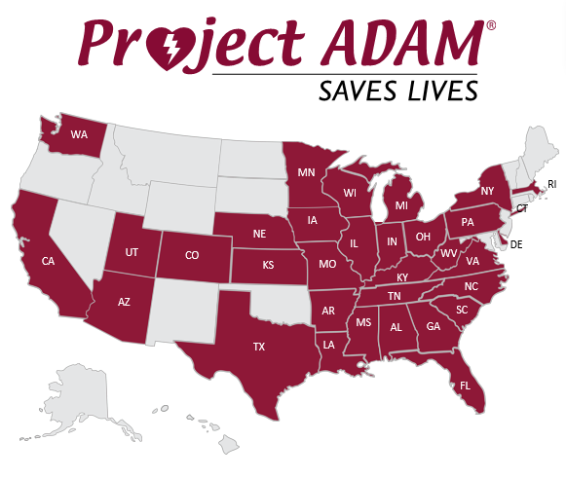
Project ADAM
Project ADAM (Automated Defibrillators in Adam’s Memory) began in 1999 in Wisconsin when Adam Lemel collapsed and died while playing basketball. Adam suffered a sudden cardiac arrest, in which an AED could have been used to save his life
Adam’s parents Patty and Joe Lemel worked with Children’s Wisconsin to create Project ADAM
Project ADAM is a nationwide initiative that has saved the lives of more than 200 children, adolescents, and adults who went into sudden cardiac arrest. We have over 45 affiliates in over 30 states and adding more locations each year
Notes:
Speaker Comments:
We have been working towards becoming/are a designated Heart Safe School with Project ADAM. Project ADAM takes its name after Adam Lemel, a 17-year-old Wisconsin high school student who collapsed and died while playing basketball.
Being a Heart Safe School with Project ADAM means we will experience annual Project ADAM all staff training as well as participate in ongoing cardiac emergency response (AED) drills. The AED drill is an exercise that helps us to measure our preparedness and identify opportunities for improvement in our process.
Project ADAM Video: https://www.youtube.com/watch?v=FNMnlHCSAdI

Slide 3
What is a Sudden Cardiac Arrest (SCA)?
The American Heart Association defines a sudden cardiac arrest as the heart suddenly stops beating due to an irregular heart rhythm – typically ventricular fibrillation (quivering of the heart without effective contraction)
Can be caused by an underlying condition - cardiomyopathy or electrical abnormality
  More than half of these disorders in children and adolescents are genetic
  Other causes: being struck at in the chest, drugs, or unknown factors
Without treatment, death can occur within minutes
There are about 356,461 people a day who suffer from a sudden cardiac arrest each year in the U.S.
Notes:
Speaker Comments:
Sudden Cardiac Arrest Video: (Labeled as Ch. 2)
-2:10 mark- discussion of what it may look like when someone has a sudden cardiac arrest

Slide 4
What is a Sudden Cardiac Arrest (SCA)? (cont.)
There are little to no warning signs with SCA. Often victims are the picture of health out for their daily run or in the middle of a ball game when they suddenly drop
Signs of SCA:
  Not moving, unresponsive or unconscious
  Not breathing normally (i.e. may have irregular breathing, gasping, gurgling, or may not be breathing at all)
  Seizure or convulsion-like activity
SCA can also occur to those who collapse shortly after being struck in the chest by a firm projectile/direct hit
Notes:
Speaker Comments:
Sudden Cardiac Arrest Video: (Labeled as Ch. 2)
-2:10 mark- discussion of what it may look like when someone has a sudden cardiac arrest

Slide 5
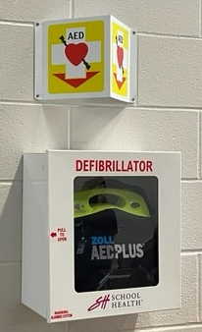
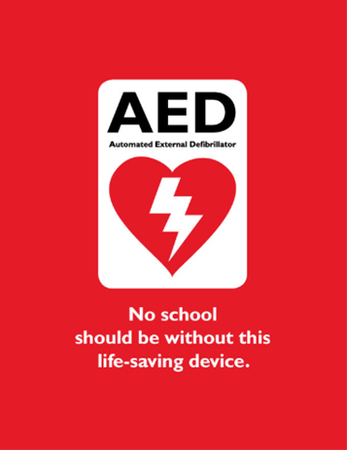
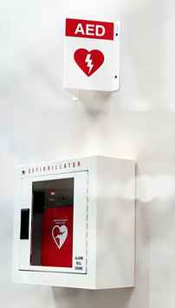
What is an AED?
AED= Automated External Defibrillator
  These devices are used to evaluate rhythm and deliver a shock if needed
  Devices should be stored in an unlocked case
  Most cases have an alarm when opened
    This alarm does NOT notify EMS, but can be an alert for the on-campus team to respond.
The AED machine will tell you step-by-step what to do from the moment it is turned on
  Tells you how to apply the pads
  When not to touch the victim
  It will determine if the victim’s heart is in need of a shock or not
Notes:
Speaker Comments:
-show staff an example of school’s AED & items located in the bag
-show how simple it would be to turn on the AED
-using an AED trainer, or YOUTube video allow them to hear what it sounds like when activated.

Slide 6
Where are our AEDs?
Campus Map
Highlight AEDs
Notes:
Speaker Comments:
Remind teachers/staff to think of where their classrooms are and frequent spots such as playground, cafeteria, specials, etc. to think about where the AED nearby is placed

Slide 7
What are all the parts of becoming Heart Safe?
Heart safe checklist
1
AED Placement
8
Clear Communication- Ex. ‘Code AED’
2
AED Signage
9
EMS have been notified of CPR-AED Program
3
AED Maintenance Check
10
Plan shared with outside groups using facilities
4
Accessory Kit Near or With AED
11
CPR- AED Training for Team Members
5
CPR-AED Site Coordinator
12
All Staff Know Location of AED
6
Cardiac Emergency Response Team (5-10 Members)
13
All Staff awareness training
7
Written Cardiac Response Plan
14
Cardiac Emergency Response Drill
Notes:
Optional Slide*
Speaker Comments:
All the steps the nurse/Project ADAM lead team member is completing.
Items to point out:
We have established a Cardiac Emergency Response Team and a plan in the event of a SCA. Part of this plan is that the entire staff is aware of the procedure. Ask response team to stand. These people have agreed to serve as our school response team. They have been trained in CPR and AED use (or they will be shortly!) and will come to your aid when needed. Whether or not you are on the “team,” you are responsible in some way.

Slide 8
Our Plan
Recognize Sudden Cardiac Arrest is occurring
Implement Code ____ Protocol
Call 9-1-1 (following protocol procedure)
Begin CPR while directing someone to get the nearest AED
Place AED & continue CPR until EMS arrives
Notes:
Speaker Comments:
Main steps for staff to follow:
At this point, describe your school’s specific response procedure including items such as:
-Identified code name (what they’ll hear on the overhead page to identify a cardiac emergency, i.e. Code AED)
-Method of communication (for example, do they call the front office on the phone, hit the panic button, send a student to the front office to activate the emergency response, etc.)
-Who waits with the victim and who will go outside to wait and direct EMS to the scene

Slide 9

Cardiac Emergency Response Drill
Drills will happen one-two times a year
  Unannounced
When you hear Code _____
  Cardiac Emergency Response Team will follow their specific steps
  If you are not a team member keep students in the classrooms and stay out of the hallways
    If your next to a team member’s class, supervise their students until an assistant/aide can cover
If your class is in the area of a sudden cardiac arrest move them all away
  All staff should make every effort to protect the privacy and dignity of the victim, while also protecting their students from the trauma of such an incident
Notes:
Speaker Comments:
*If you are not a team member, keep your students in their classroom and stay out of the hallways. If your classroom is near a team member, make sure their students are supervised so the team member can attend to the victim. All staff should make every effort to protect the privacy and dignity of the victim, while also protecting their students from the trauma of such an incident.
Next, explain to all staff the frequency and process for conducting Cardiac Emergency Response (AED) Drills in your school (i.e. our drill will be sometime in __________). Do NOT give them an exact date, just a general timeframe.
All other personnel should clear the area and should take care to keep students away from the victim and out of the hallways. When EMS has left the premises, the front office should notify the staff with an overhead announcement: “Staff may resume normal activities at this time.”
Sample Drill Video: https://www.youtube.com/watch?v=U1iqmAsnvxg

Slide 10

Questions?
?
Notes:
Speaker Comments:
Are there any questions? Does everyone understand our plan? Remember, we could do the AED drill in front of your classroom and pull you to participate, so it’s important you understand the process!

